Slide 1
Open Science and Global Visibility
Practical Action Steps

Slide 2
Presentation outline
What is Open Science?
The Open Science Taxonomy: Nine Dimensions
Open Science, individual and institutional visibility
Open Access typology and creative commons licences
Implementing open access in universities: practical action

Slide 3
‘In Africa there is a concept known as ‘ubuntu’ – the profound sense that we are human only through the humanity of others; that if we are to accomplish anything in this world it will in equal measure be due to the work and achievement of others.
Nelson Rolihlahla Mandela
(1918-2013)

Slide 4
What is Open Science?
Open science is a set of principles and practices that aim to make scientific research from all fields accessible to everyone for the benefits of scientists and society as a whole.
Open science is about making sure not only that scientific knowledge is accessible but also that the production of that knowledge itself is inclusive, equitable and sustainable.
UNESCO, 2022

Slide 5
Open Science Taxonomy
The 9 Dimensions

Slide 6
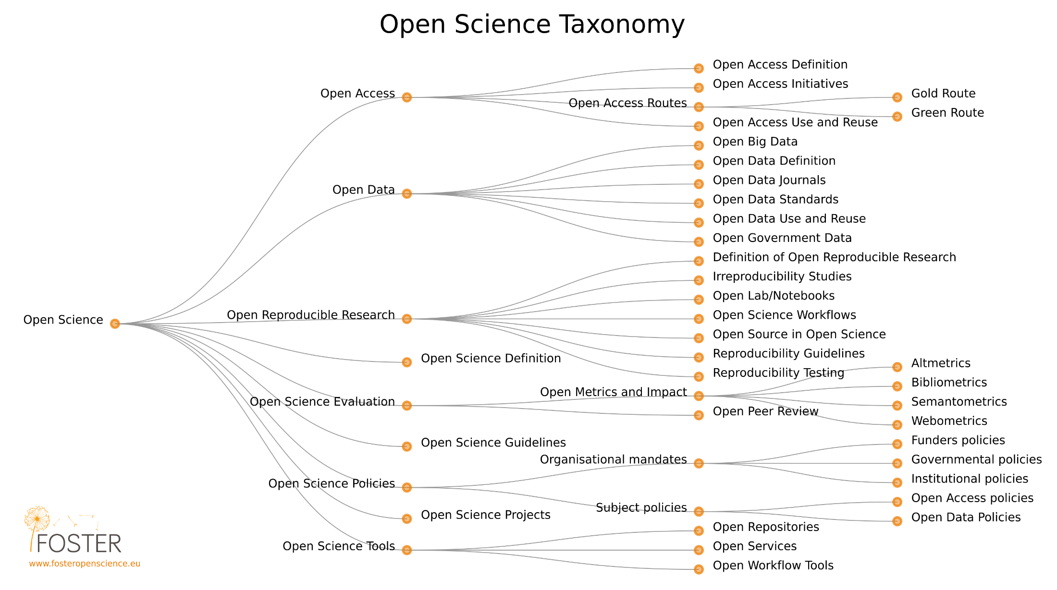

Slide 7
Open Science and Individual Visibility
INCREASED CITATION & IMPACT
Open access publications, shared data, and openly available research outputs can lead to more citations, increasing an individual's visibility and impact.
NETWORKING OPPORTUNITIES
Open Science practices facilitate collaboration, potentially leading to new research opportunities, co-authorship, and increased visibility within the research community.
PROFESSIONAL REPUTATION
By contributing to Open Science, individuals can demonstrate their commitment to transparency, collaboration, and innovation, enhancing their professional reputation.
By embracing Open Science practices, individuals and institutions can increase their visibility, impact, and reputation, ultimately contributing to the advancement of knowledge and innovation.

Slide 8
Open Science and Institutional Visibility
RESEARCH IMPACT & REPUTATION
Institutions that embrace Open Science can increase the visibility and impact of their research, potentially attracting more funding, talent, and partnerships.
GLOBAL RECOGNITION
Institutions that prioritize Open Science can be recognized as leaders in innovation, transparency, and collaboration, enhancing their global reputation.
COLLABORATION & PARTNERSHIPS
Open Science practices can facilitate collaboration between institutions, industries, and other stakeholders, increasing visibility and opportunities for partnerships.
By embracing Open Science practices, individuals and institutions can increase their visibility, impact, and reputation, ultimately contributing to the advancement of knowledge and innovation.

Slide 9
Open Access
A practical guide on implementation

Slide 10
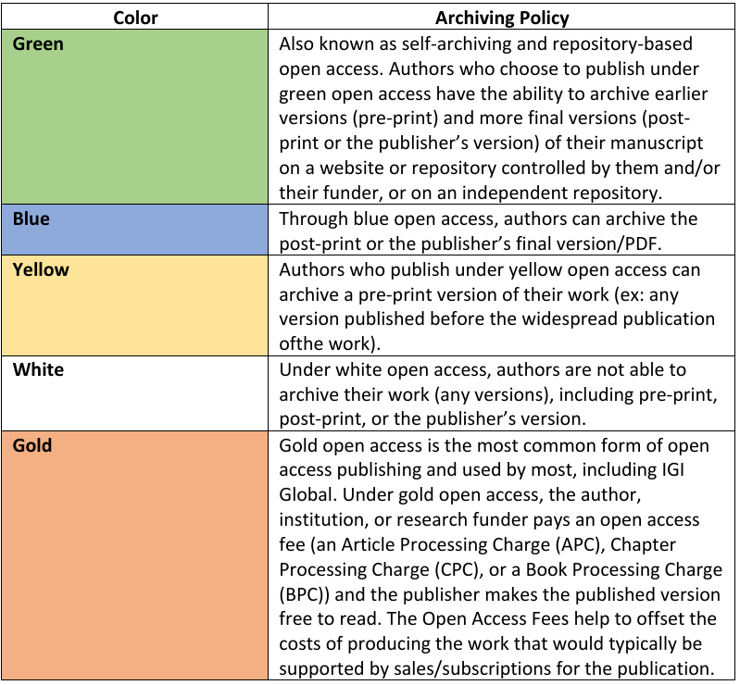
Open Access Typology

Slide 11
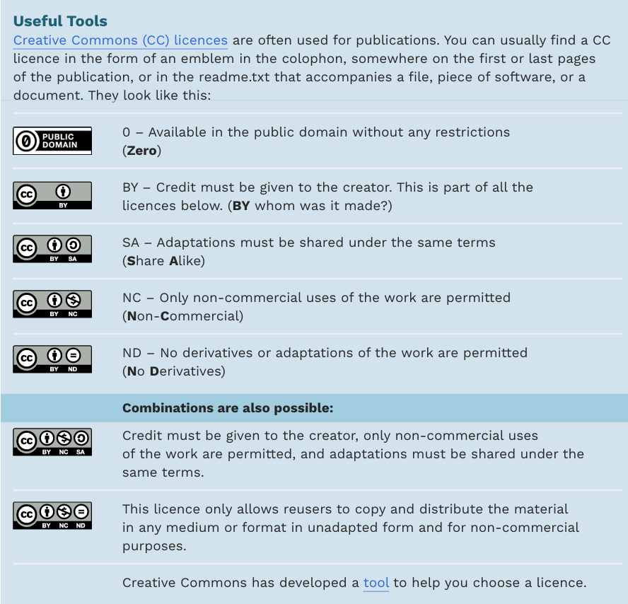
Creative commons licences

Slide 12
University Open Access Checklist
The checklist covers three main goals:
1) Empowerment, through high-level policies and strategies;
2) Capacity building, through libraries and negotiating consortia; and
3) Reinforcement of existing structures, through academic community-driven infrastructures.
European Universities Association (2021). The new university Open Access checklist. https://www.eua.eu/downloads/publications/2021%20oa%20checklist%20final.pdf

Slide 13
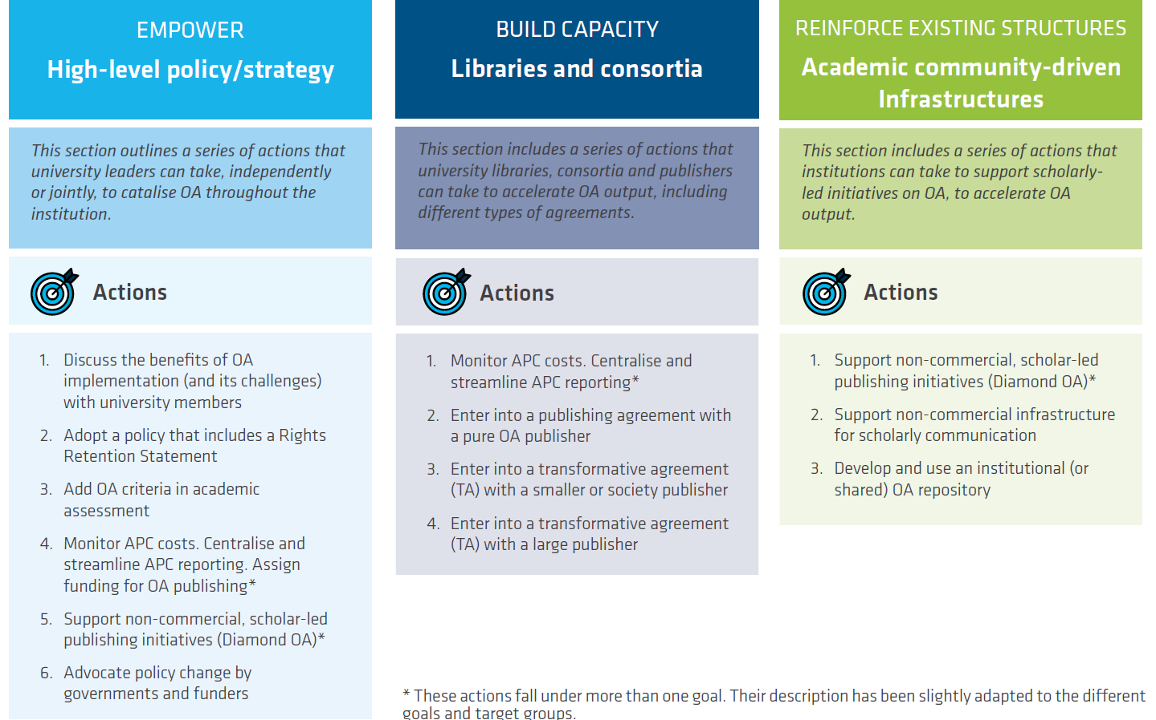
European Universities Association (2021). The new university Open Access checklist. https://www.eua.eu/downloads/publications/2021%20oa%20checklist%20final.pdf

Slide 14
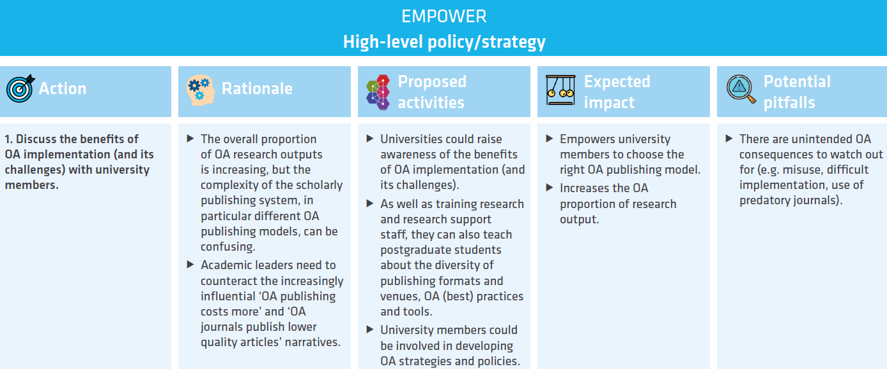
European Universities Association (2021). The new university Open Access checklist. https://www.eua.eu/downloads/publications/2021%20oa%20checklist%20final.pdf

Slide 15
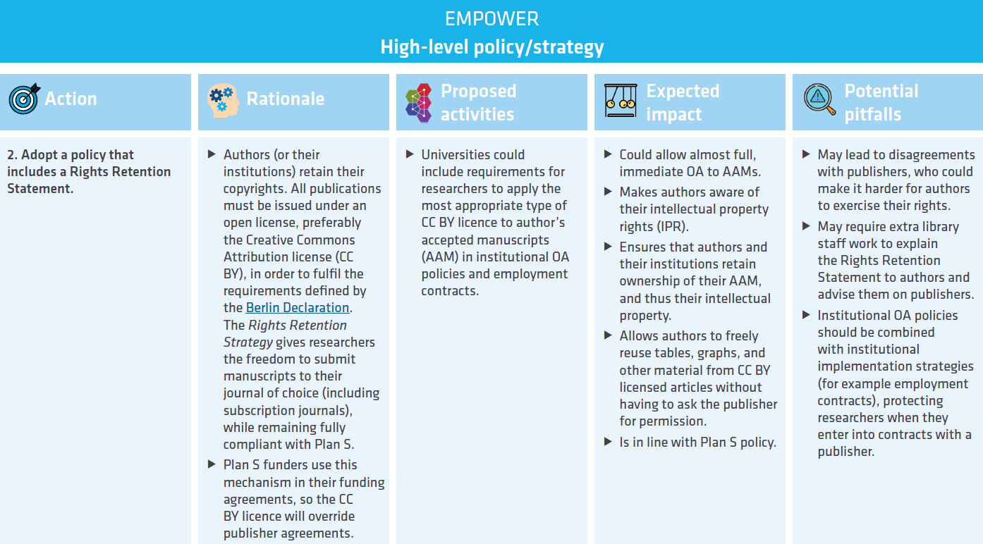
European Universities Association (2021). The new university Open Access checklist. https://www.eua.eu/downloads/publications/2021%20oa%20checklist%20final.pdf

Slide 16
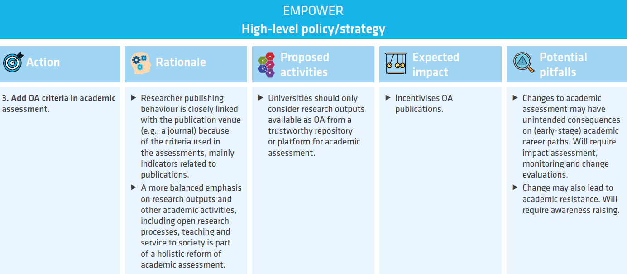
European Universities Association (2021). The new university Open Access checklist. https://www.eua.eu/downloads/publications/2021%20oa%20checklist%20final.pdf

Slide 17
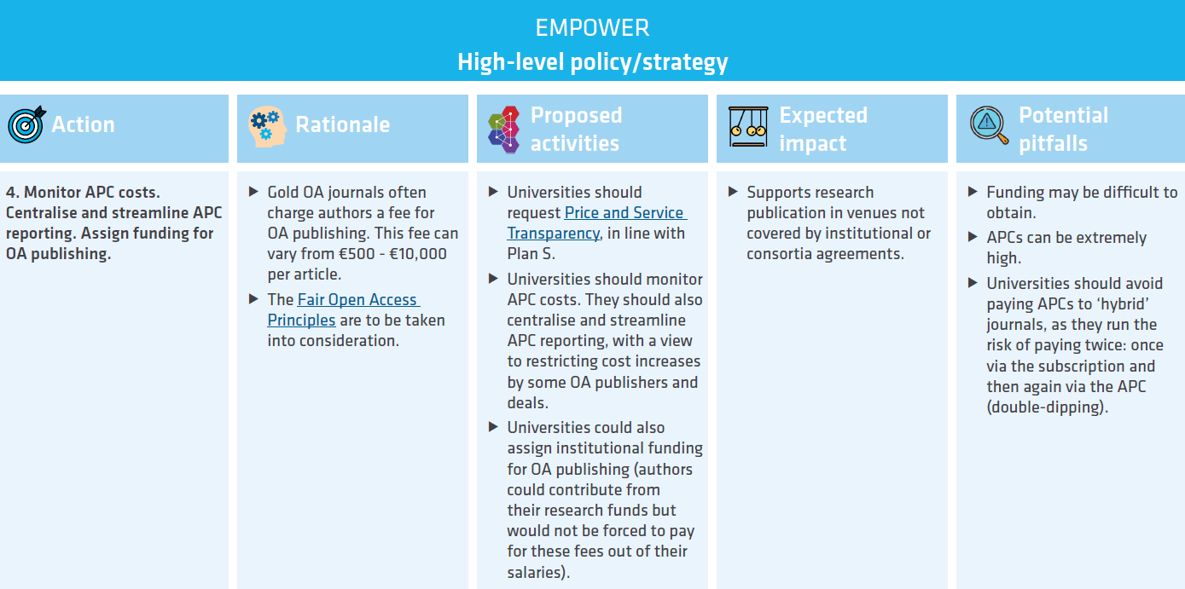
European Universities Association (2021). The new university Open Access checklist. https://www.eua.eu/downloads/publications/2021%20oa%20checklist%20final.pdf

Slide 18
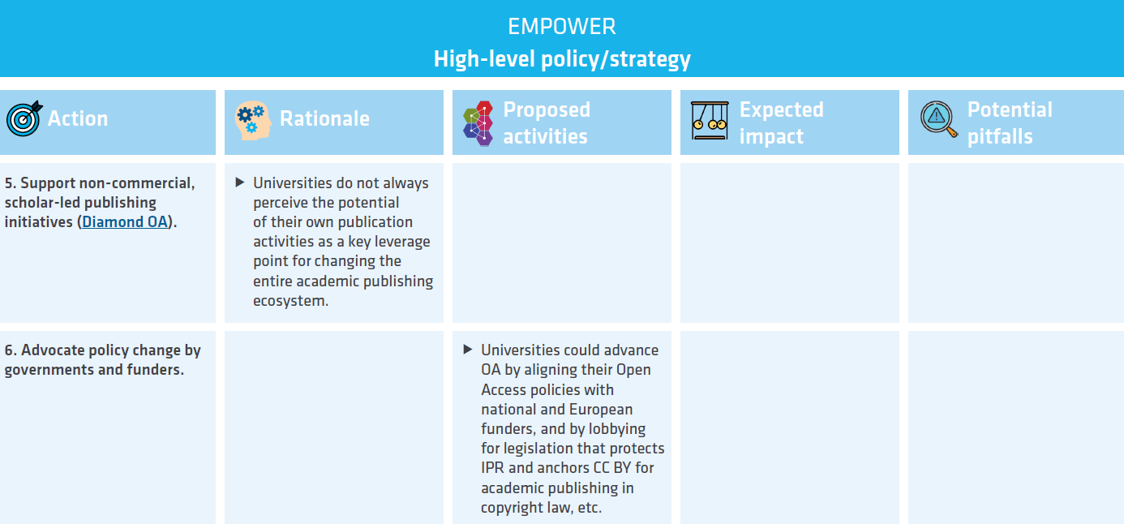
European Universities Association (2021). The new university Open Access checklist. https://www.eua.eu/downloads/publications/2021%20oa%20checklist%20final.pdf

Slide 19
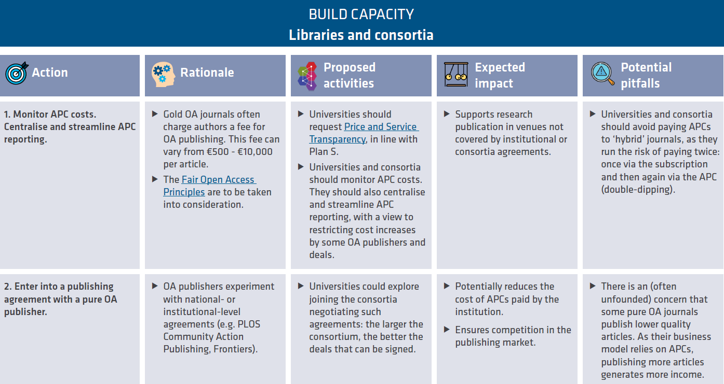
European Universities Association (2021). The new university Open Access checklist. https://www.eua.eu/downloads/publications/2021%20oa%20checklist%20final.pdf

Slide 20
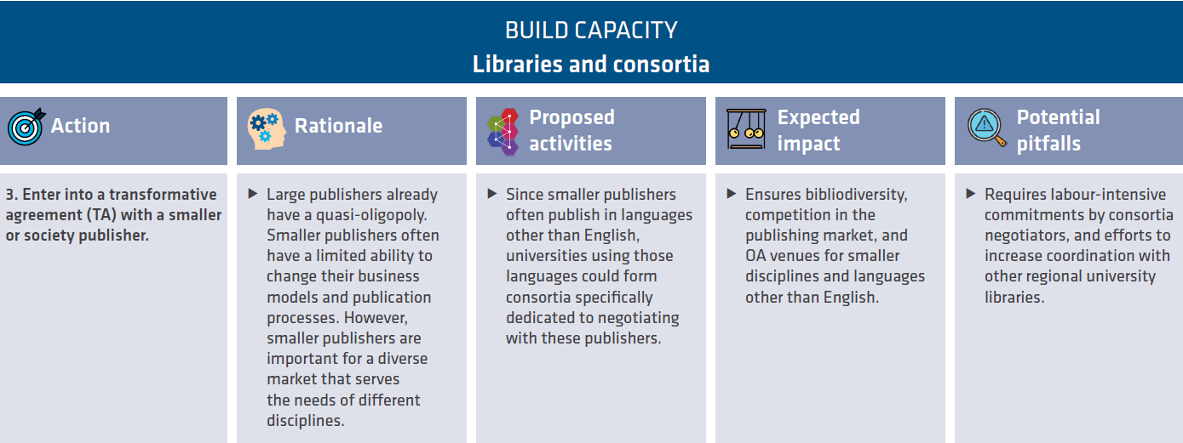
European Universities Association (2021). The new university Open Access checklist. https://www.eua.eu/downloads/publications/2021%20oa%20checklist%20final.pdf

Slide 21
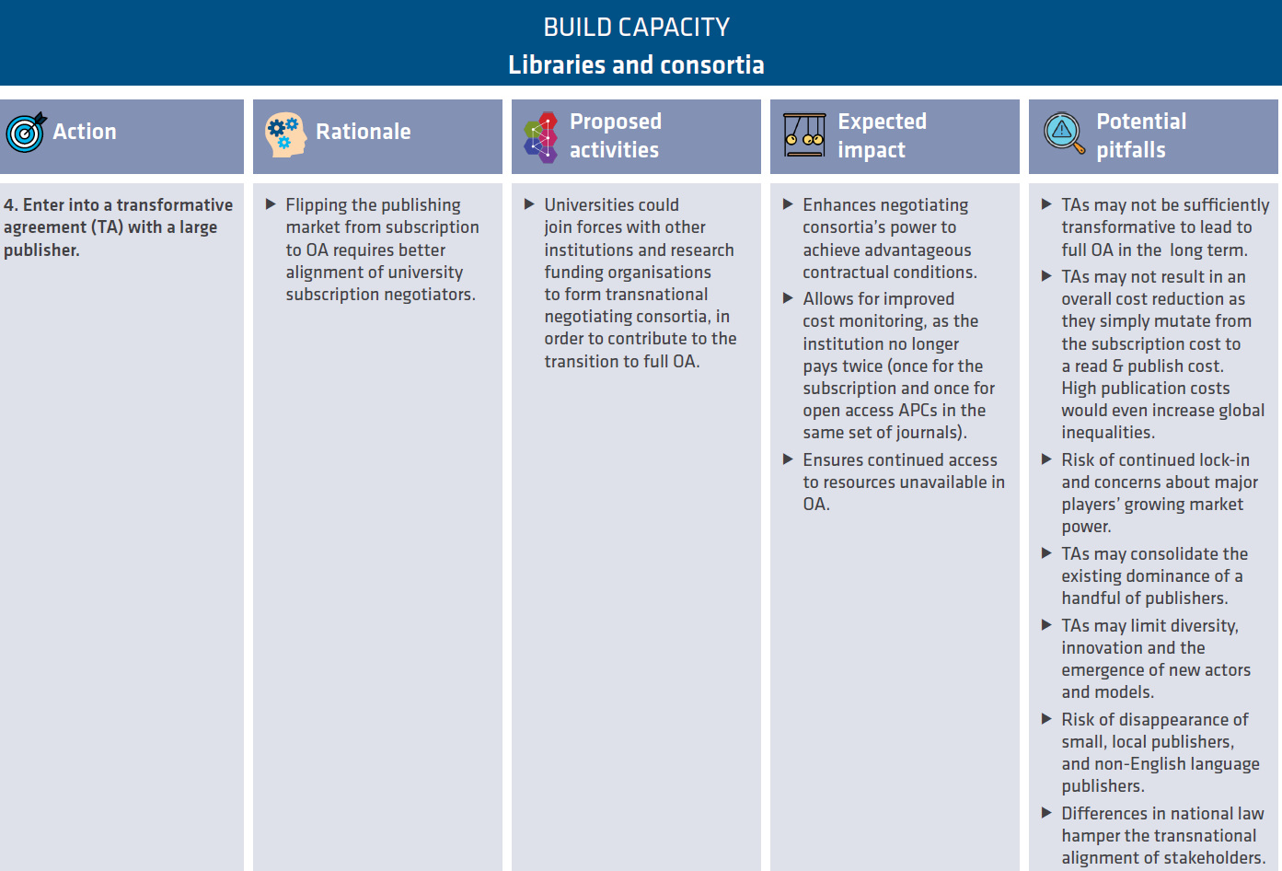
European Universities Association (2021). The new university Open Access checklist. https://www.eua.eu/downloads/publications/2021%20oa%20checklist%20final.pdf

Slide 22
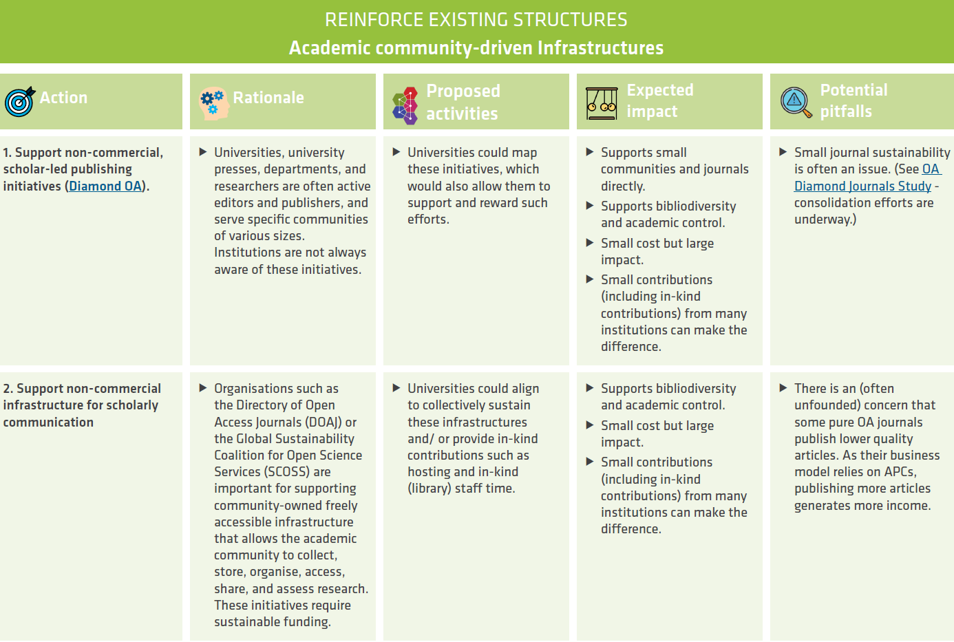
European Universities Association (2021). The new university Open Access checklist. https://www.eua.eu/downloads/publications/2021%20oa%20checklist%20final.pdf

Slide 23
European Universities Association (2021). The new university Open Access checklist. https://www.eua.eu/downloads/publications/2021%20oa%20checklist%20final.pdf

Slide 24
Thank you. Now, please let’s move on to the group activity on open access

