Slide 1
STATUS UPDATE OF THE NSTC GRANTS MANAGEMENT SYSTEM
PRESENTED AT
THE PEER-TO-PEER LEARNING VISIT IN WINDHOEK, NAMIBIA
BY
MARTIN MAYEMBE and phica n. jalabani
7TH May 2025

Slide 2
About nstc
NSTC; a statutory body established by the science and technology act no. 26 of 1997.
Has a statutory mandate to promote science and technology so as to improve the quality of life in Zambia
Act prescribes 16 other specific functions clustered as promotion, coordination, regulation, resource mobilisation and policy advice.

Slide 3
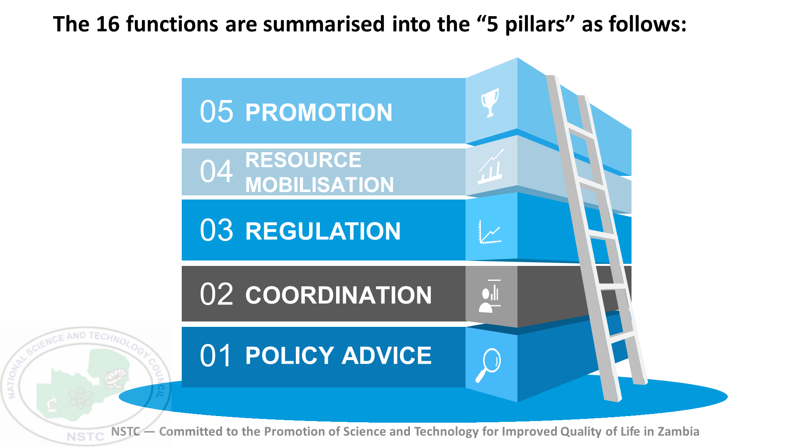

Slide 4
Research and innovation grants
SRF
STIYF
Strategic Research Fund (Being revised to become the National Research Fund)
Science, Technology and Innovation Youth Fund

Slide 5
Development of the gms
Due to challenges in the paper-based approach in the Grants Management process, the Council developed a system to digitize these processes.
The system development began in 2021 and a prototype was released in 2022
The system was tested with a call. Its functionality included reception of applications and evaluation of them by reviewers.

Slide 6
outcomes of the gms
Increased response rate from researchers
Reviewers also reported that the system made things easier for them
Increased registration of R&D institutions
Improved institutional reputation and standing when applying for grants
Database of researchers

Slide 7
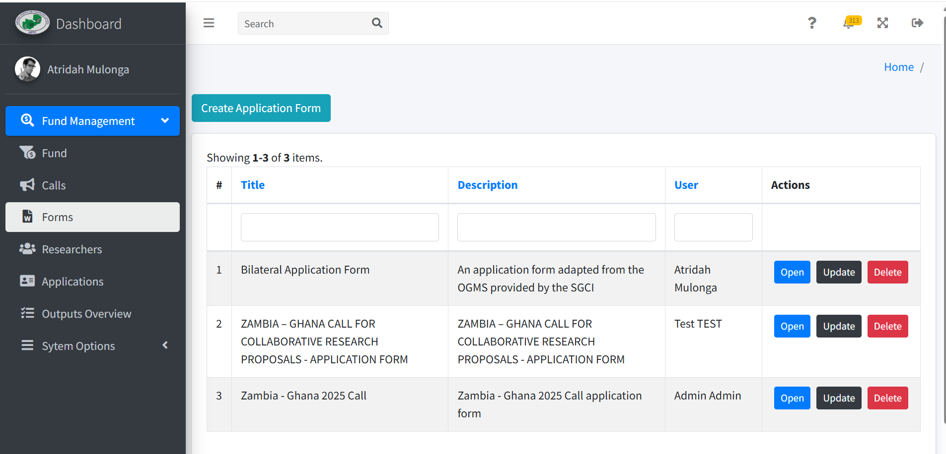
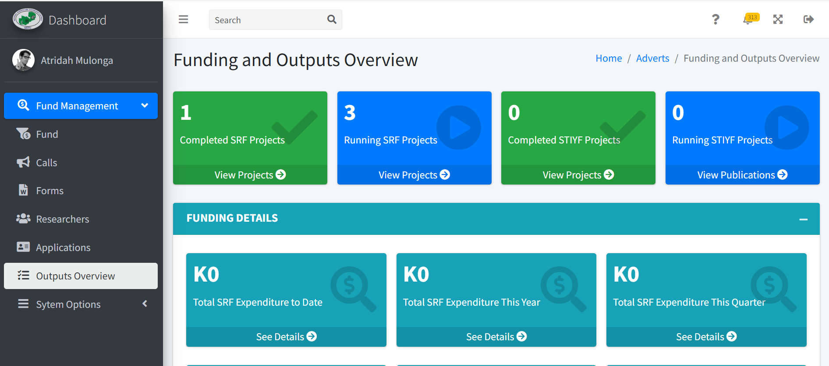

Slide 8
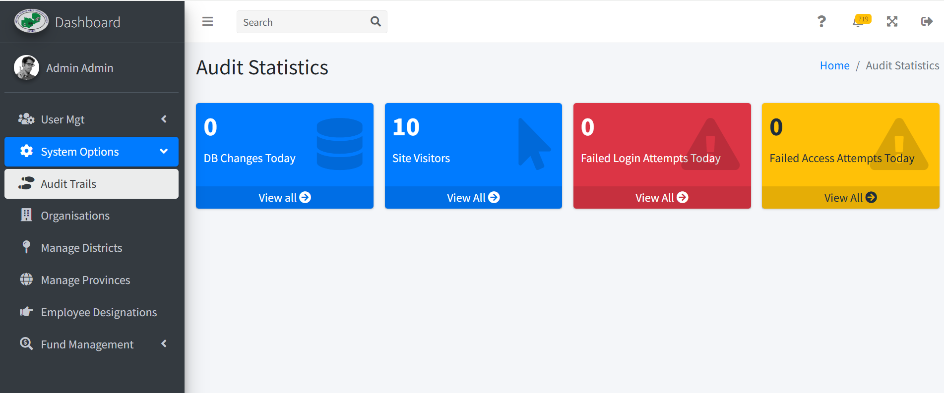
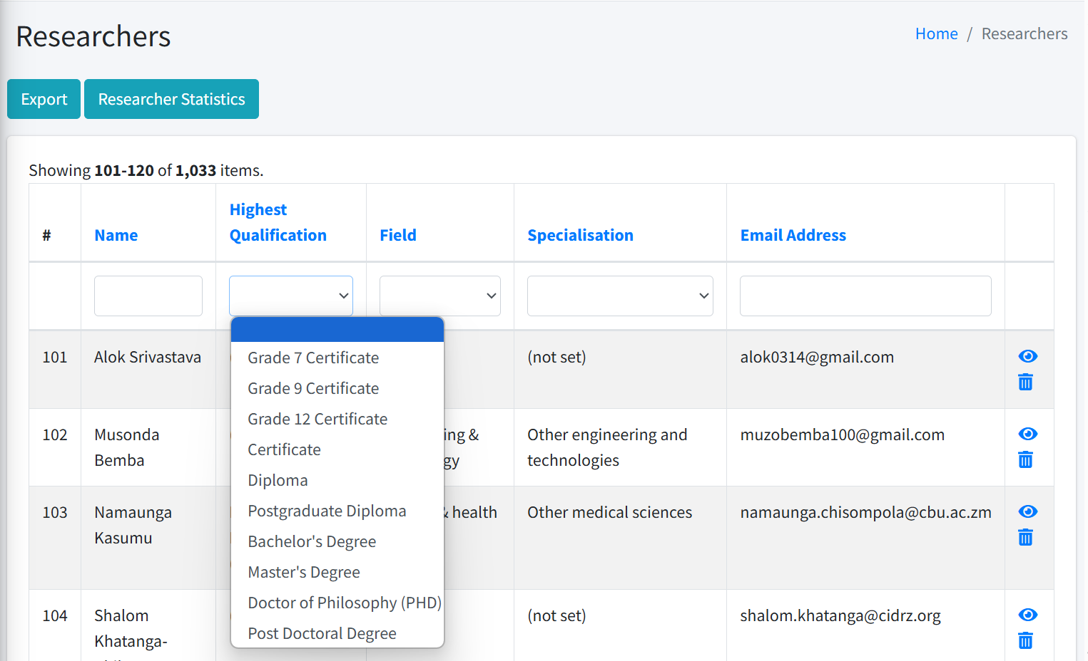

Slide 9
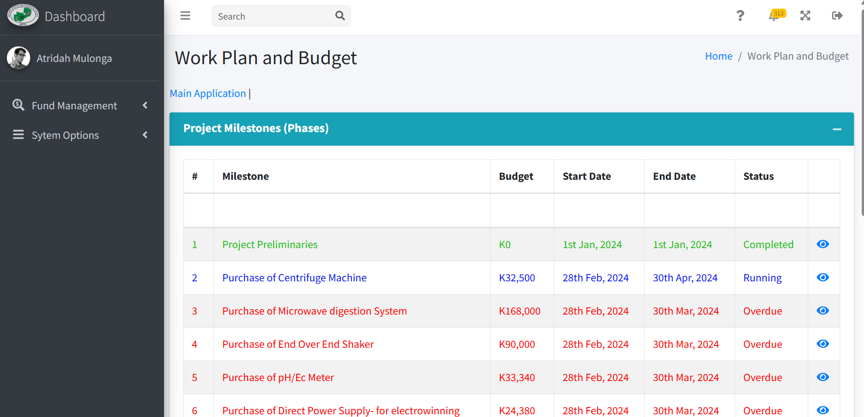
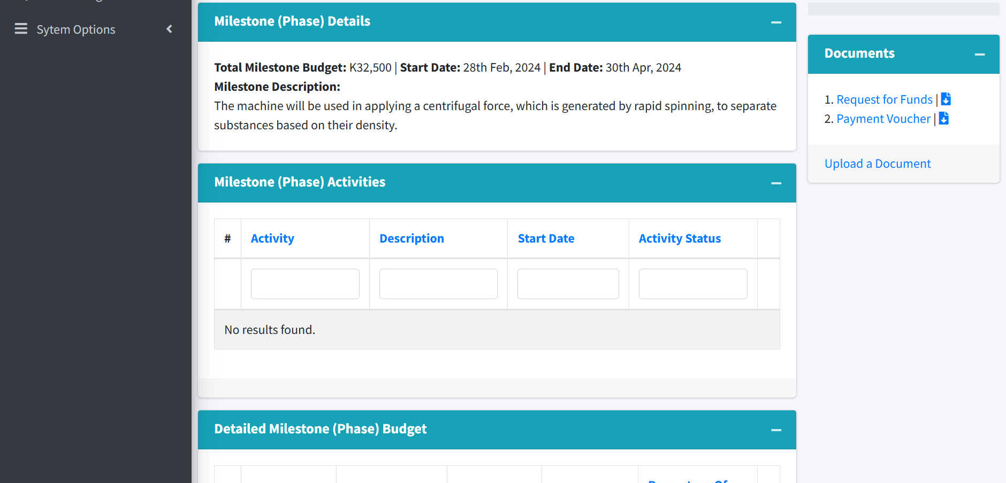

Slide 10
challenges
01
Collaborations
02
Evaluations
03
Application process
04
Lack OF developers
Differing application between the NSTC and generic SGCI system
Some evaluations for applications still have to be done outside the system
Applicants have to fill in one budget item or task at a time
The Council does not have dedicated developers/system admins to maintain the system and support users due to budgetary constraints

Slide 11
Progress made
Continuous improvement
New Forms
Review of structure
The Council has embraced continuous improvements to the system through feedback from users and benchmarking with the generic GMS
Adopted the system to include new forms, which allowed the Council to use the application form provided in the generic GMS
Development of IT governance framework (IT policy based on ITIL and ISO 27000) to ensure sustainability and maintainability of the system

Slide 12
Way forward
Continue to keep improving the system as feedback comes from the users
Improve work-planning and budgeting interface to make less tedious
Continue benchmarking with the SGCI system to ensure standardization
Update the system based on the new guidelines

Slide 13
recommendations
IT Governance is key – especially in ensuring maintainability of the system
Dedicated developers are important for proper maintenance and improvement of the system
Change management – plan the systematic release of the system and user engagement to ensure adoption by users (dedicated IT support and system admins, user trainings, et cetera)
Plan sustainability of the system – ensure a budget line for the systems support (hosting, backups, maintenance, et cetera)
Ensure support from management
Continuous improvement is also very key!

Slide 14
The end
Thank you

