Slide 1

Online Grants Management system (OGMS) –SGCI PEER TO PEER MEETING
BY
Zacheous Kantchowa & Yalonda Mwanza
THE PEER-TO-PEER LEARNING MEETING, AVANI Windhoek Hotel,
Windhoek, Namibia,
7th to 9th April 2025

Slide 2
Presentation Outline
NCST background
Achievements
Challenges Faced
Progress Made
Way Forward

Slide 3
National commission for science and Technology
Establishment
The NCST was established by the S&T Act No.16 of 2003 (Section 5)
The S&T Act itself became operational on 14th November, 2008 Following the Gazette Notice of 14th Feb.,2009
NCST started its operations in 2010
Mandate
To advise the Government and other stakeholders on all science and technology matters in order to achieve a science and technology-led development (Part IV, Section 18 of the S&T Act No.16 of 2003)
Mission
To promote, support, co-ordinate and regulate the development and application of research, science, technology and innovation in order to create wealth and improve the quality of life

Slide 4
Role and responsibilities
Promote understanding of STI at all levels of society
Promote STI capacity building including human resource
Chart out STI national direction and priorities (research agenda/programs)
Promote establishment and coordination of RSTI institutions
Promote Technology transfer and commercialization
Develop STI indicators
Establish and maintain partnerships
Prepare status of STI report every 2 years
Source funding for STI programs
Research clearance
Administer grants (S&T fund and other sources)

Slide 5
Engagement with SGCI on OGMS
SGCI- Phase II, (2021 to 2022)
System development led by the Uganda Council for Science and Technology (UNCST) in collaboration with the African Universities (AAU) in Ghana.
SGCs Participated in a series of online consultative and system review meetings
Malawi was one of the first countries to be on the roll-out list.
AAU provided systems installation files and guide to enable NCST install the system.
The system is hosted on the cloud.
Ubuntunet is the service provider
AAU subscribed on our behalf for 3 years

Slide 6
Achievements
  Development and publishing of a call (4 calls in total)
  A joint exercise between grants officers and ICT team
  Published in the press and website
  Compulsory submission of proposals through OGMS
  Successfully conducted the review process using the OGMS

Slide 7
Challenges
Technical Challenges
  Important system functionalities stops working after upgrading the version of PHP from 7.0 to PHP version 8.0
  The procurement Module does not function as intended
  The financial module does not work properly

Slide 8
Challenges
Received a couple of requests wanting to submit through email
Received a number of calls from applicants that they were having problems to:
Create an account
Save their work
Applicants were exceeding the word limit on a number of fields
increased the number of words in the system

Slide 9
Challenges
Some of the researcher wanted to be assisted to upload information
for instance, one researcher had to travel to our office to upload his proposal onto the system
A couple of researchers requested for a word version of the system (work sheets) where they can simply type and submit
Some applicants were requesting for an extension of the call

Slide 10
Challenges
Last minute random calls-inquires
Despite assigning a contact person
Not all grants officers have fully embraced the system.
don’t fully participate
Advocating for manual alongside OGMS

Slide 11
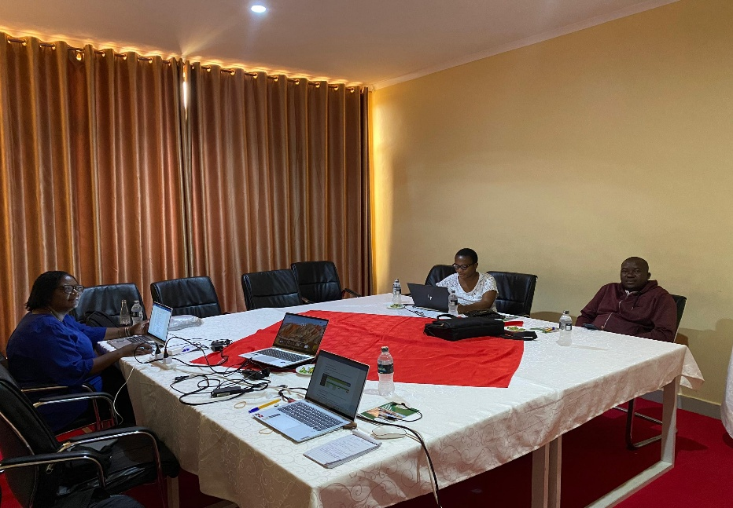
Progress Made
Number of Trainings conducted
NCST conducted 6 Trainings in Total
  Grants officers training (2 Trainings)
    How to generate a call
    How to publish the call
    Adding Evaluation Criteria
    Assign Reviewers
  Applicant training (3 Trainings were conducted)
    How to access the system
    How to create an account on the system
    Ho to respond to a call and submit
    Submission of Reports
Grants officers Training, 2025

Slide 12
  Reviewers Training
    How to access the system
    How to accept/reject the review invitation
    How to provide Scores and comments
    Submit final scores

Slide 13
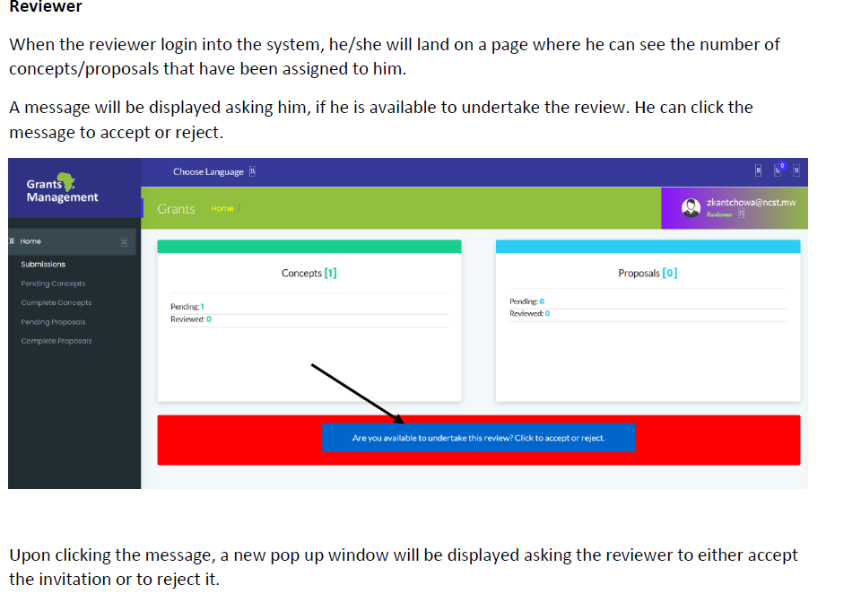
Development of system user Manual (3 user manuals in total), Step by step approach with visuals
  Grants officer module user manual
  Applicant module user manual
  Reviewers module user manual
Example of the system manual that has been developed

Slide 14
Way Forward
Improvements to be made:
  The system to work with latest technologies e.g PHP 8.0
  Procurement module needs improvement
  The accounts module needs improvement
Provide more trainings
  To ensure that system users are familiar with the system and they are able to use it effectively
Continue System customisation
      Continue with customisation to ensure that the system is becoming more user friendly and incorporating new functionalities

Slide 15
Thank you!!
Zikomo

