Slide 1
Online Grants Management System (OGMS)
SGCI Peer-to-Peer Learning Meeting
in
Namibia 6 – 9 May

Slide 2
Presentation Outline
• Background
• Achievements
• Challenges Faced
• Progress Made
• Way Forward
• Conclusion (Recommendations and Experience)

Slide 3
About the Research Council of Zimbabwe
Establishment
Founded in 1986 under the Research Act [Chapter 10:22].
Vision
Mission
To be the pivotal leader steering demand-driven research for wealth creation and sustainable development by 2030.
To contribute to the knowledge economy through promoting demand-driven research and translating results into goods and services.
In 2022, the RCZ adopted an online granting system to streamline the grant application
and review process supported by the Association of African Universities (AAU) and
Uganda National Council for Science and Technology (UNCST)
The adoption of the Online Grants Management System streamlined grant management,
and enhanced efficiency, transparency, and accountability in research funding.

Slide 4
Achievements
Efficiency
Faster grant application/review processes.
Transparency
Real-time tracking of application status and evaluations
Accountability
Auditable tracking of grant application, award and fund usage.

Slide 5
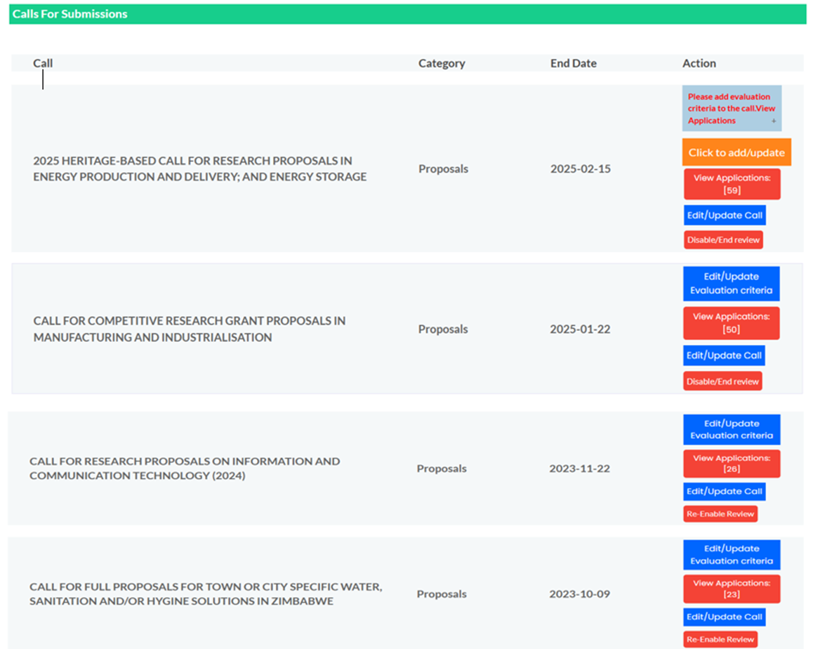
Achievements Cont.….

Slide 6
Challenges Faced
User Experience Issues
System Enhancement Needs
Automated reviewer selection
Research project monitoring platform.
Procurement and Accounts Modules
Reports, at every stage, a report must be generated so that other
steps which are performed outside the system, a report must be
attached, e.g payment of reviewers.
Two officers to perform completeness (in cases of councils’
Collaboration and joint calls funding.
System to allow collaborations of Councils (e.g allow two currency
budgets)
Profile for funding partners (e.g POTRAZ, ZERA)
The need for a back button to applications list not straight to the home.
List of reviewers who have worked on an application and their scores
on the project information page after the review process.
Deeper analytics.
More details when establishing a reviewer account, like CV upload
Long application process
Fake account prevention
Account verification notifications

Slide 7
Progress Made
Training Webinars
Research Management and Funding Opportunities sessions
Custom Modifications
Non-Disclosure agreements and RCZ-branded email notifications
Security Enhancements
CAPTCHA tool implementation for user registration
Future Integration
Plans for accounts integration and AI-driven security

Slide 8
Way Forward
Budget Allocation
Systems hosting included in the 2025 Council budget to ensure continued operation.
System Enhancements
Implementation of automated reviewer selection, accounts module and project monitoring.
Security Expansion
Development of AI-based security features to protect system integrity.
User Support
Continuous training and awareness campaigns for all system users.

Slide 9
Recommendations
Other Councils to Adopt Digital Systems
Implement similar online grant management platforms
User-Centric Design
Focus on user-friendly interfaces and user experience
Iterative Feedback
Establish continuous improvement through user feedback loops
Foster Collaboration
Partner with other research councils for greater impact

Slide 10
THANK YOU

