Slide 1
OGMS Peer-to-Peer Learning Meeting
NSTIC

Slide 2
TABLE OF CONTENTS
(MODIFICATIONS MADE)
01. Active Calls UI
02. Statistics UI
03. New Pages
04. Responsive Sidebar
05. Grant Officer Dashboard
06. Applicant Dashboard
07. Reviewer Dashboard
08. User Enhancements

Slide 3
OGMS Peer-to-Peer Learning Meeting | NSTIC
01.
ACTIVE CALLS UI

Slide 4
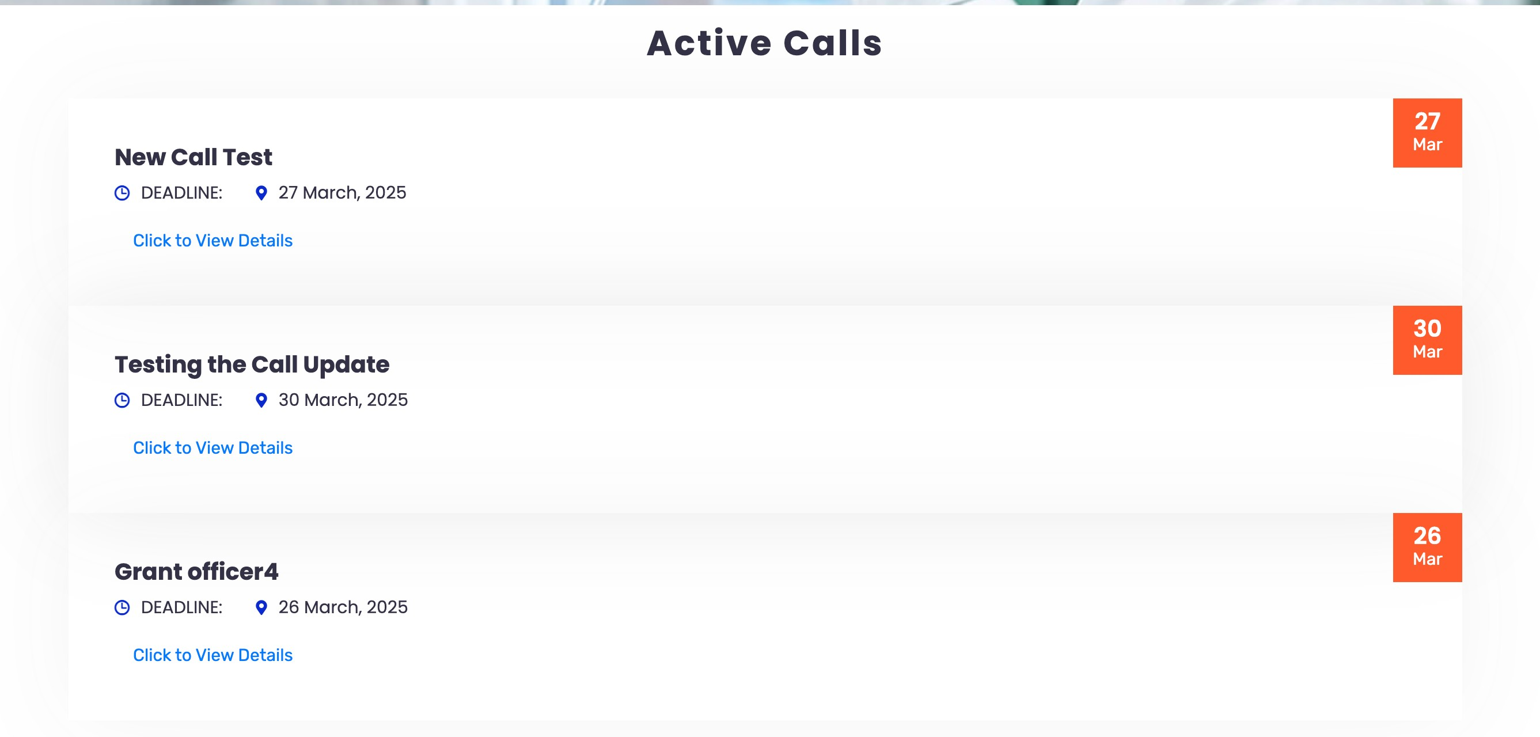
OGMS Peer-to-Peer Learning Meeting | NSTIC
01. Active Calls UI
- OLD DESIGN

Slide 5
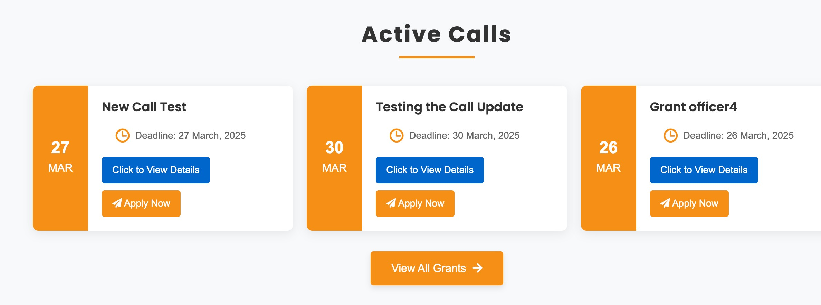
OGMS Peer-to-Peer Learning Meeting | NSTIC
01. Active Calls UI
- NEW DESIGN

Slide 6
OGMS Peer-to-Peer Learning Meeting | NSTIC
02.
STATISTICS UI

Slide 7
OGMS Peer-to-Peer Learning Meeting | NSTIC
02. Statistics UI
- OLD DESIGN

Slide 8
OGMS Peer-to-Peer Learning Meeting | NSTIC
02. Statistics UI
- NEW DESIGN

Slide 9
OGMS Peer-to-Peer Learning Meeting | NSTIC
03.
NEW PAGES

Slide 10
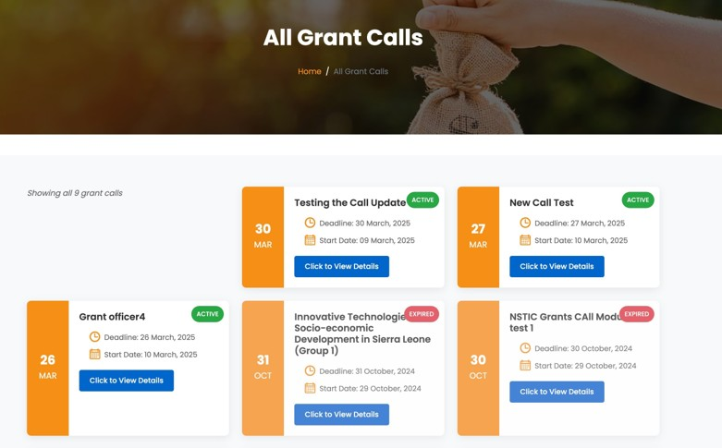
OGMS Peer-to-Peer Learning Meeting | NSTIC
03. New Pages
- ALL GRANT CALLS

Slide 11
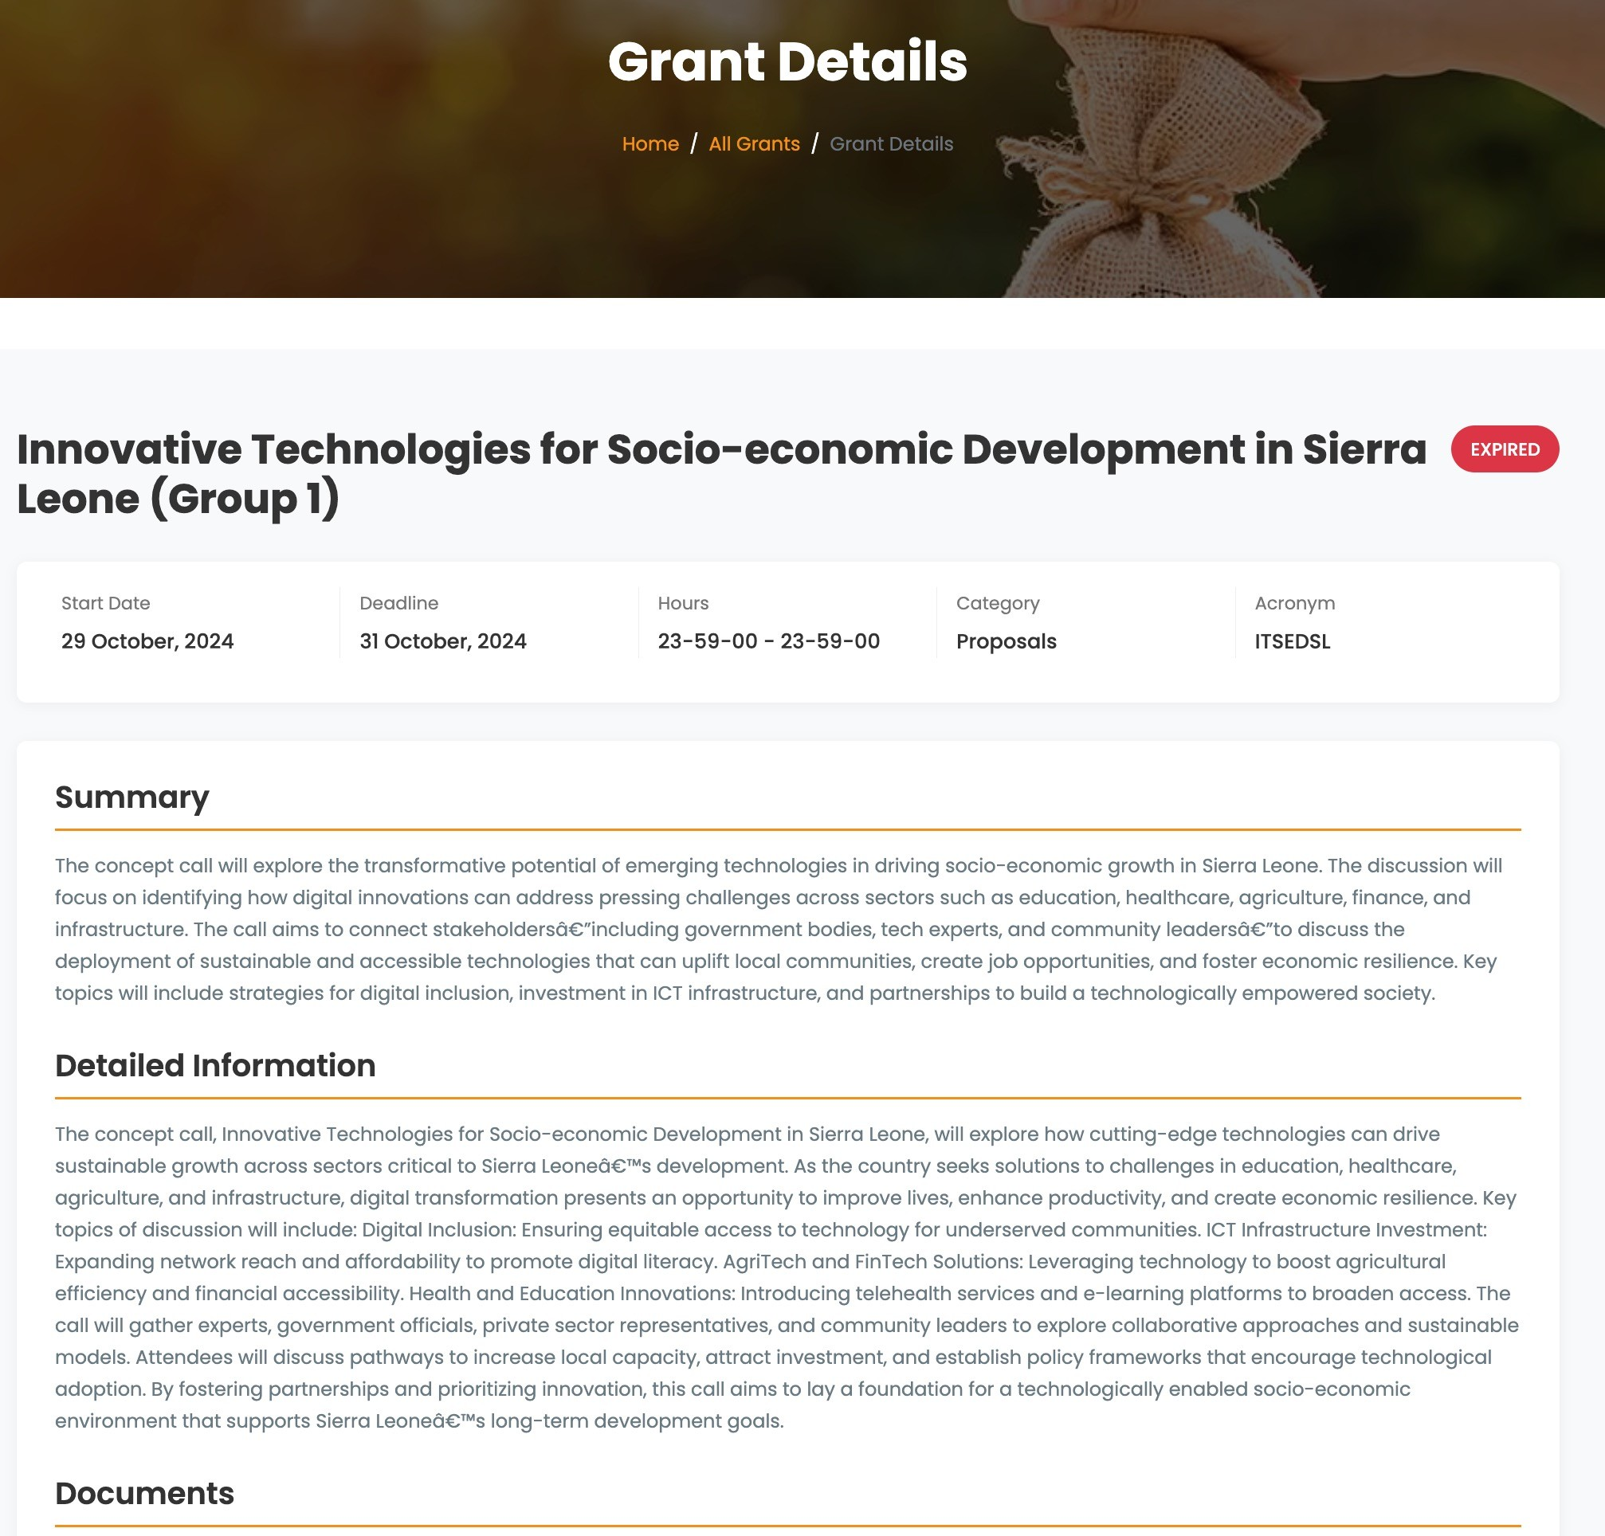
OGMS Peer-to-Peer Learning Meeting | NSTIC
03. New Pages
- GRANT DETAILS

Slide 12
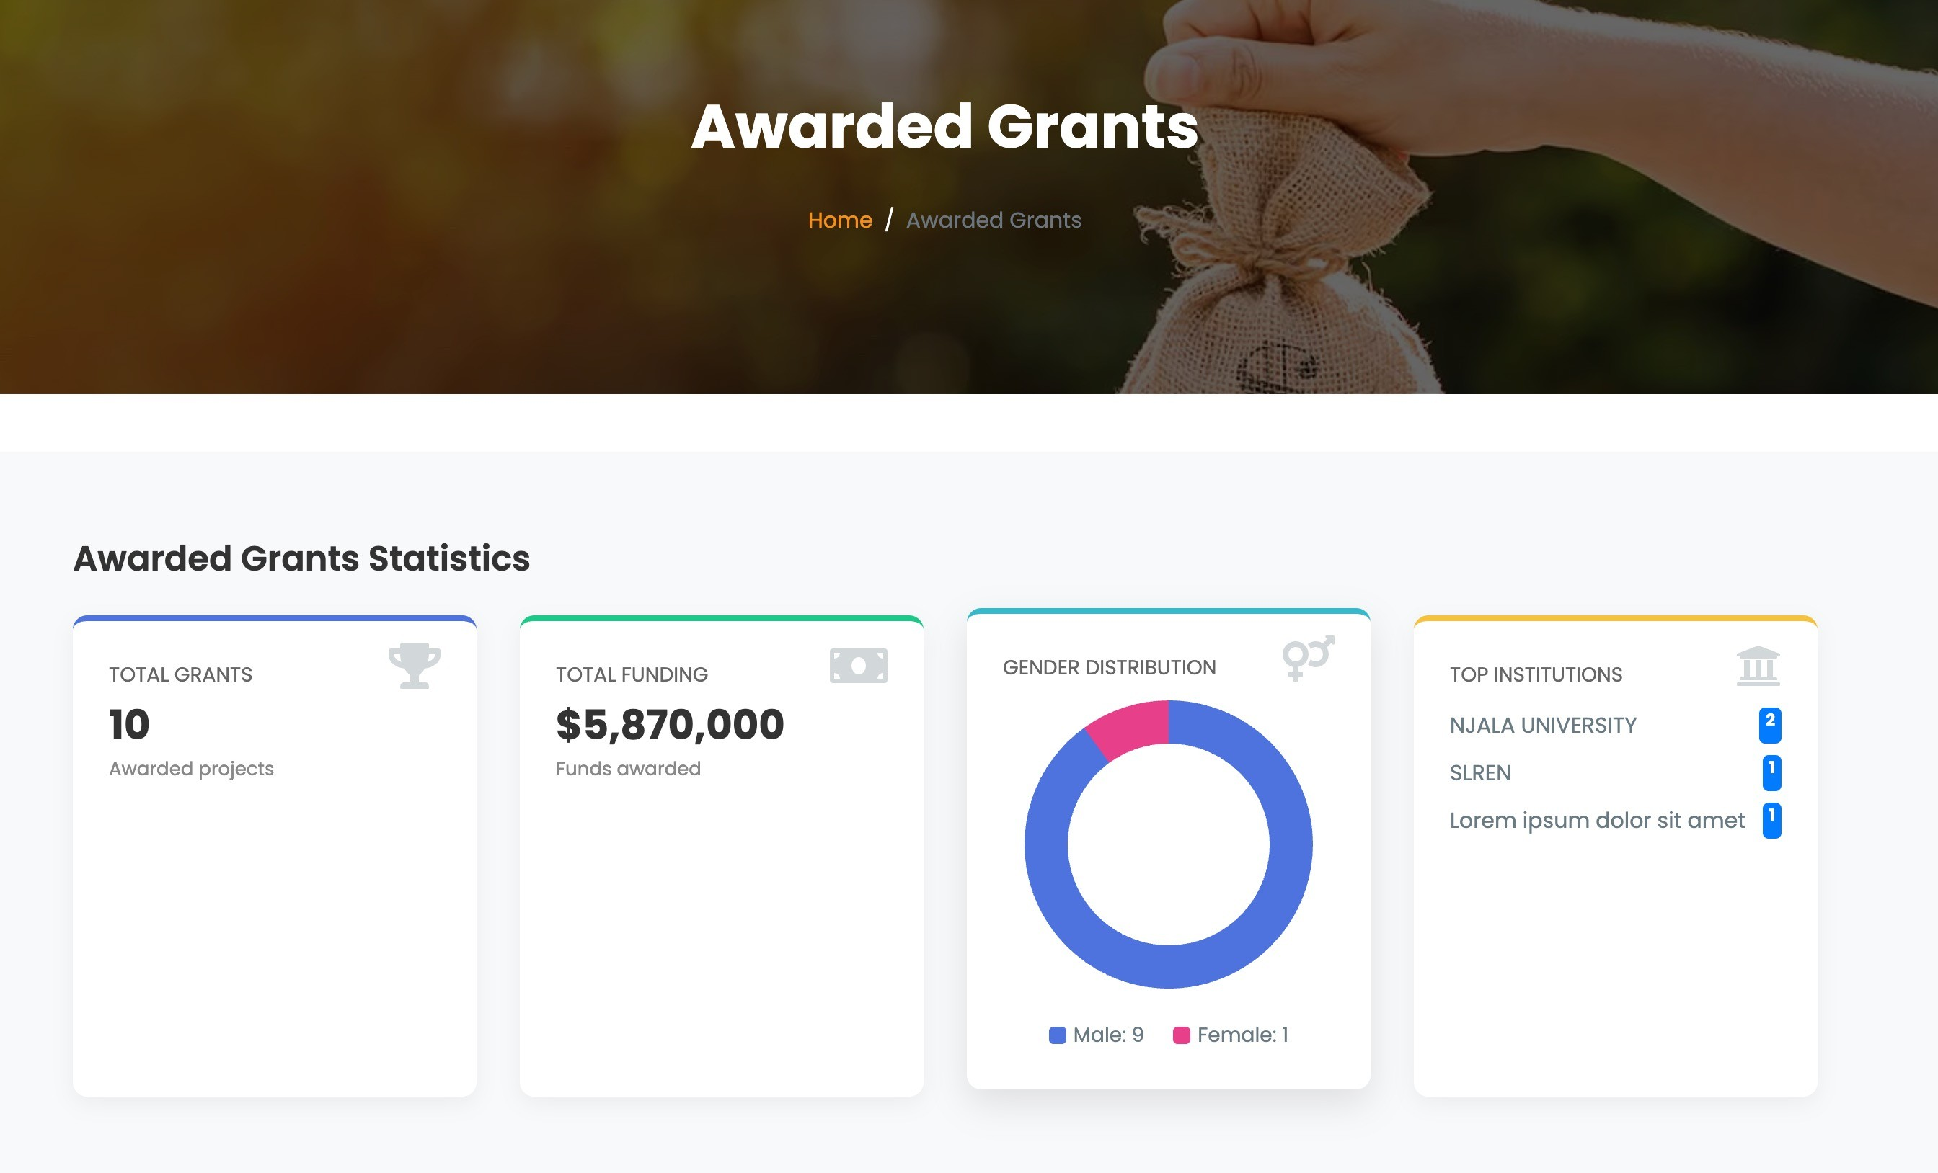
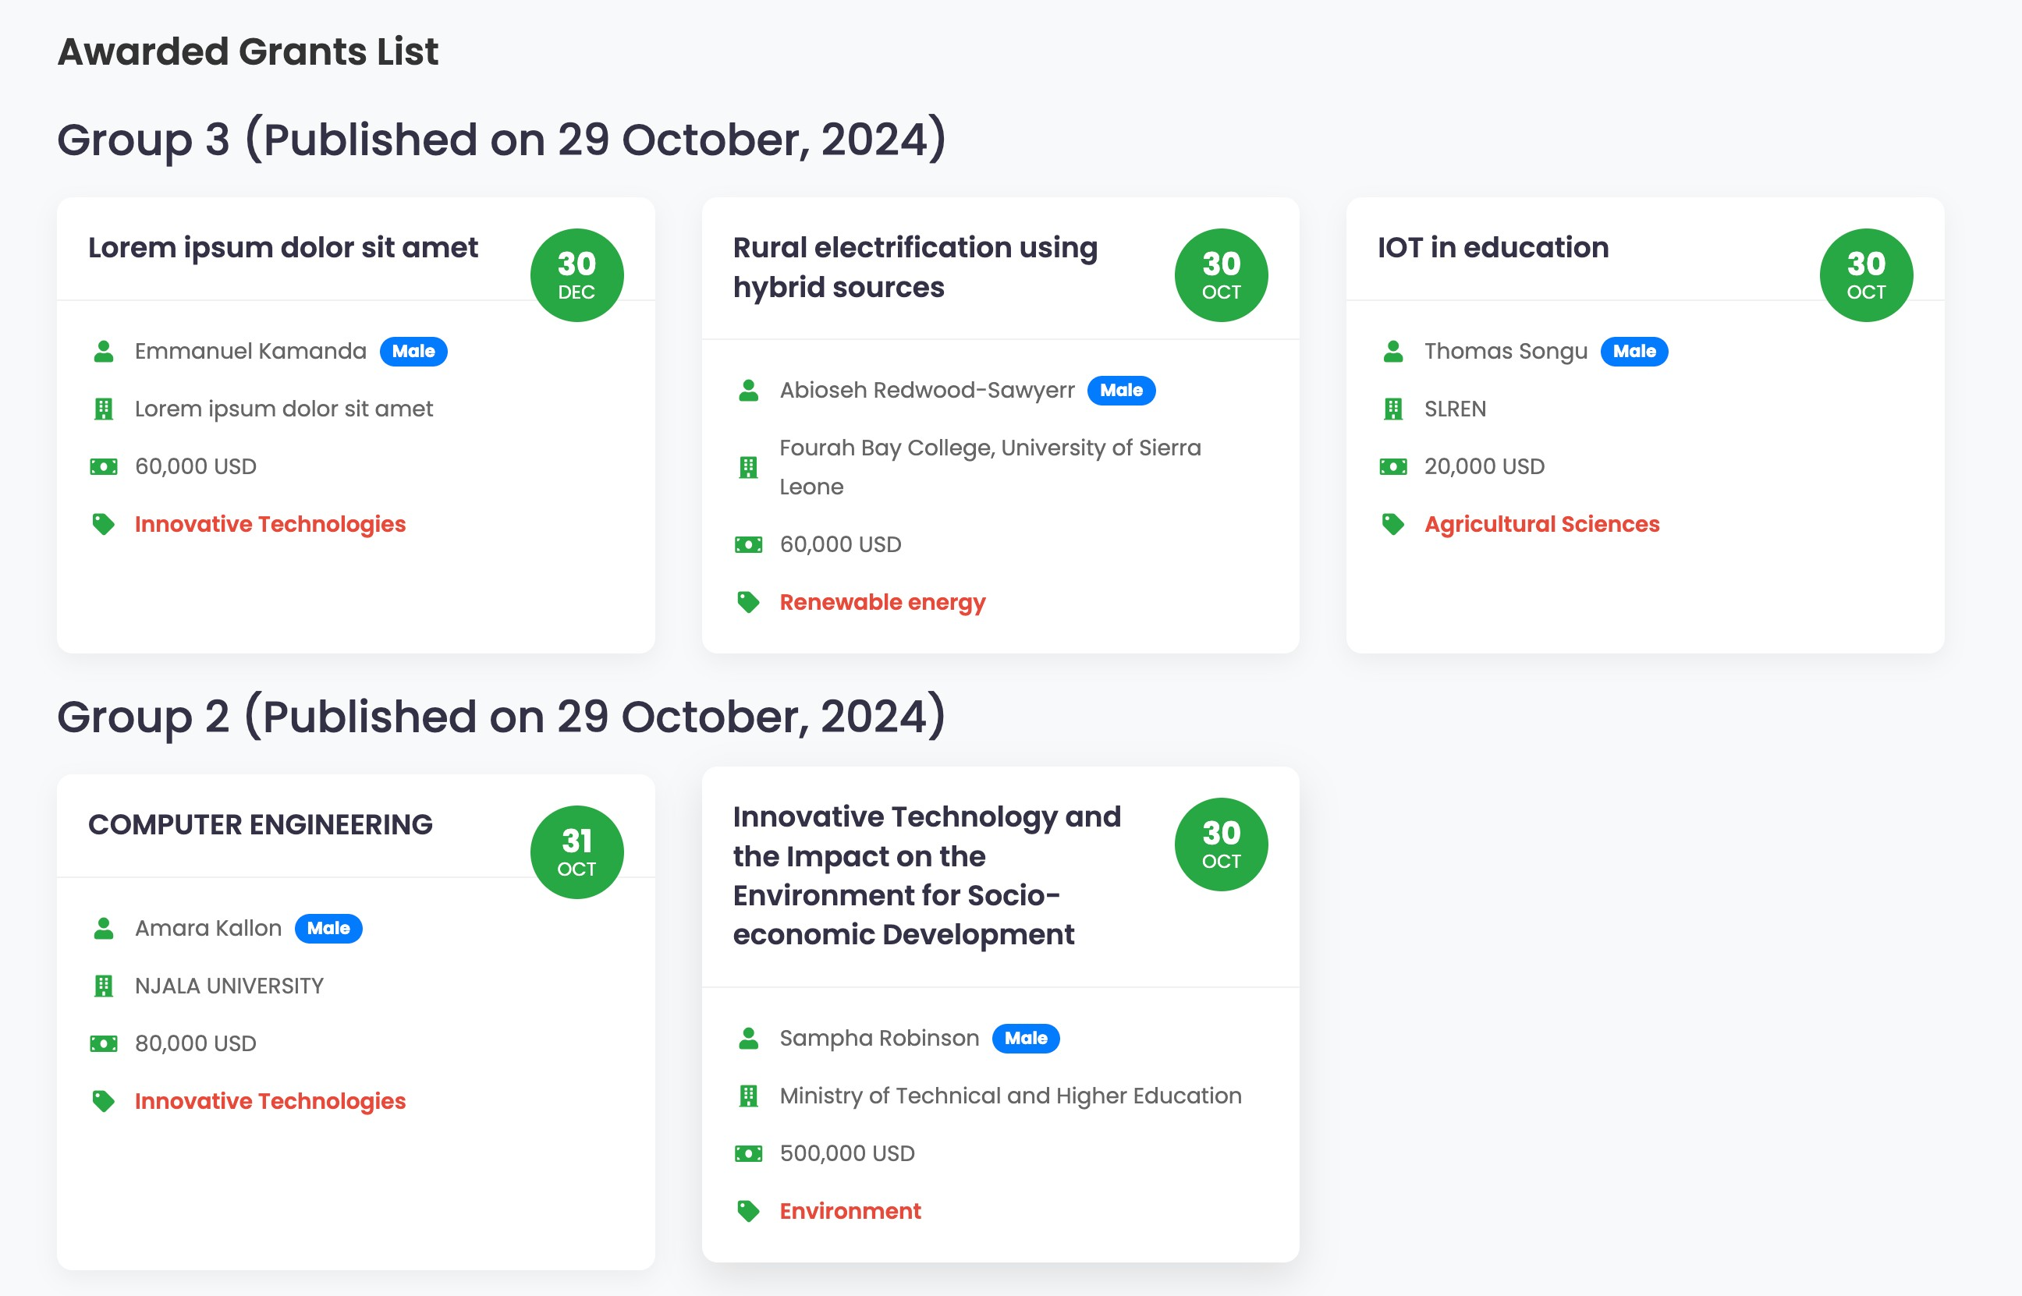
OGMS Peer-to-Peer Learning Meeting | NSTIC
03. New Pages
- AWARDED GRANTS

Slide 13
OGMS Peer-to-Peer Learning Meeting | NSTIC
04.
RESPONSIVE SIDEBAR

Slide 14
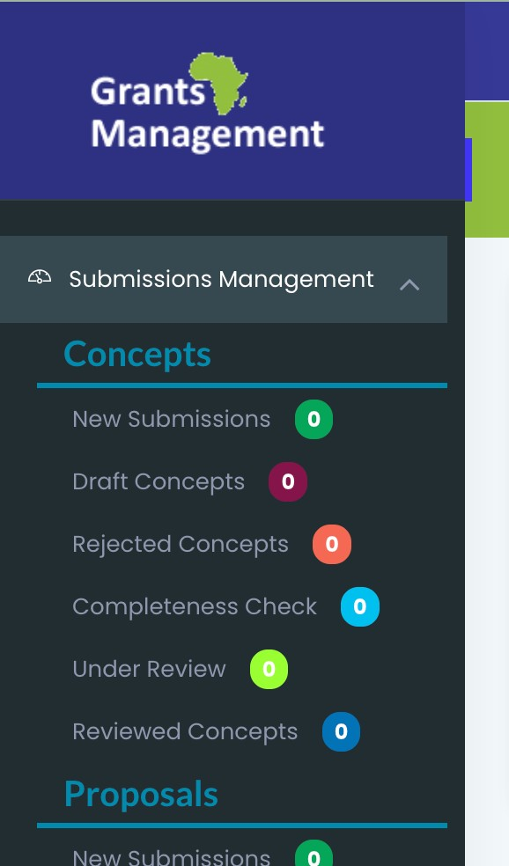
OGMS Peer-to-Peer Learning Meeting | NSTIC
No Button to toggle view control
04. Responsive Sidebar
- OLD DESIGN

Slide 15
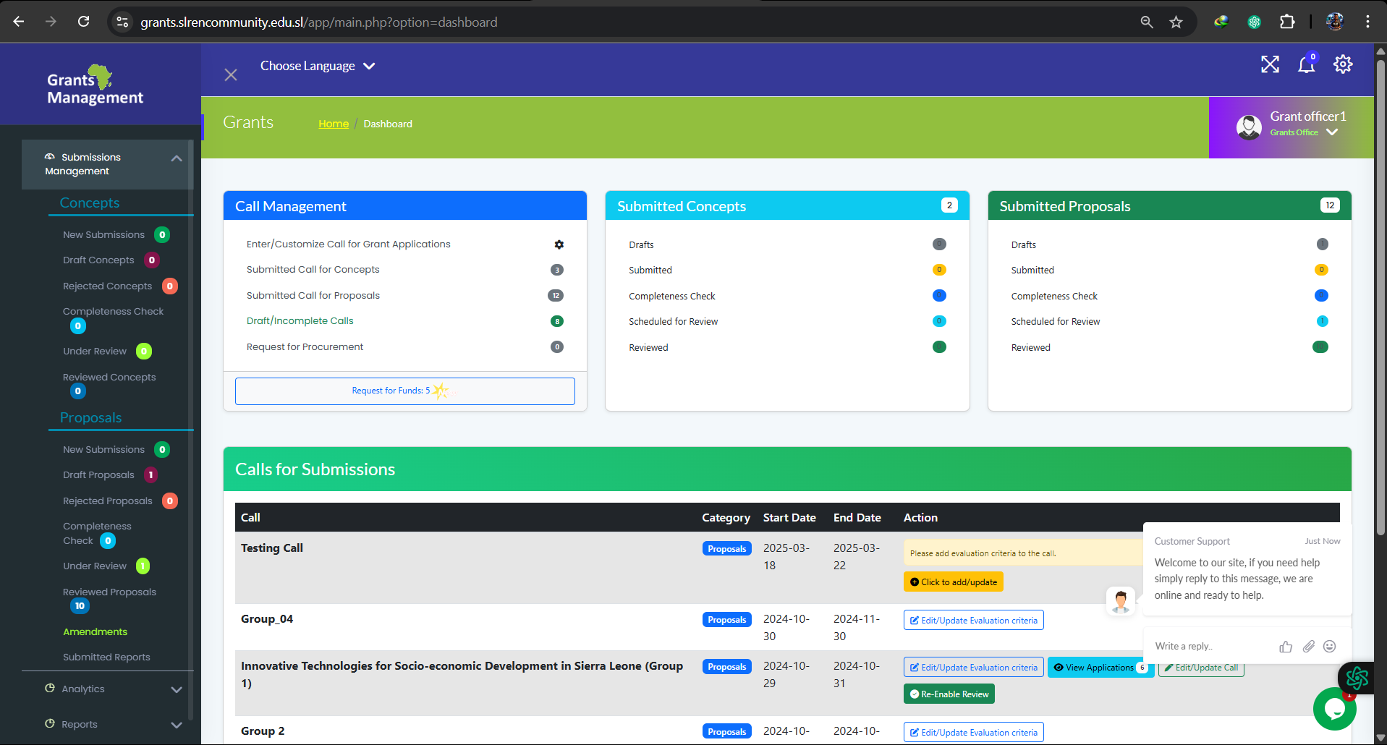
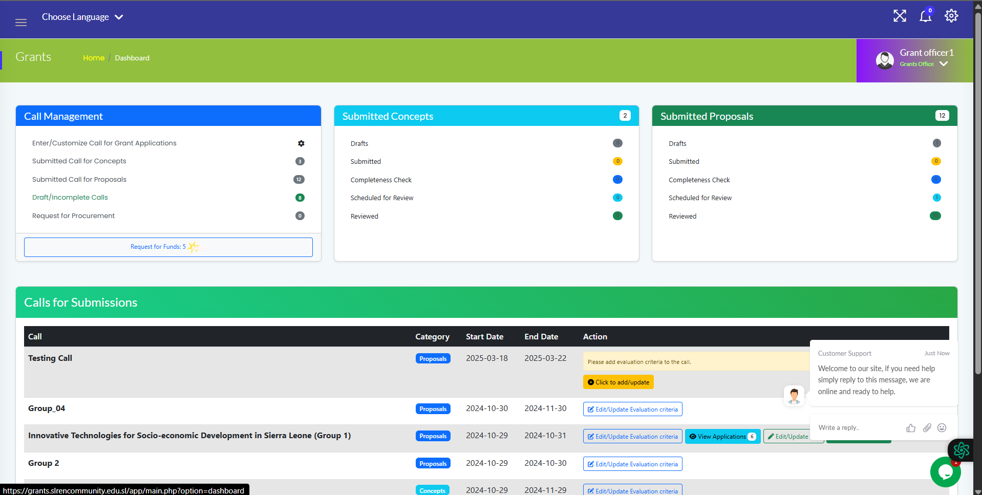
OGMS Peer-to-Peer Learning Meeting | NSTIC
A Button to toggle view control
A Button to toggle view control
04. Responsive Sidebar
- NEW DESIGN

Slide 16
OGMS Peer-to-Peer Learning Meeting | NSTIC
05.
GRANT OFFICER
DASHBOARD

Slide 17
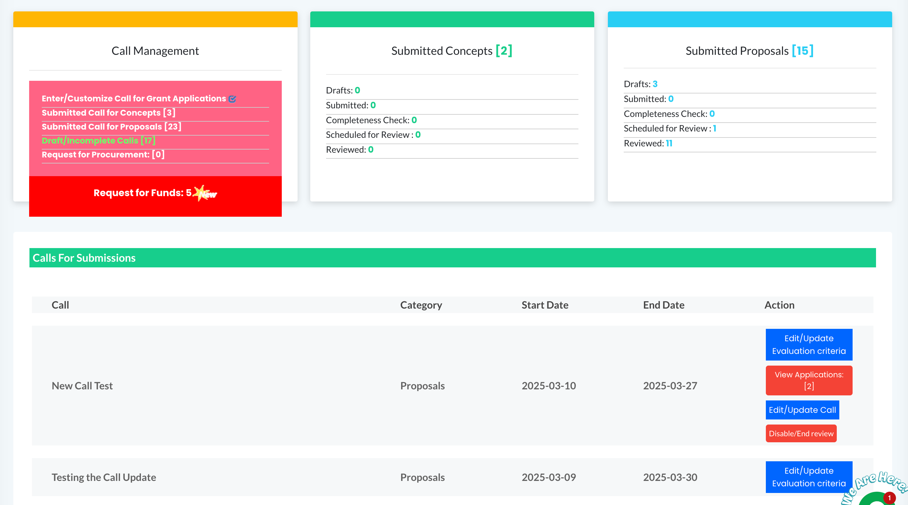
OGMS Peer-to-Peer Learning Meeting | NSTIC
05. Grant Officer Dashboard
- OLD DESIGN

Slide 18
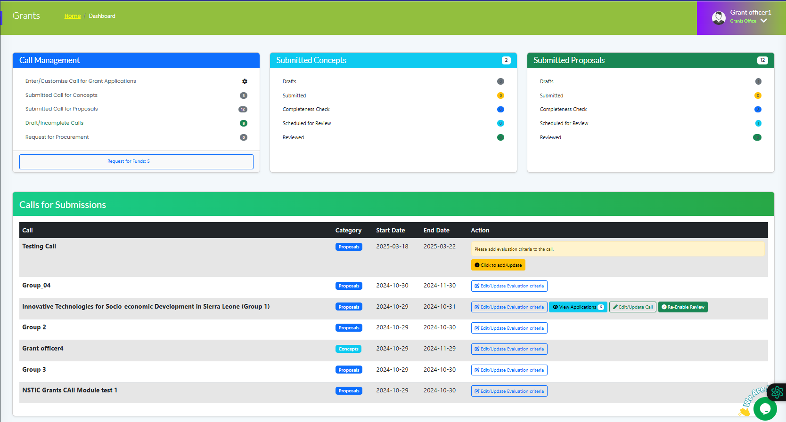
OGMS Peer-to-Peer Learning Meeting | NSTIC
05. Grant Officer Dashboard
- NEW DESIGN

Slide 19
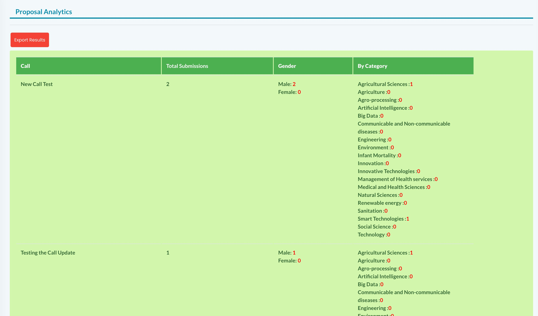
OGMS Peer-to-Peer Learning Meeting | NSTIC
05. Grant Officer Dashboard
- PROPOSAL ANALYTICS / OLD DESIGN

Slide 20
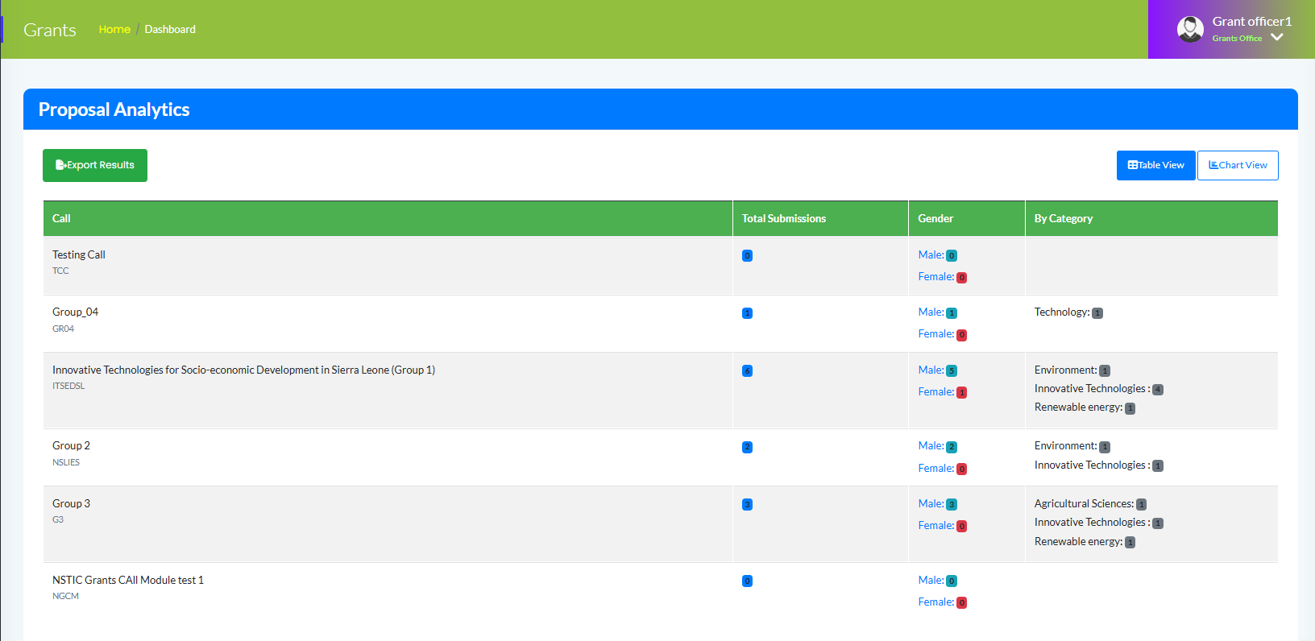
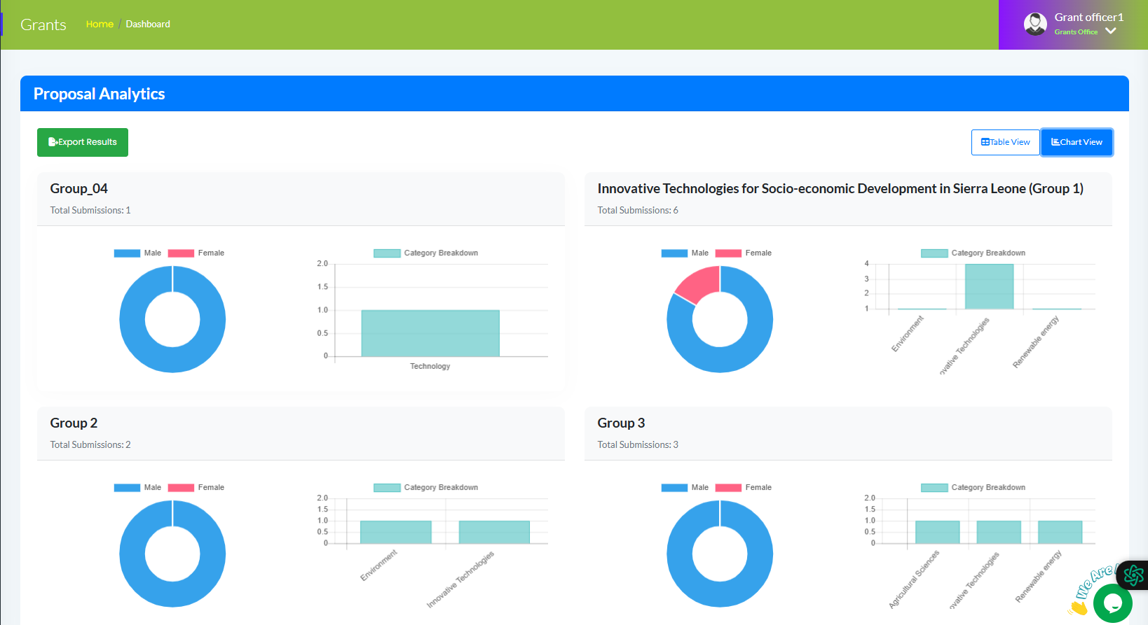
OGMS Peer-to-Peer Learning Meeting | NSTIC
Table View
Chart View
05. Grant Officer Dashboard
- PROPOSAL ANALYTICS / NEW DESIGN

Slide 21
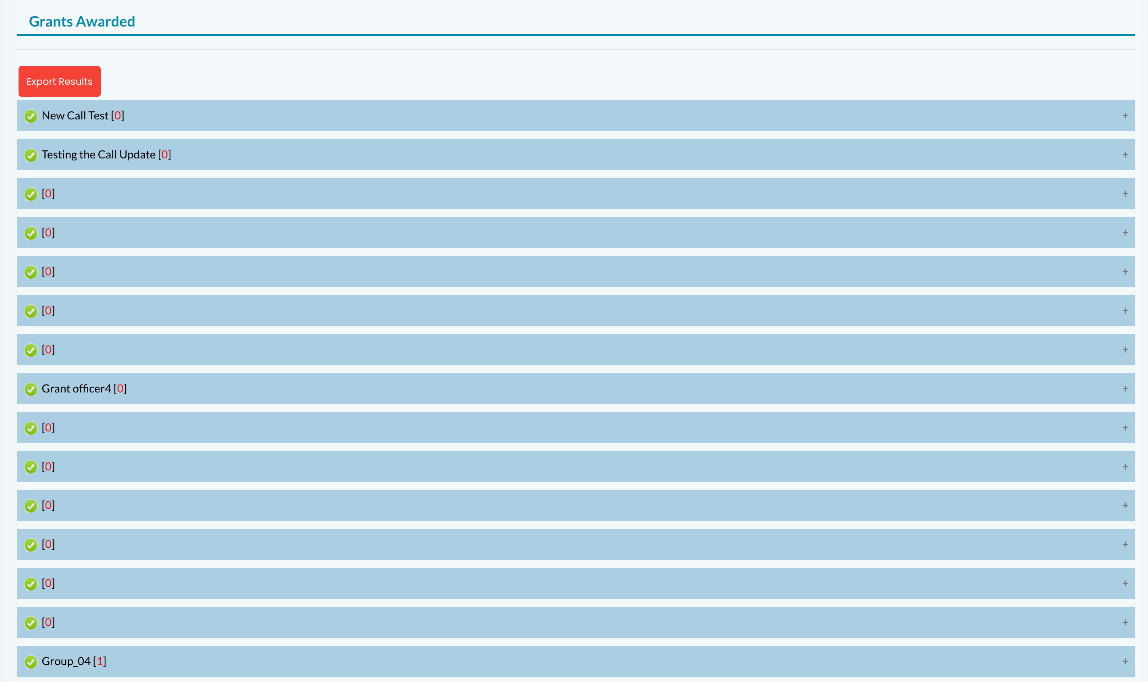
OGMS Peer-to-Peer Learning Meeting | NSTIC
05. Grant Officer Dashboard
- GRANTS AWARDED/ OLD DESIGN

Slide 22
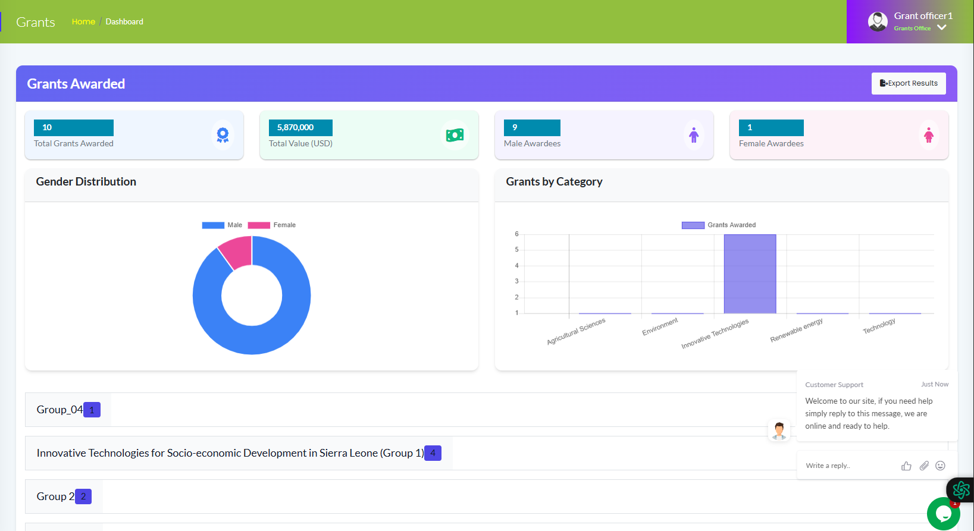
OGMS Peer-to-Peer Learning Meeting | NSTIC
05. Grant Officer Dashboard
- GRANTS AWARDED/ NEW DESIGN

Slide 23
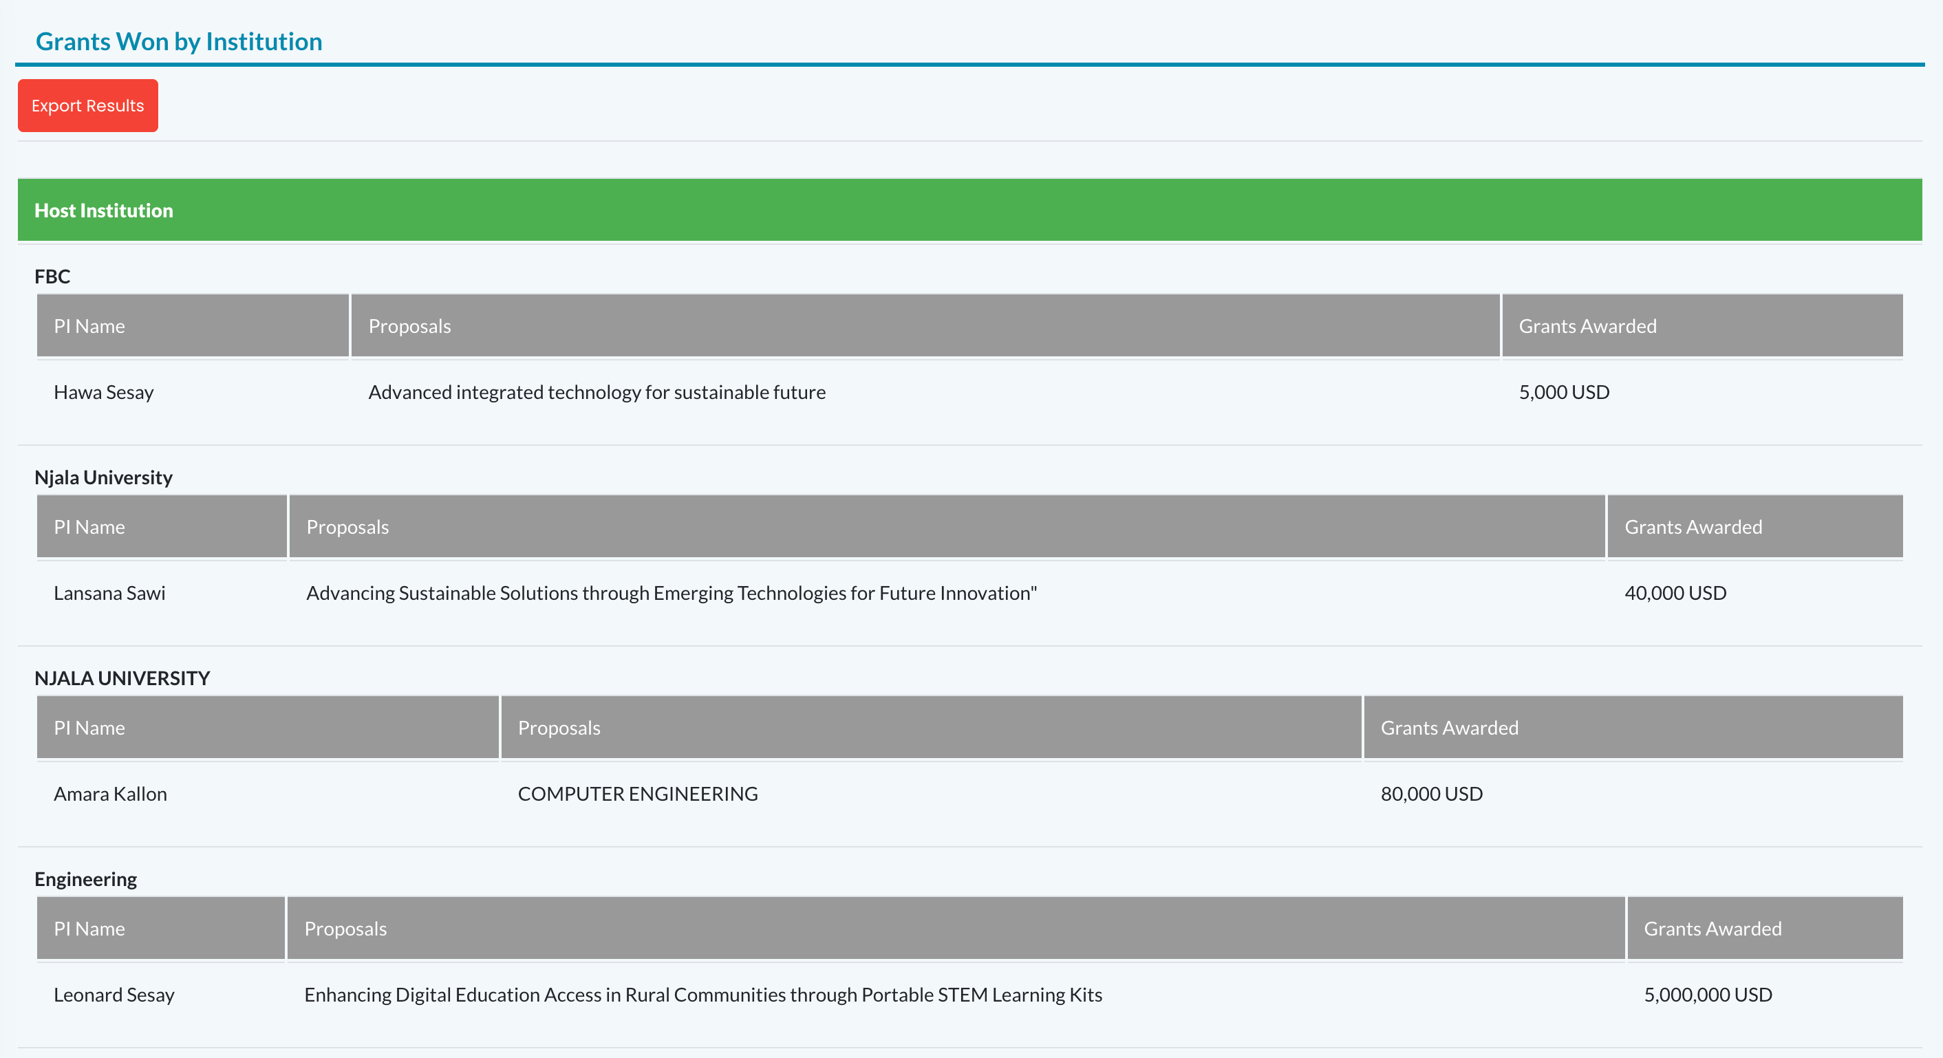
OGMS Peer-to-Peer Learning Meeting | NSTIC
05. Grant Officer Dashboard
- GRANTS WON BY INSTIUTION / OLD DESIGN

Slide 24
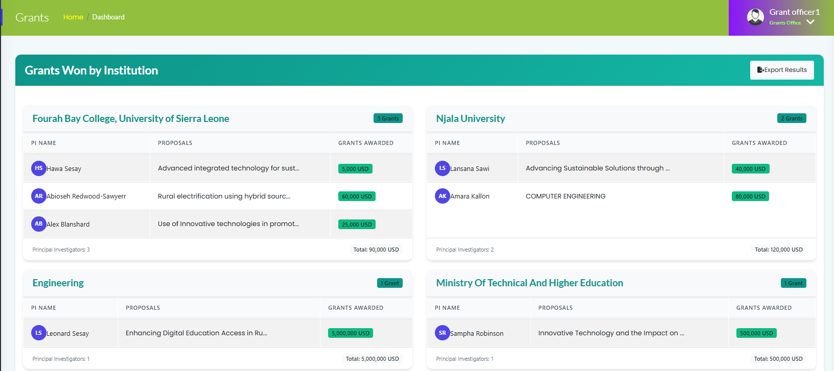
OGMS Peer-to-Peer Learning Meeting | NSTIC
05. Grant Officer Dashboard
- GRANTS WON BY INSTIUTION / NEW DESIGN

Slide 25
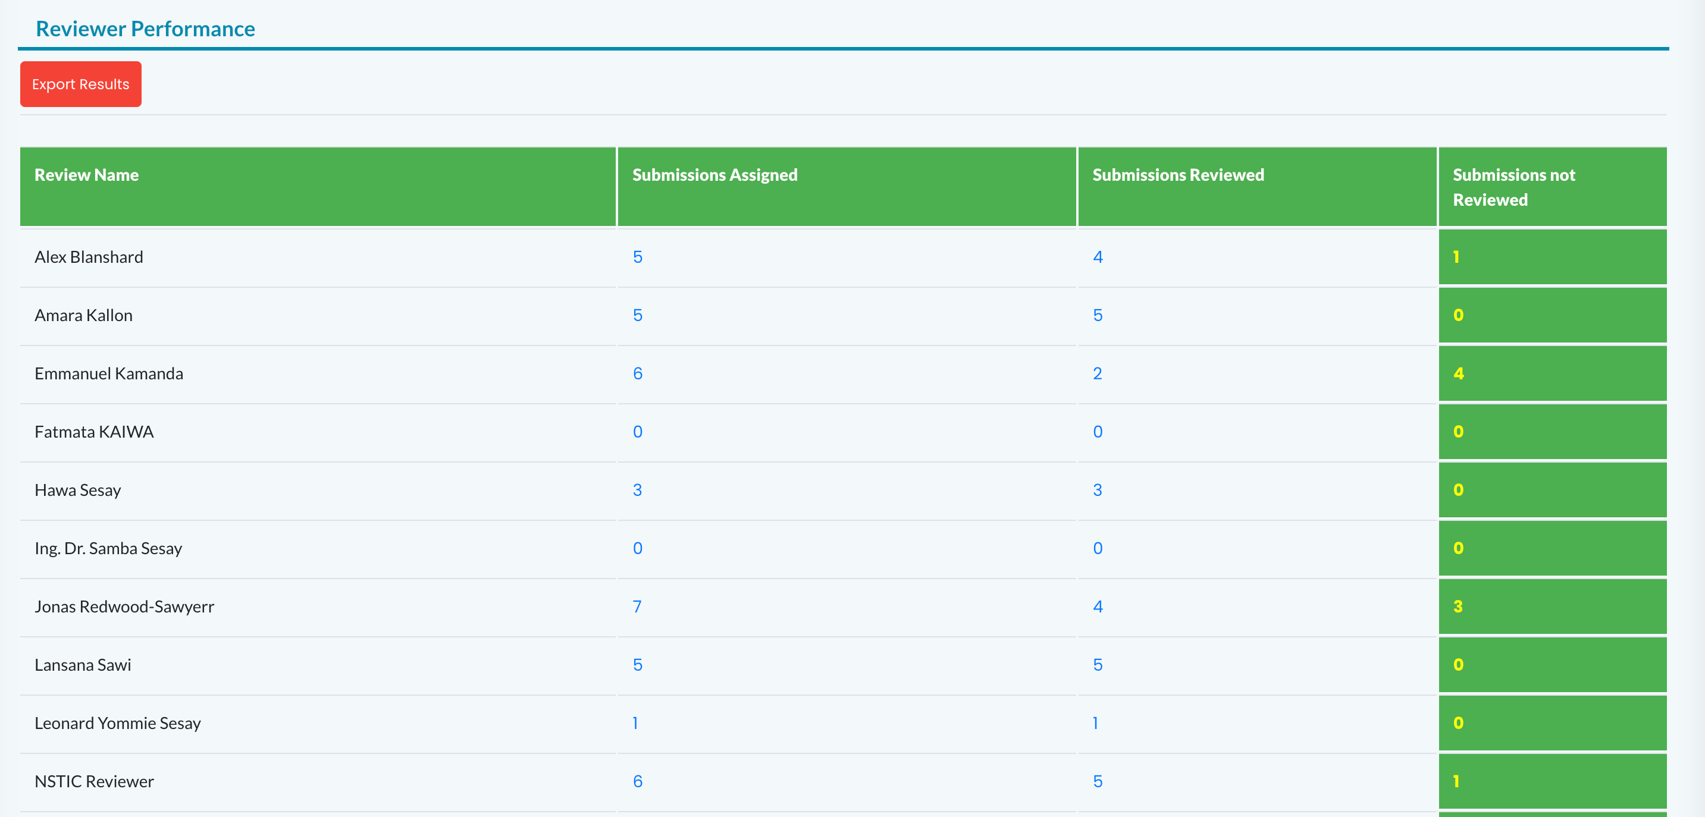
OGMS Peer-to-Peer Learning Meeting | NSTIC
05. Grant Officer Dashboard
- REVIEWER PERFORMANCE / OLD DESIGN

Slide 26
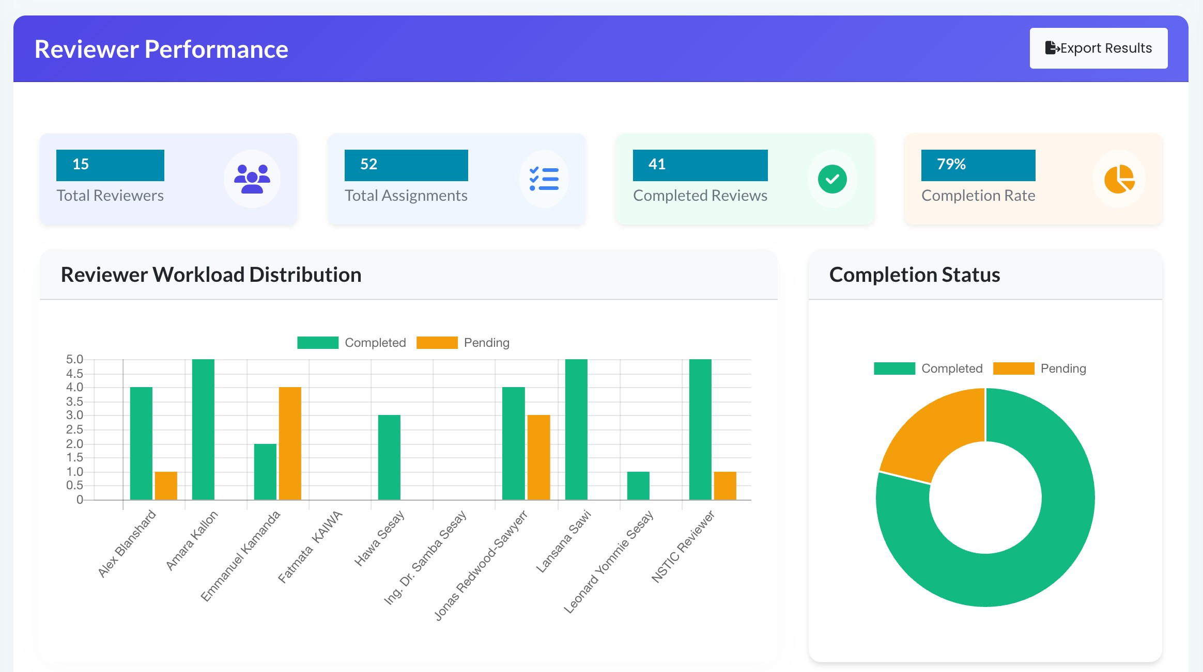
OGMS Peer-to-Peer Learning Meeting | NSTIC
05. Grant Officer Dashboard
- REVIEWER PERFORMANCE / NEW DESIGN

Slide 27
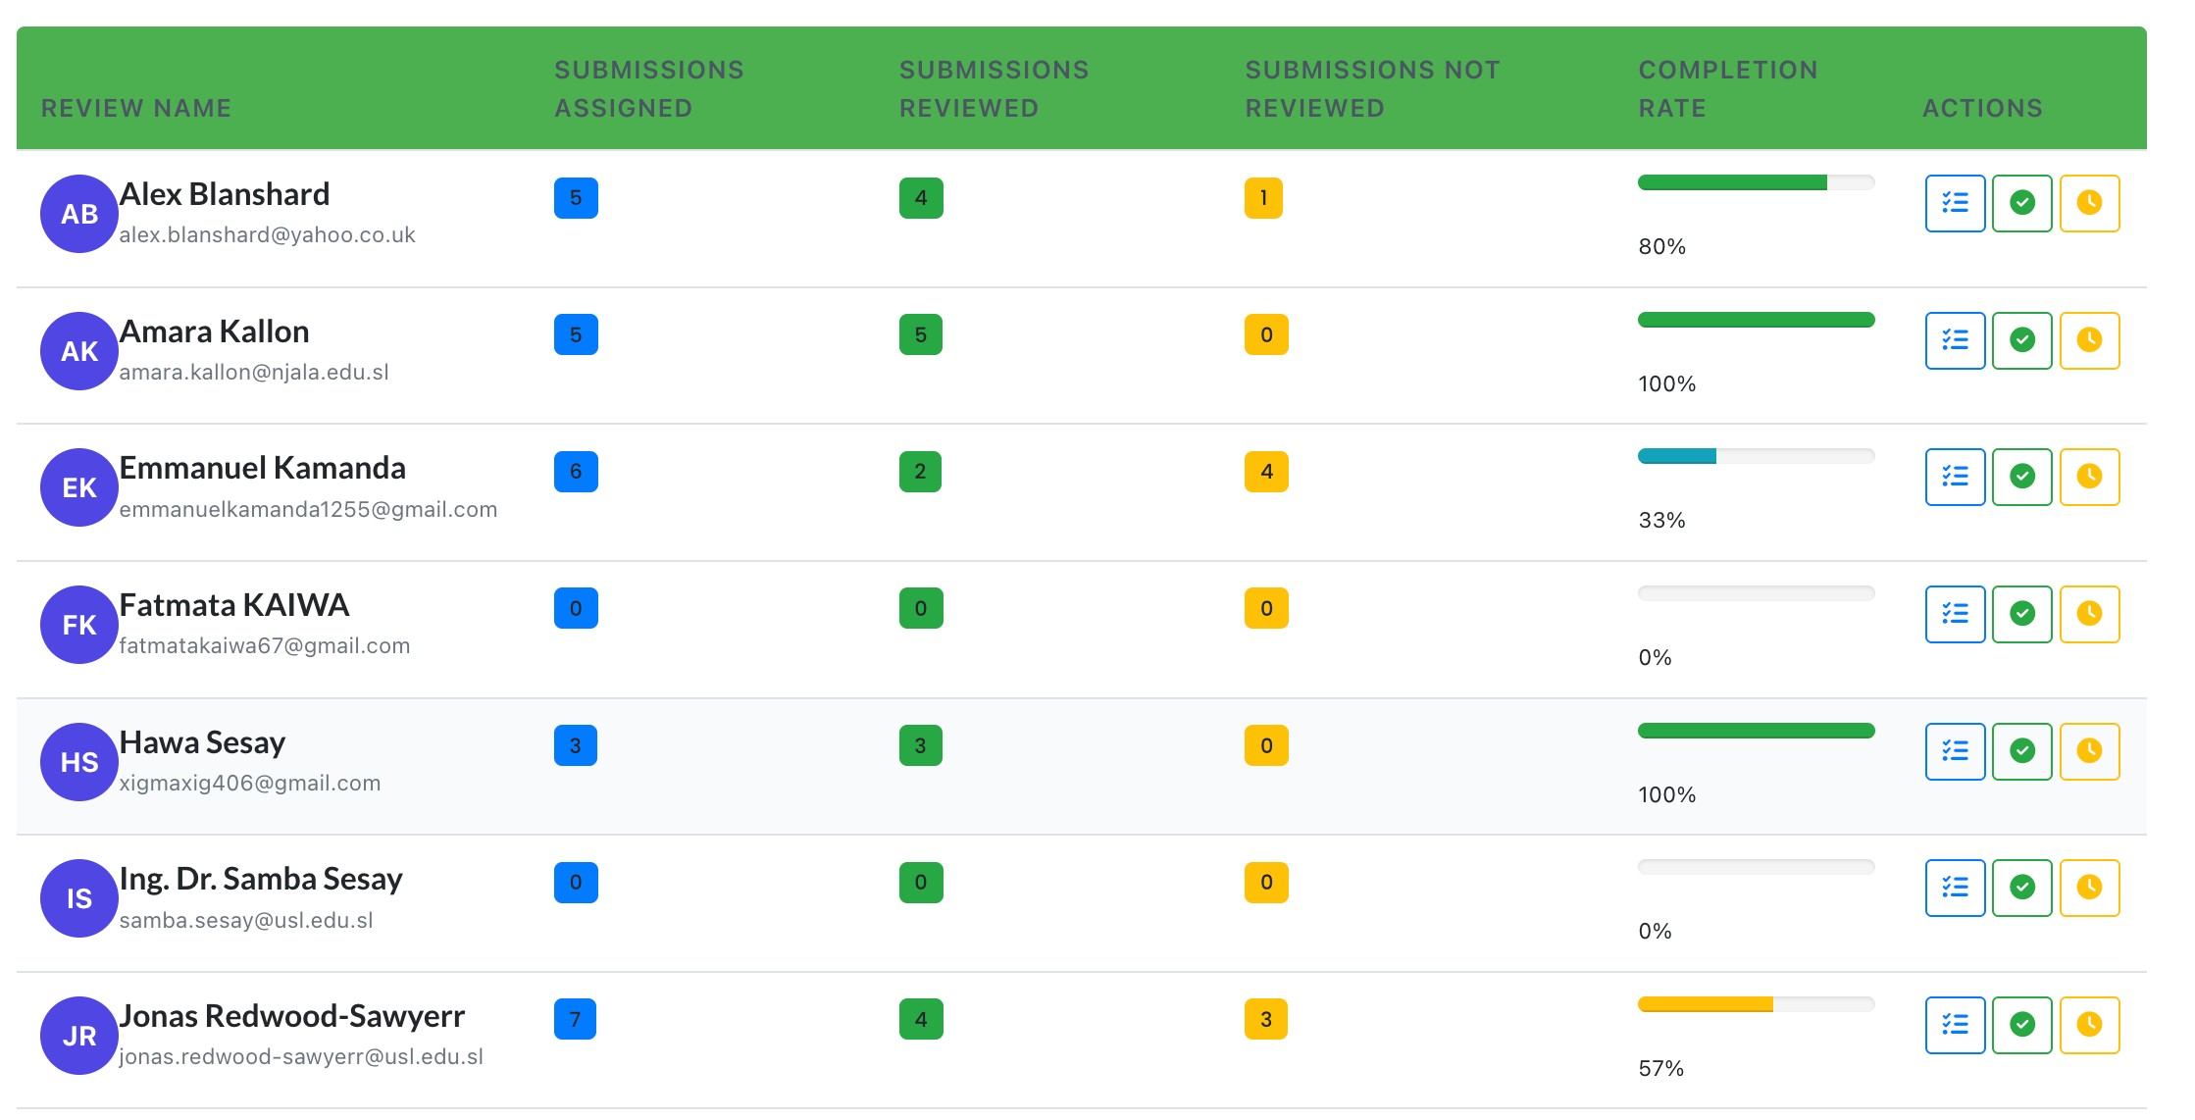
OGMS Peer-to-Peer Learning Meeting | NSTIC
05. Grant Officer Dashboard
- REVIEWER PERFORMANCE / REVIEWER LIST

Slide 28
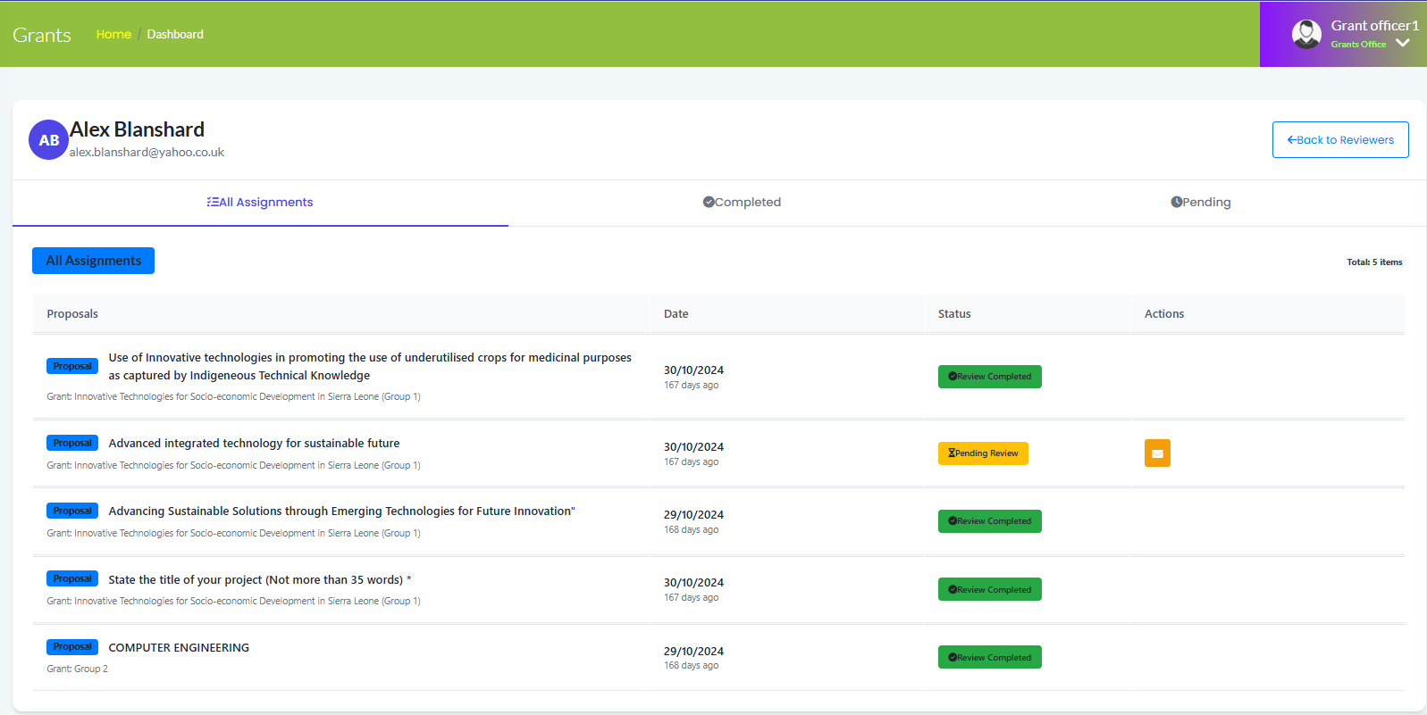
OGMS Peer-to-Peer Learning Meeting | NSTIC
Click here to send Email Reminder
Click here to see Pending Review
05. Grant Officer Dashboard
Click here to see Completed Review
- REVIEWER PERFORMANCE / INDIVIDUAL REVIEWER

Slide 29
OGMS Peer-to-Peer Learning Meeting | NSTIC
06.
APPLICANT DASHBOARD

Slide 30
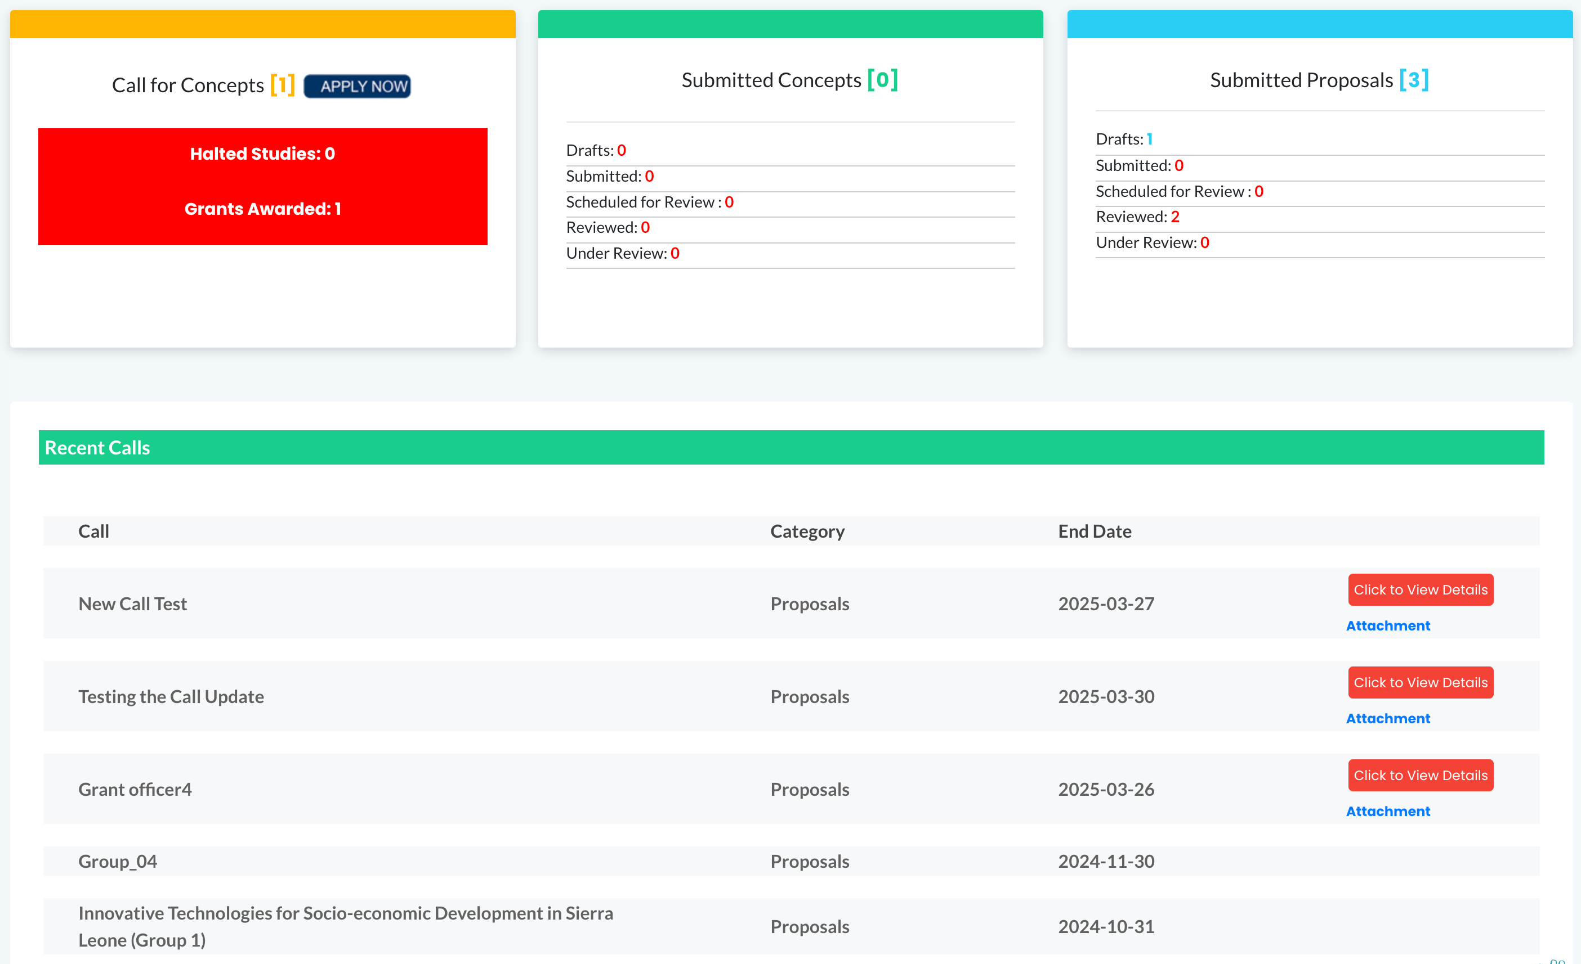
OGMS Peer-to-Peer Learning Meeting | NSTIC
06. Applicant Dashboard
- OLD DESIGN

Slide 31
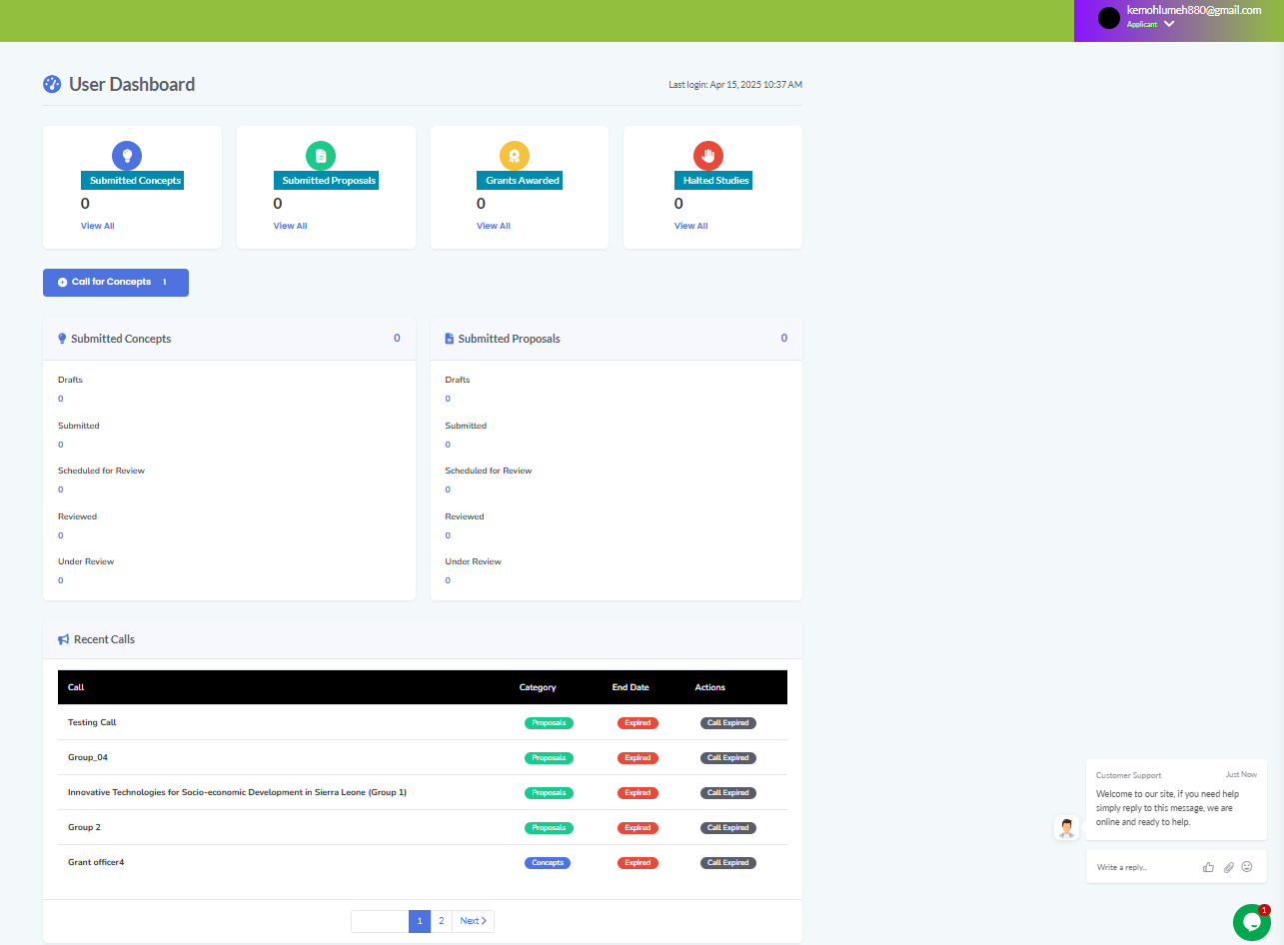
OGMS Peer-to-Peer Learning Meeting | NSTIC
06. Applicant Dashboard
- NEW DESIGN

Slide 32
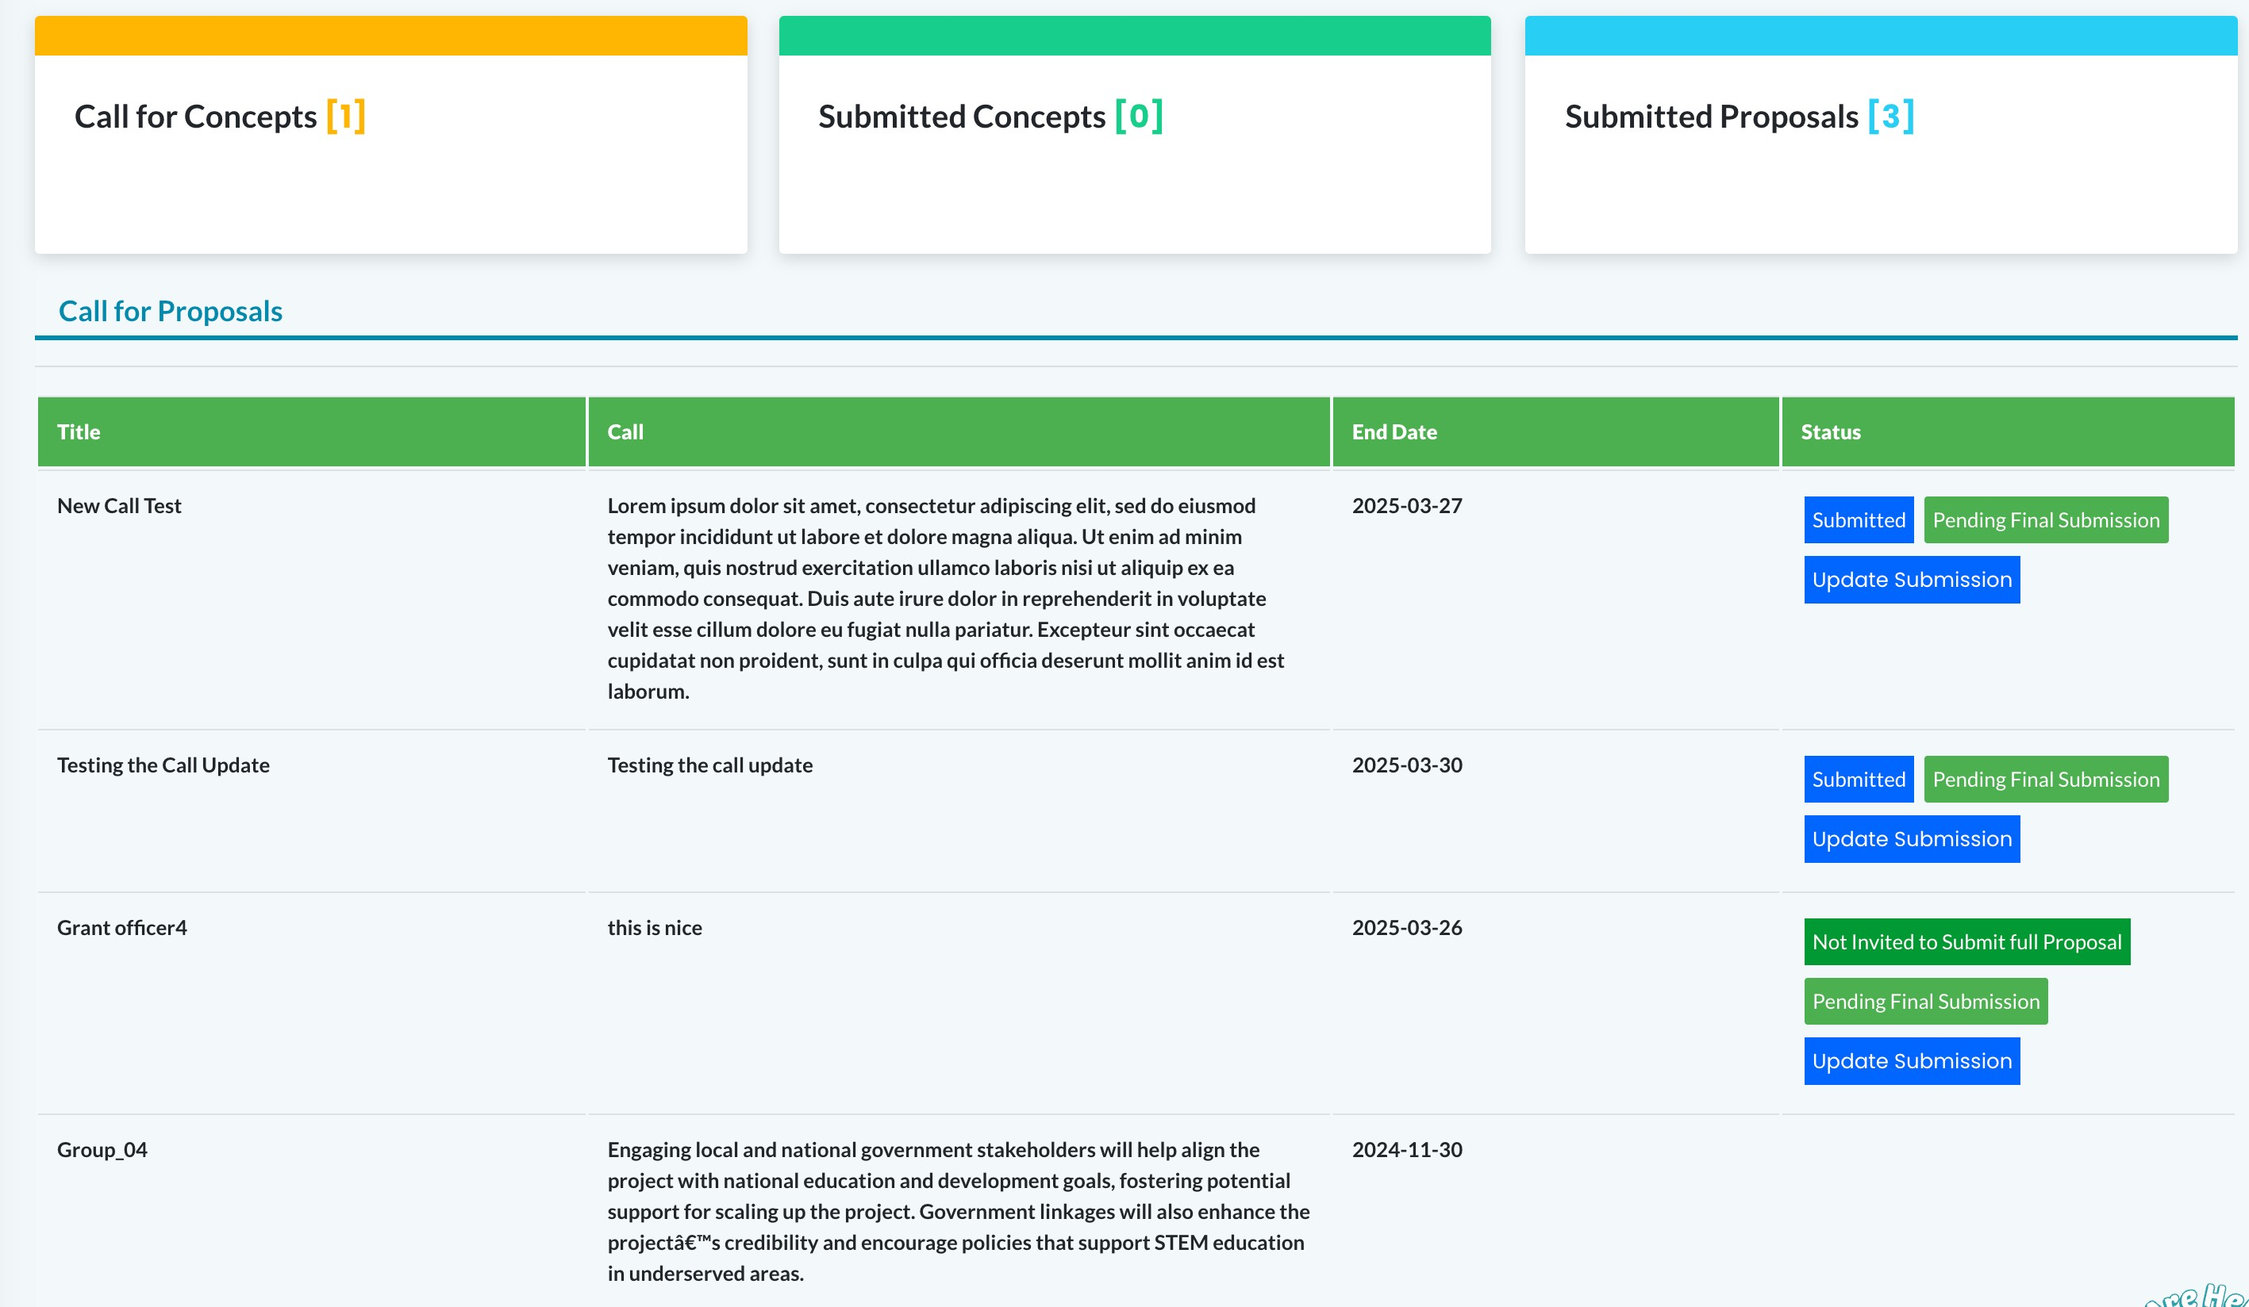
OGMS Peer-to-Peer Learning Meeting | NSTIC
06. Applicant Dashboard
- CALLS OLD DESIGN

Slide 33
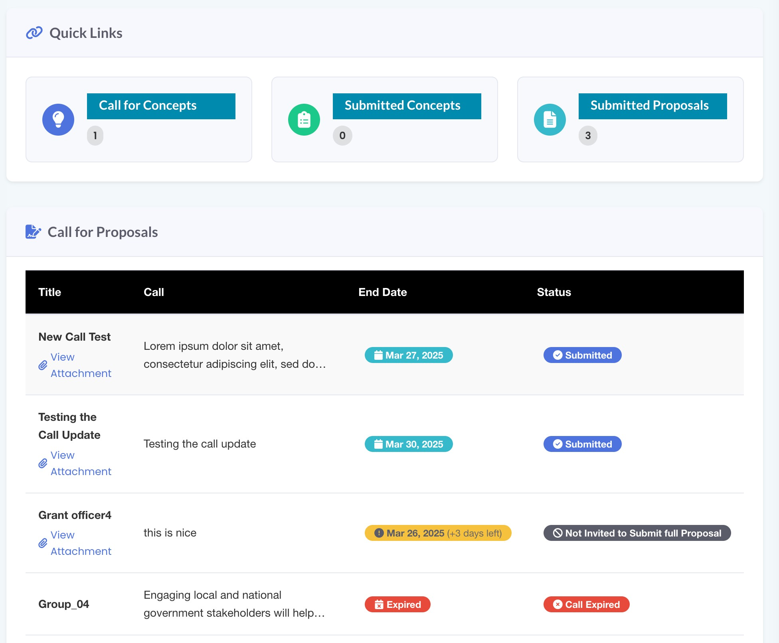
OGMS Peer-to-Peer Learning Meeting | NSTIC
06. Applicant Dashboard
- CALLS NEW DESIGN

Slide 34
OGMS Peer-to-Peer Learning Meeting | NSTIC
07.
REVIEWER DASHBOARD

Slide 35
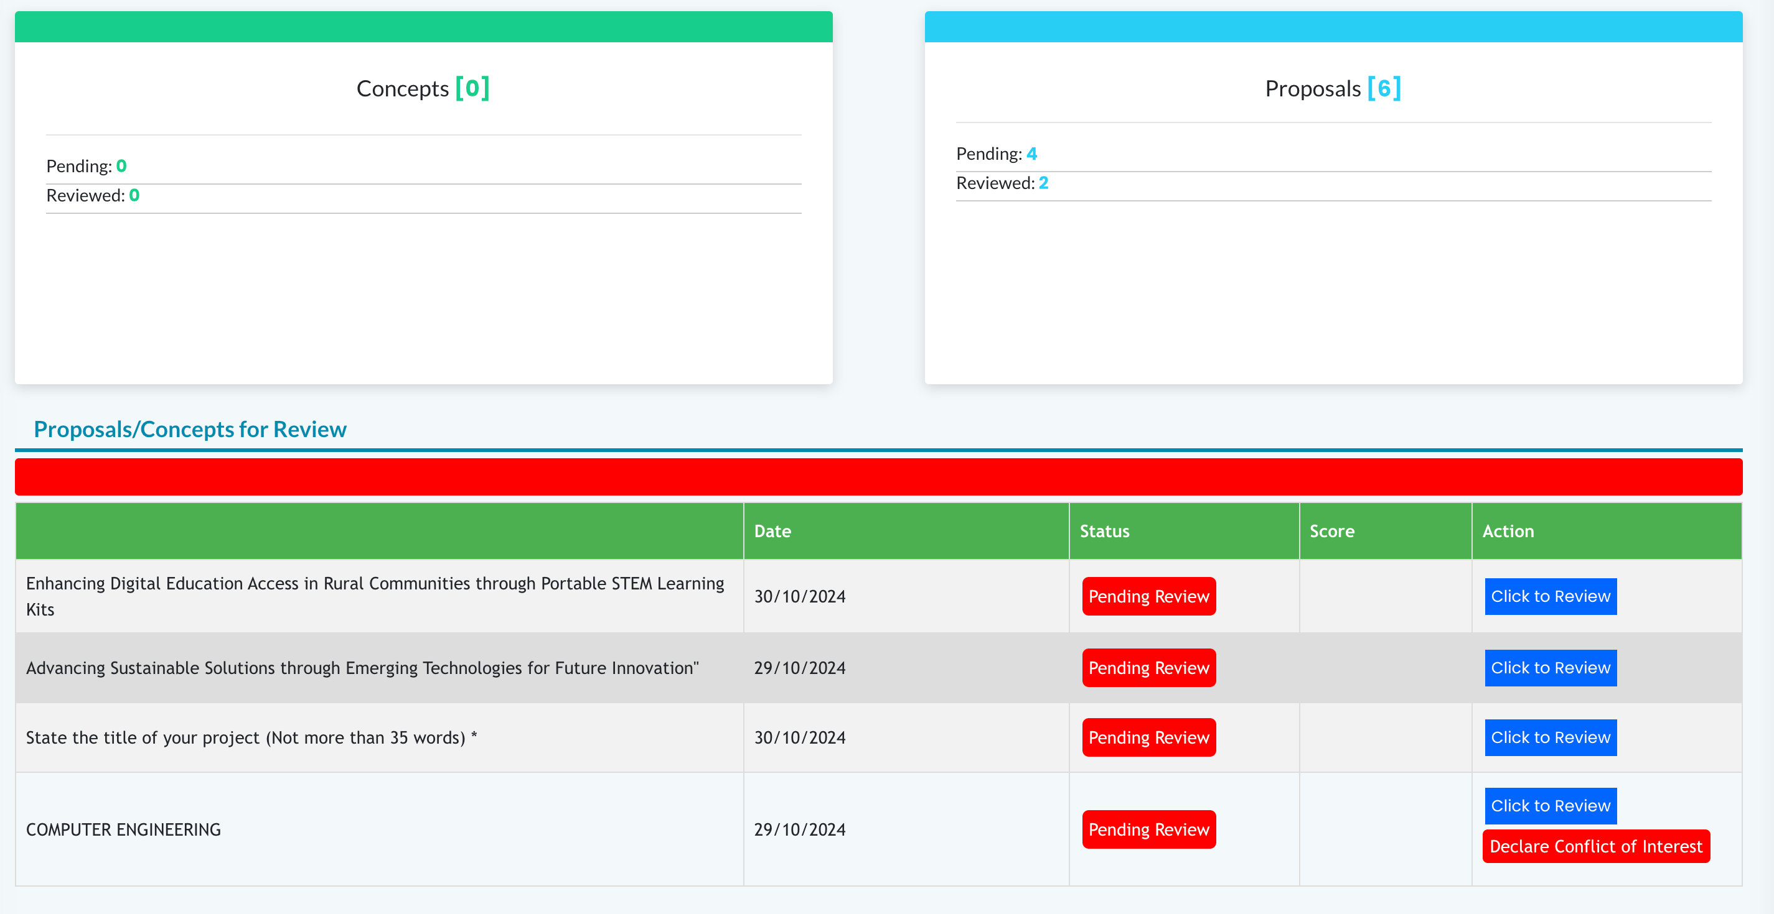
OGMS Peer-to-Peer Learning Meeting | NSTIC
07. Reviewer Dashboard
- OLD DESIGN

Slide 36
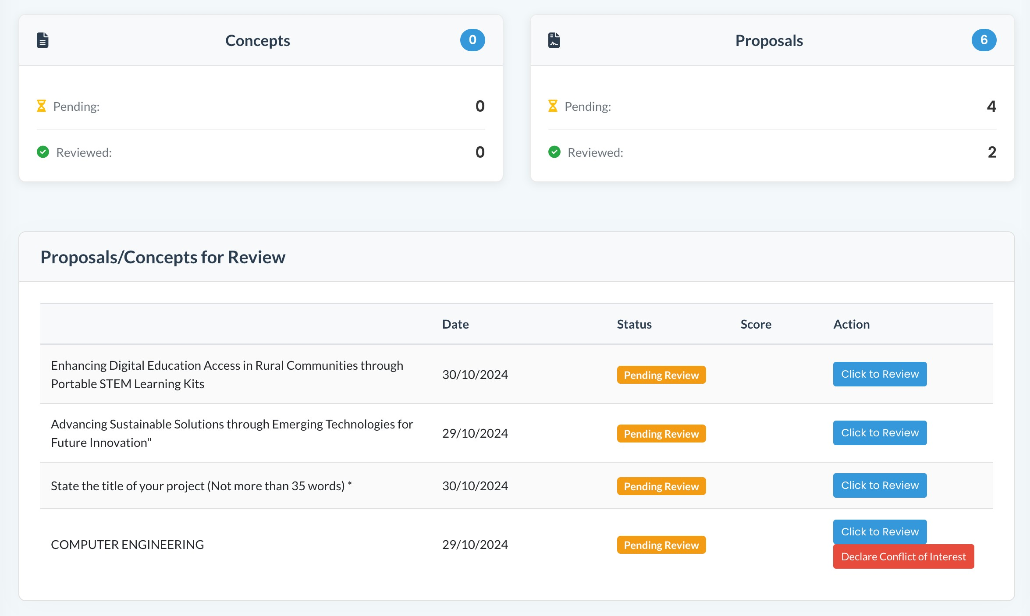
OGMS Peer-to-Peer Learning Meeting | NSTIC
07. Reviewer Dashboard
- NEW DESIGN

Slide 37
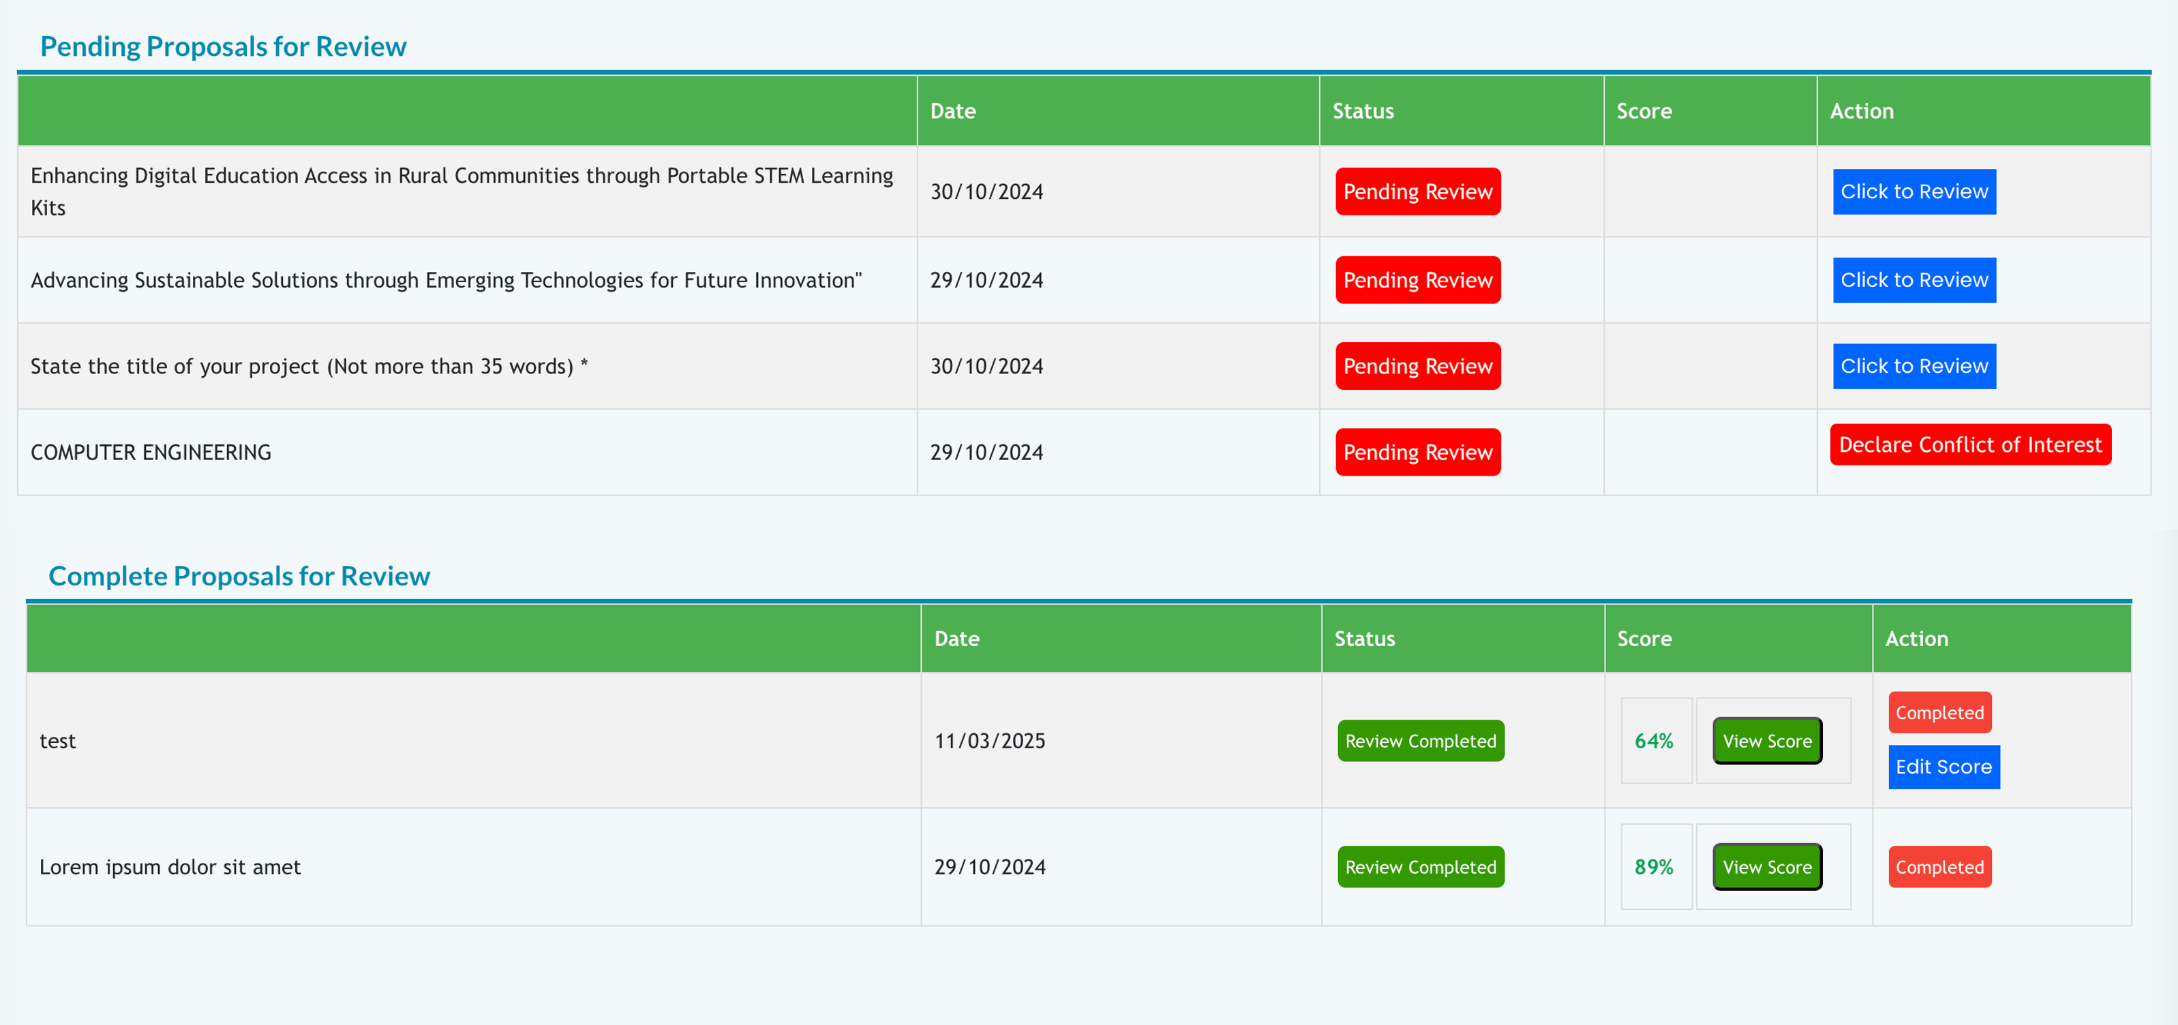
OGMS Peer-to-Peer Learning Meeting | NSTIC
07. Reviewer Dashboard
- PROPOSALS / OLD DESIGN

Slide 38
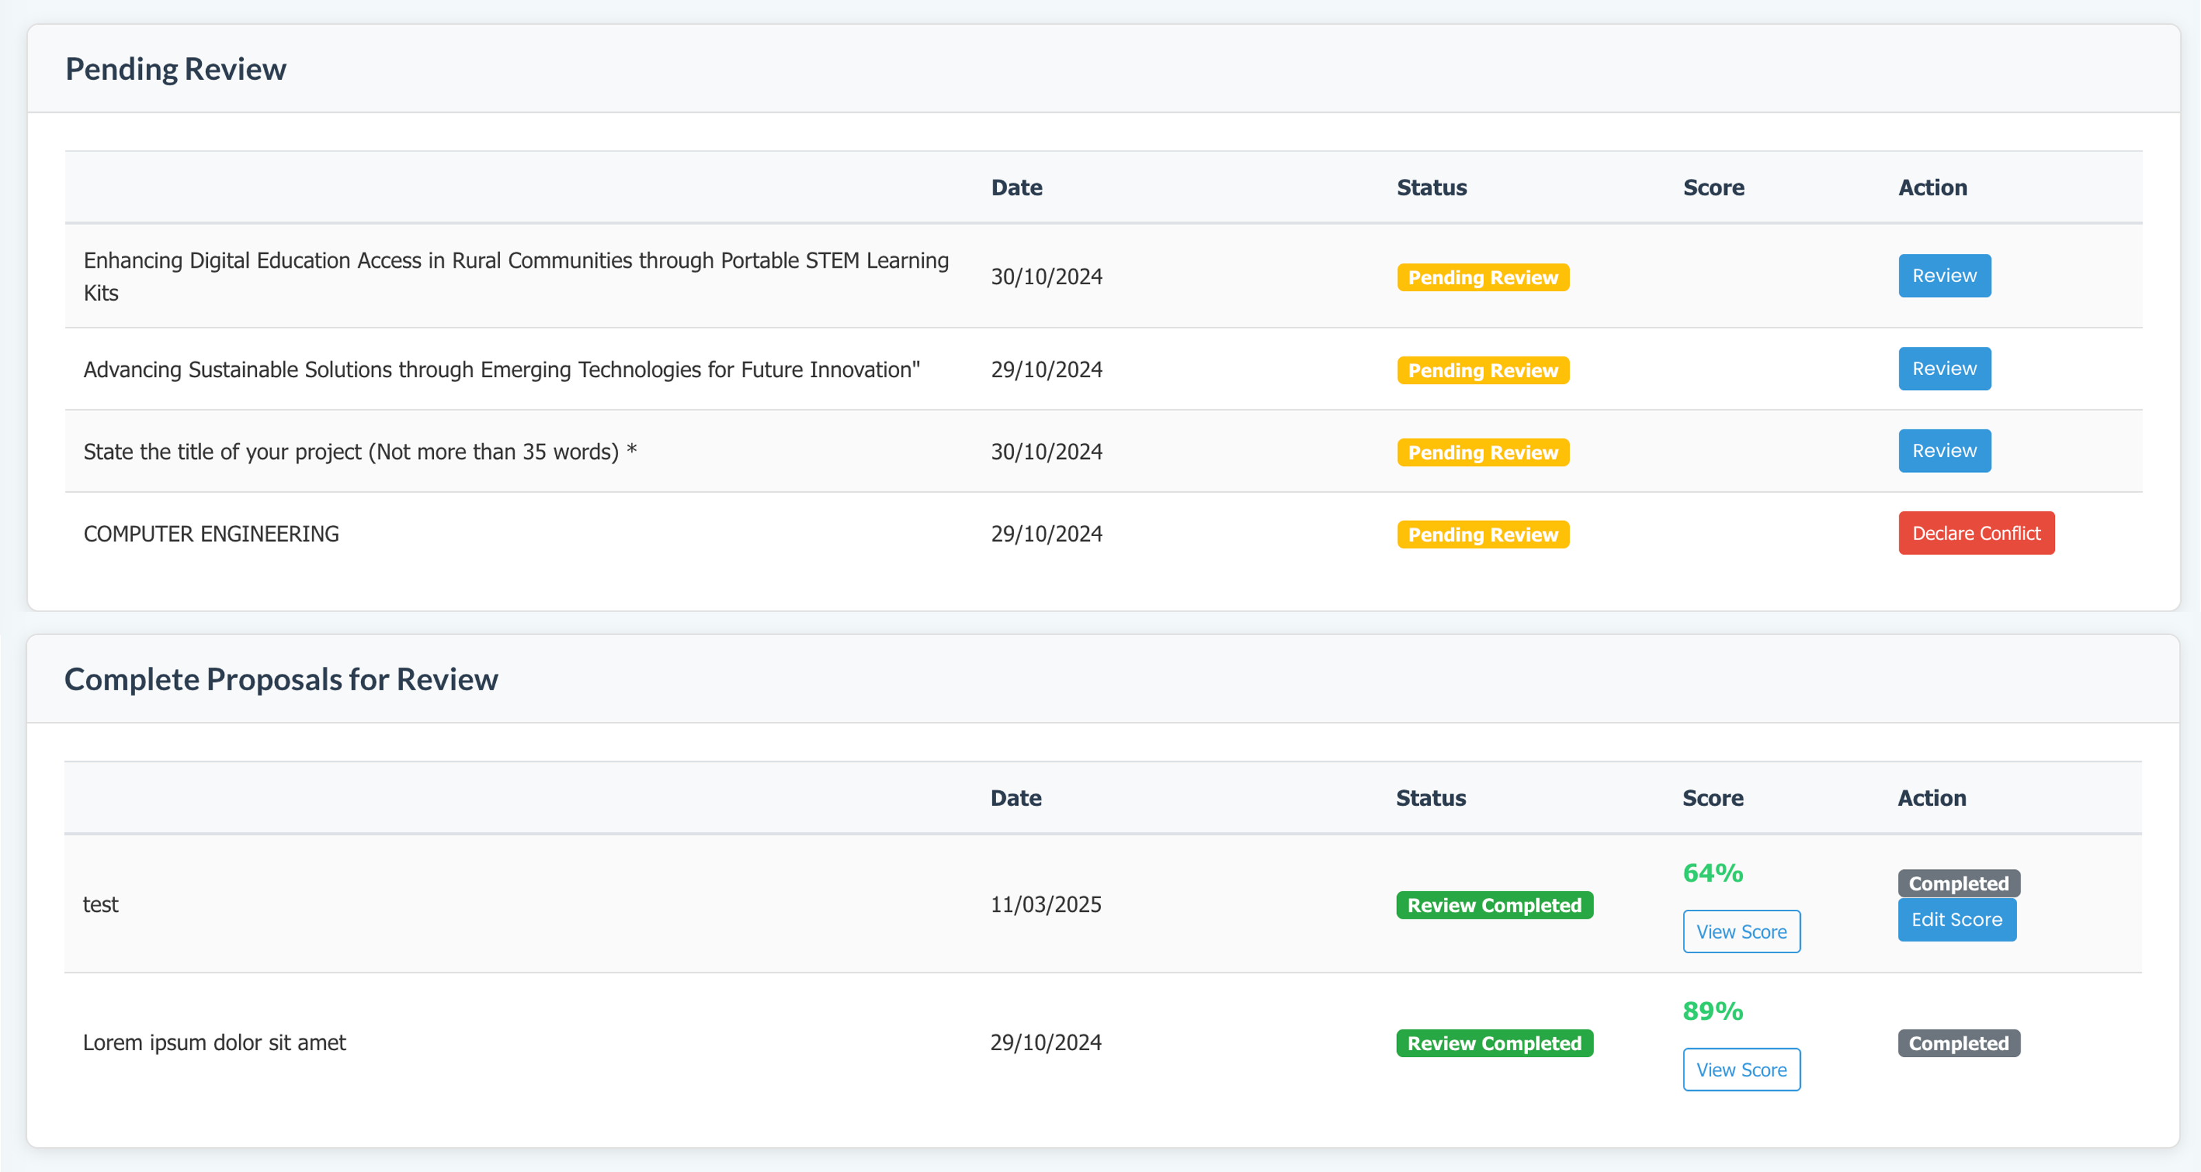
OGMS Peer-to-Peer Learning Meeting | NSTIC
07. Reviewer Dashboard
- PROPOSALS / NEW DESIGN

Slide 39
OGMS Peer-to-Peer Learning Meeting | NSTIC
08.
USER ENHANCEMENTS

Slide 40
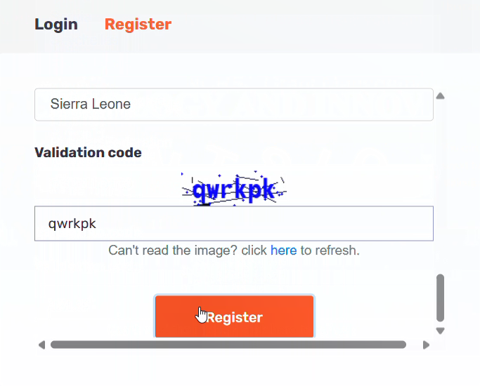
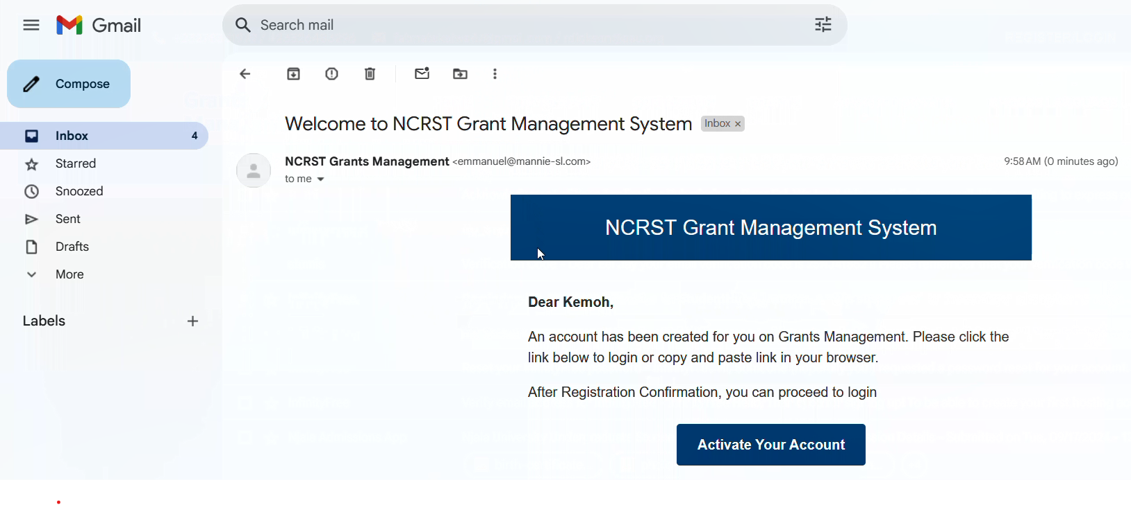
OGMS Peer-to-Peer Learning Meeting | NSTIC
Applicants now receives “Account Activation” mail in their “Inbox” instead of the “Spam” section or sometimes don’t receive any mail
Applicant Creating Account in the OGMS
08. User Enhancements
- EMAIL ON APPLICANT ACCOUNT ACTIVATION

Slide 41
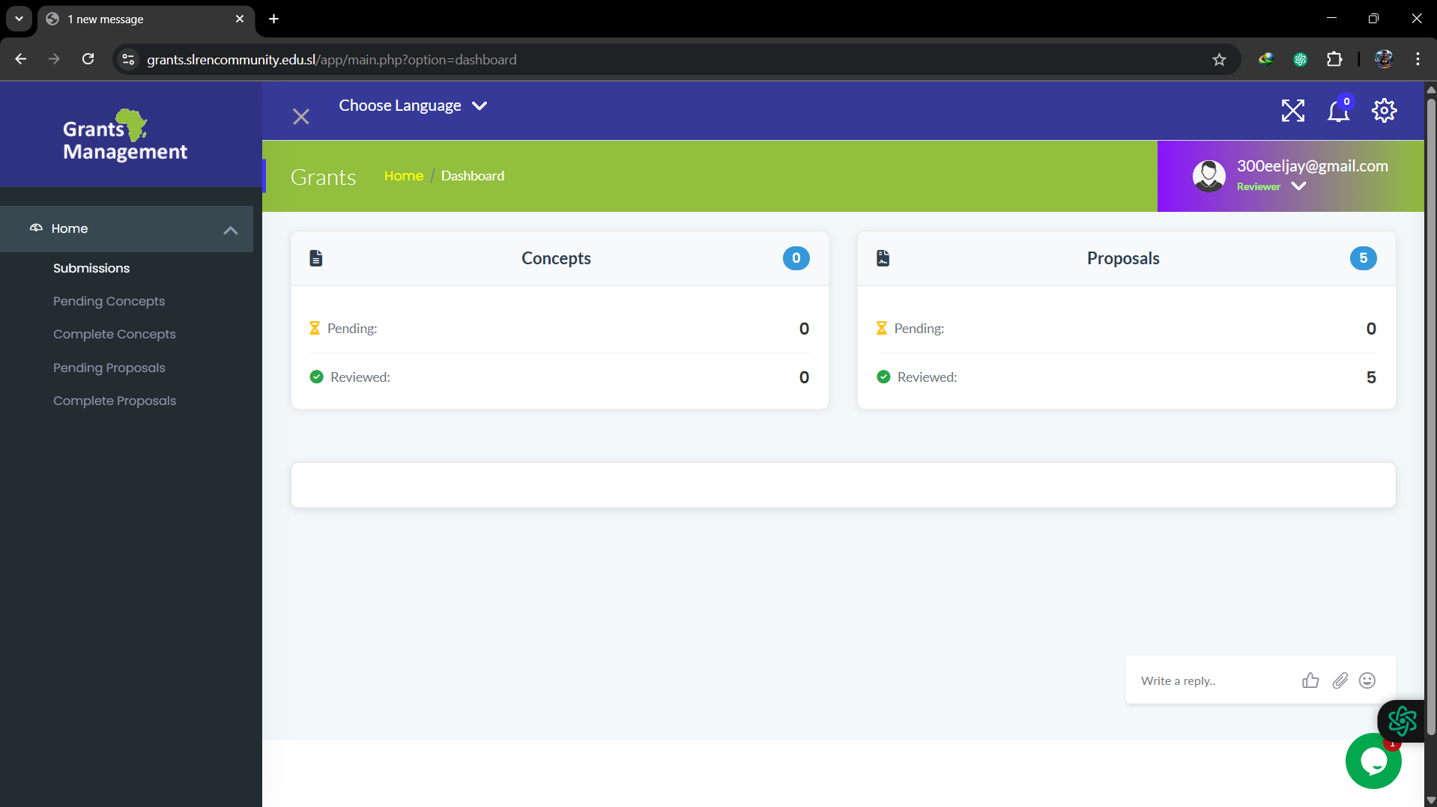
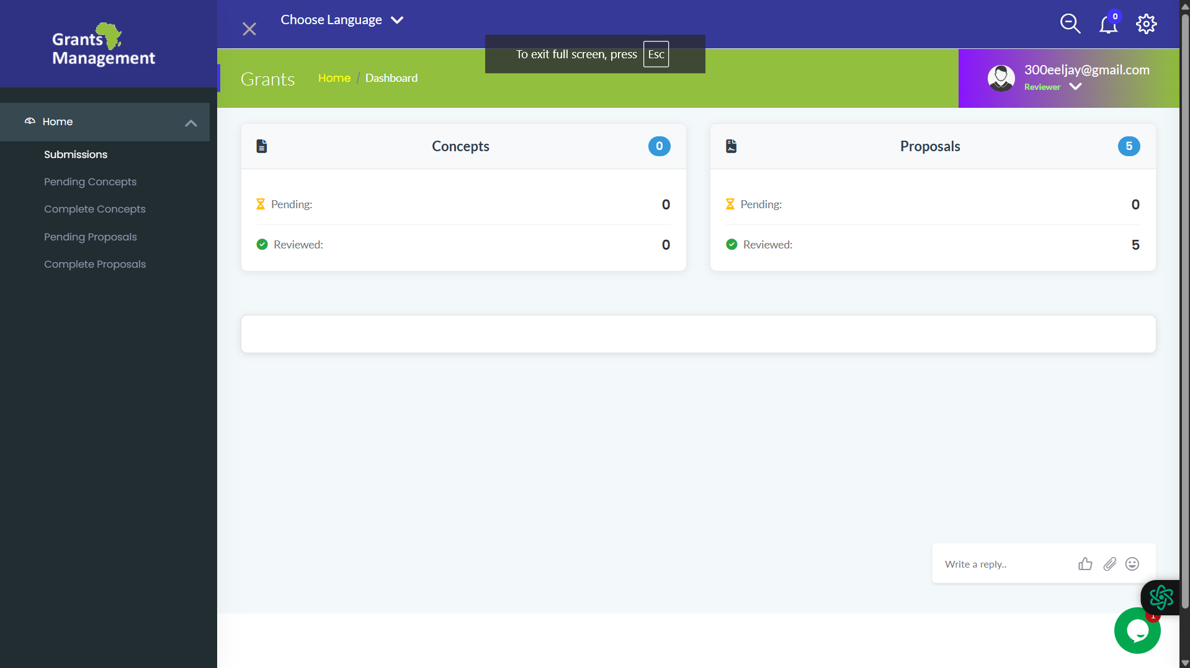
OGMS Peer-to-Peer Learning Meeting | NSTIC
Default View with
Browser Interface
Full-Screen Mode
Once logged in—whether as a Grant Officer, Applicant, or Reviewer—users can switch to full-screen mode, allowing the platform to appear just like a dedicated software application. This removes distractions such as browser tabs and other interface elements, helping users stay focused.
08. User Enhancements
- DISTRACTION-FREE FULL-SCREEN EXPERIENCE

Slide 42
OGMS Peer-to-Peer Learning Meeting | NSTIC
THANKS FOR
YOUR ATTENTION.

