Slide 1
AN OVERVIEW OF THE NATIONAL SCIENCE, TECHNOLOGY & INNOVATION COUNCIL SIERRA LEONE (NSTIC_SL)
PEER-TO-PEER LEARNING UNDER THE SGCI RESEARCH MANAGEMENT PROJECTS
7-9 May 2025
NSTIC-SL,
Ministry for Technical and Higher Education, Sierra Leone

Slide 2
PRESENTATION PROFILE
Background
Achievements
Challenges Faced
Progress Made
Way Forward
Conclusion (Recommendations and Experience)

Slide 3
Genesis of the National ST&I Policy and Council
S&T Council established by Cabinet in 2001 under MoDEP
Non-statutory and ad hoc interim Science and Technology Committee in 1978 under MoDEP
NSTIC 2023 under MTHE
Directorate of STI (2018) (currently under the Office of HE the President)
Draft National S&T Policy 2009

Slide 4
ABOUT NSTIC_SL
SGCI Membership
Full member since 2023, observer since 2019.
Mission
Strengthening advocacy and management of STI interventions in Sierra Leone.
Vision
To ensure sustainable growth and development in Sierra Leone that is led by Science and Technology.
Notes:
(NSTIC) was established in February 2023, through a cabinet paper. It is to operate as a statutory body attached to the Ministry of Technical and Higher Education.
Mission: “strengthening advocacy and management of STI interventions in Sierra Leone”.
The Council’s Vision: “To ensure sustainable growth and development in Sierra Leone that is led by Science and Technology”

Slide 5
NSTIC CORE MANDATE
To promote, regulate and coordinate research and innovation in Sierra Leone.
To mobilize resources for science, technology and innovation (STI)
To promote science and technology so as to improve the quality of life of the people of Sierra Leone.
To advise Government on STI matters, among other functions

Slide 6
Proposed STI and Research Committees of NSTIC-SL
S/N | Proposed STI and Research Committees of Council including a mandate for policy formulation
1 | Grants Management System and Portal maintenance
2 | MEL including Research Ethics
3 | Intellectual Property and Audit
4 | STI & OS Policies promotion including STEAM
5 | Emerging technologies and innovation (including AI, IoT, drones, etc)
6 | Gender Diversity and Inclusion
7 | Food Security and Modern Agriculture
8 | Energy and Climate Change Research
Notes:
1. Produce stove that use different types of biofuel for less fuel use and low level of pollution.

Slide 7
POLICY OBJECTIVES AND NSTIC_SL THEMATIC AREAS
Health
Food Security and Modern Agriculture
Energy
New and Emerging Technologies
Environmental Sustainability, Natural Resources and Climate change
Human Capital Development in STI & STEM
National Cohesion and Security
Tourism

Slide 8
KEY ACHEIVEMENTS
Government Cabinet Approval of STI Policy and NSTIC
Collaboration with SLREN in the development of a national Open Science Policy
STI & OS Policy Validation, Priority Setting & National Stakeholder Mapping jointly with SLREN
Capacity Building and Training
Development and Approval of NSTIC Research and Innovation Framework (RIF)
Notes:
RIF: For each objective/Themes, outline activities, performance indicators and potential societal impact
I will elaborate on some of these achievements

Slide 9
KEY ACHEIVEMENTS
5 Funded STI research Projects: 1st Call
Development of NSTIC MEL Logframe
Public Private Partnership multi-stakeholder workshop
Developing a Grant Management System
Notes:
RIF: For each objective/Themes, outline activities, performance indicators and potential societal impact
I will elaborate on some of these achievements

Slide 10
ON-GOING COLLABORATION
Partnership with Councils in Uganda, Tanzania and Kenya on a proposal development in response to an IDRC call on Vaccine development and innovation.
Deadline for submission – 6th June 2025.

Slide 11
ON-GOING COLLABORATION
The Call aims at allowing SGCs to collaborate in developing a research agenda that:
Identifies and builds on shared development priorities linked to vaccine innovation that can be addressed through a collaborative research call.
Relies on scientific and technological strengths (human capacity, existing programs and infrastructure, etc.) of the participating countries.
Strengthens the capacity of SGCs and key actors in the health research landscape.

Slide 12
Capacity Building and Training
Research & Innovation Framework (RIF)
IP Audit
3
MEL
1
2
Conduct training on conducting an IP audit to protect intellectual property.
Enhance monitoring, evaluation, and learning (MEL) skills for research projects.
MEL Log Framework
Provide training on developing a comprehensive RIF to guide research activities.
4
Grant Craftmanship
5
Grant Management System
6
Research Excellence and Ethics
Enhance skills in accessing and writing winnable grant proposals
Training on how to develop and manage a robust and flexible grant management portal system
Introduction to Research Excellence and Research Ethics

Slide 13
Capacity Building and Trainings
7
Use of the Technomart platform
8
Visits to more established SGCs
Technomart platform sharing of research equipment and facilities.
Learning about the operations and management of more established Councils in Africa. Peer-to-Peer visits have already been made to Uganda and Kenya.
9
P2P learning on the OGMS
Theme: Sustainability and Maintenenace and scalability of digital Grants Management Systems.

Slide 14
5 Funded Projects
THEMES | RESEARCH TOPIC | RESEARCH INSTITUTIONS
FOOD SECURITY | Indigenous Vegetable Species for Malnutrition | Njala University
CLEAN ENERGY SOLUTIONS | Multi Biomass Fueled Stove | Fourah Bay College, University of Sierra Leone
HEALTH | Pulmonary Aspergillosis Assessment | College of Medicine and Allied Health Sciences, University of Sierra Leone
EMERGING TECHNOLOGIES | Drone and AI for Vector Control | Njala University
 | Artificial Intelligence In Education - Abu Sense Bod | EASY STEM – a privately owned young software development company

Slide 15
Evaluation Of Indigenous Vegetable Species’ Potential As Alternatives To Tackle Malnutrition And Food Insecurity At Rural Households In Sierra Leone
AIMS
PROGRESS
Identify indigenous vegetable
Classifying indigenous vegetables into lowest taxonomic level
Evaluation of Nutritive values of indigenous vegetables through Laboratory analysis
Domesticate Production.
Develop management guidelines for sustainable production
Conduct of household survey in 2 districts, 10 communities involving about 1200 participants
Over 30 indigenous vegetable species were sourced, collected and identified to their lowest taxonomic level
Construction of a building that serves as a control room with solar water pump for irrigation
The construction of the nursery site to domestic production ongoing

Slide 16
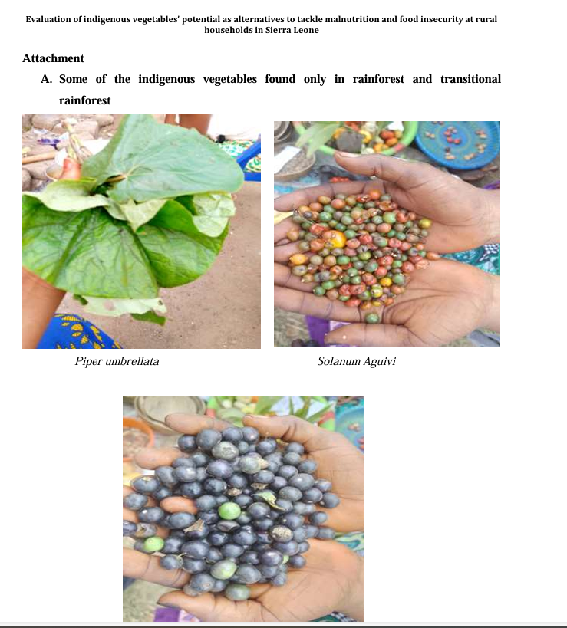
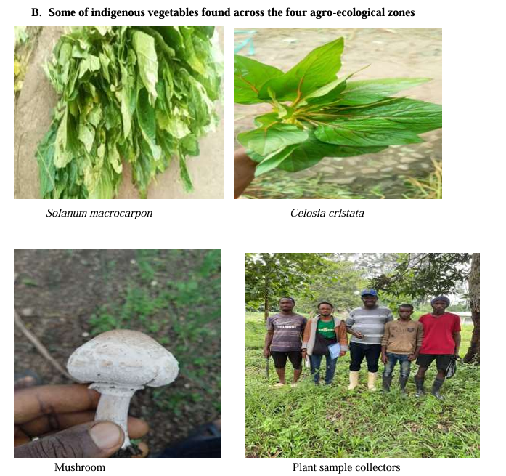
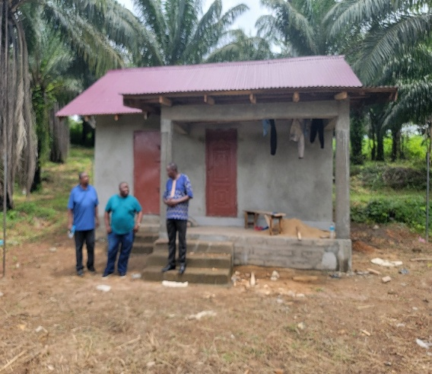
Evaluation Of Indigenous Vegetable Species’ Potential As Alternatives To Tackle Malnutrition And Food Insecurity At Rural Households In Sierra Leone

Slide 17
Incorporating Drone and AI technologies for cost-effective vector controls in Sierra Leone
AIMS
PROGRESS
The main aim is to identify high malaria "infectious risk index" water bodies using AI, drone mapping, and field data.
Development of High-risk house/community detection technology with drone and AI
Develop and explore visible machine learning algorithms to predict malaria infection
Be able to predict disease outbreaks and assist in planning health interventions
Household surveys and Focus group discussions with all stakeholders completed
Entomological data collection was completed where larvae habitats have been identified.
Training and skill development of technicians and healthcare workers involved in drone-based flight.
Some drone flights have been undertaken to collaborate field entomological data

Slide 18
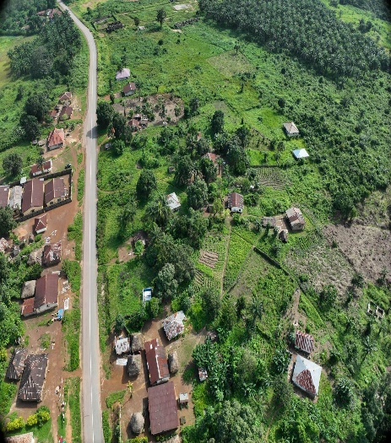
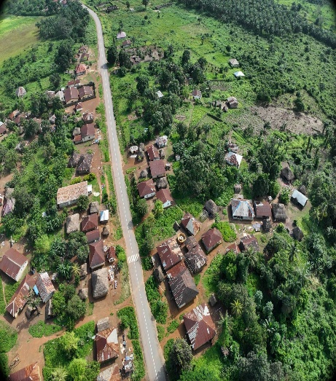
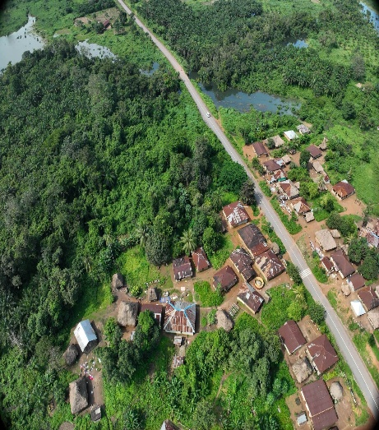
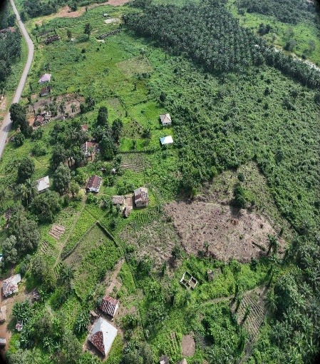
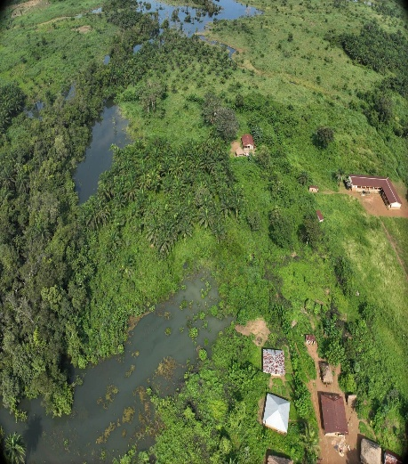
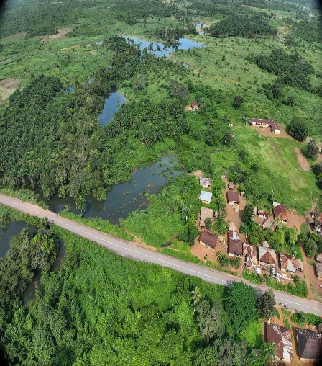
Incorporating Drone and AI technologies for cost-effective vector controls in Sierra Leone

Slide 19
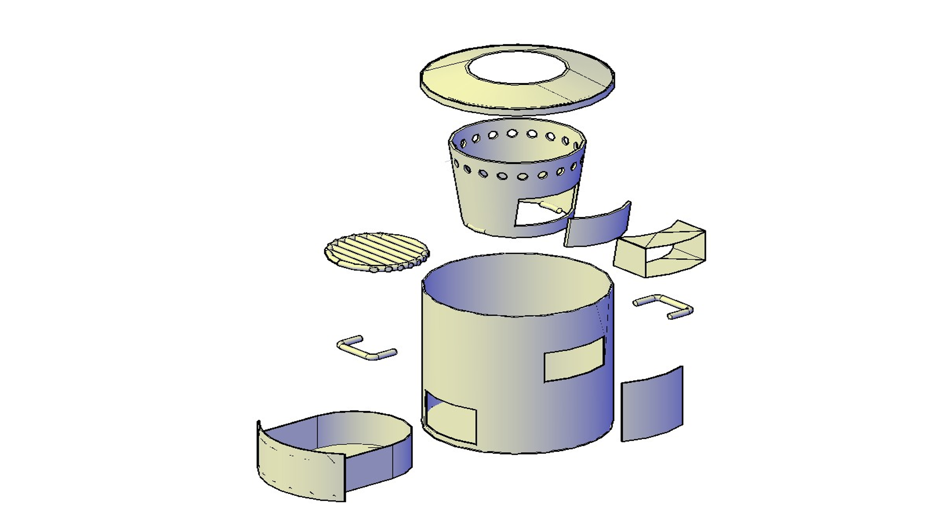
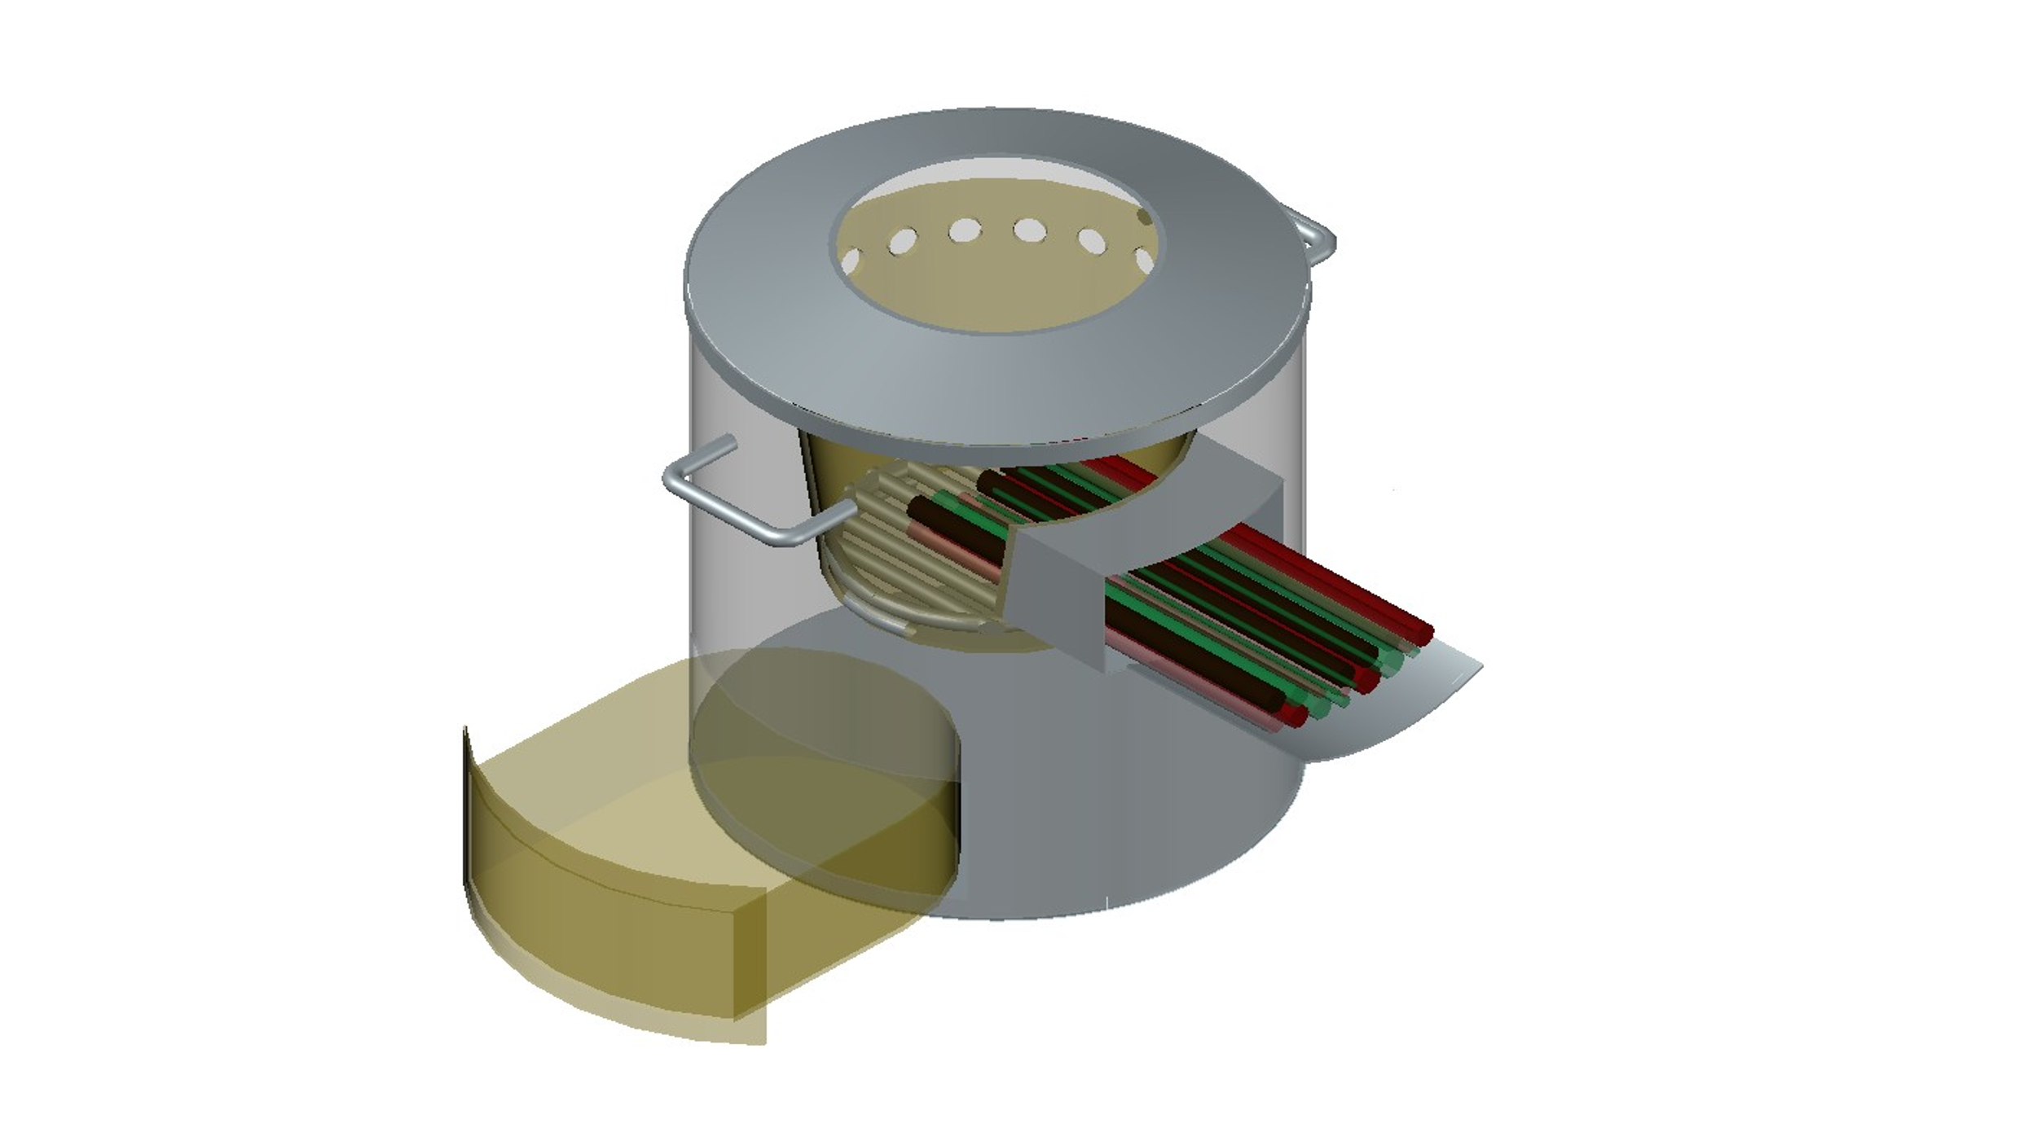
A multi biomass fueled continuously running stove and its environmental and social impact.
AIMS
PROGRESS
Designs and production of biomass fuel stoves that can be made to use less bio-fuel and produce low level of pollutants.
Develop User Manual
Stakeholders’ engagement in the four regions of the country.
Design of four different stove prototypes, including their Engineering drawings with dimensions.
The construction of the test room/kitchen is completed.
Develop a draft user and maintenance manual.

Slide 20
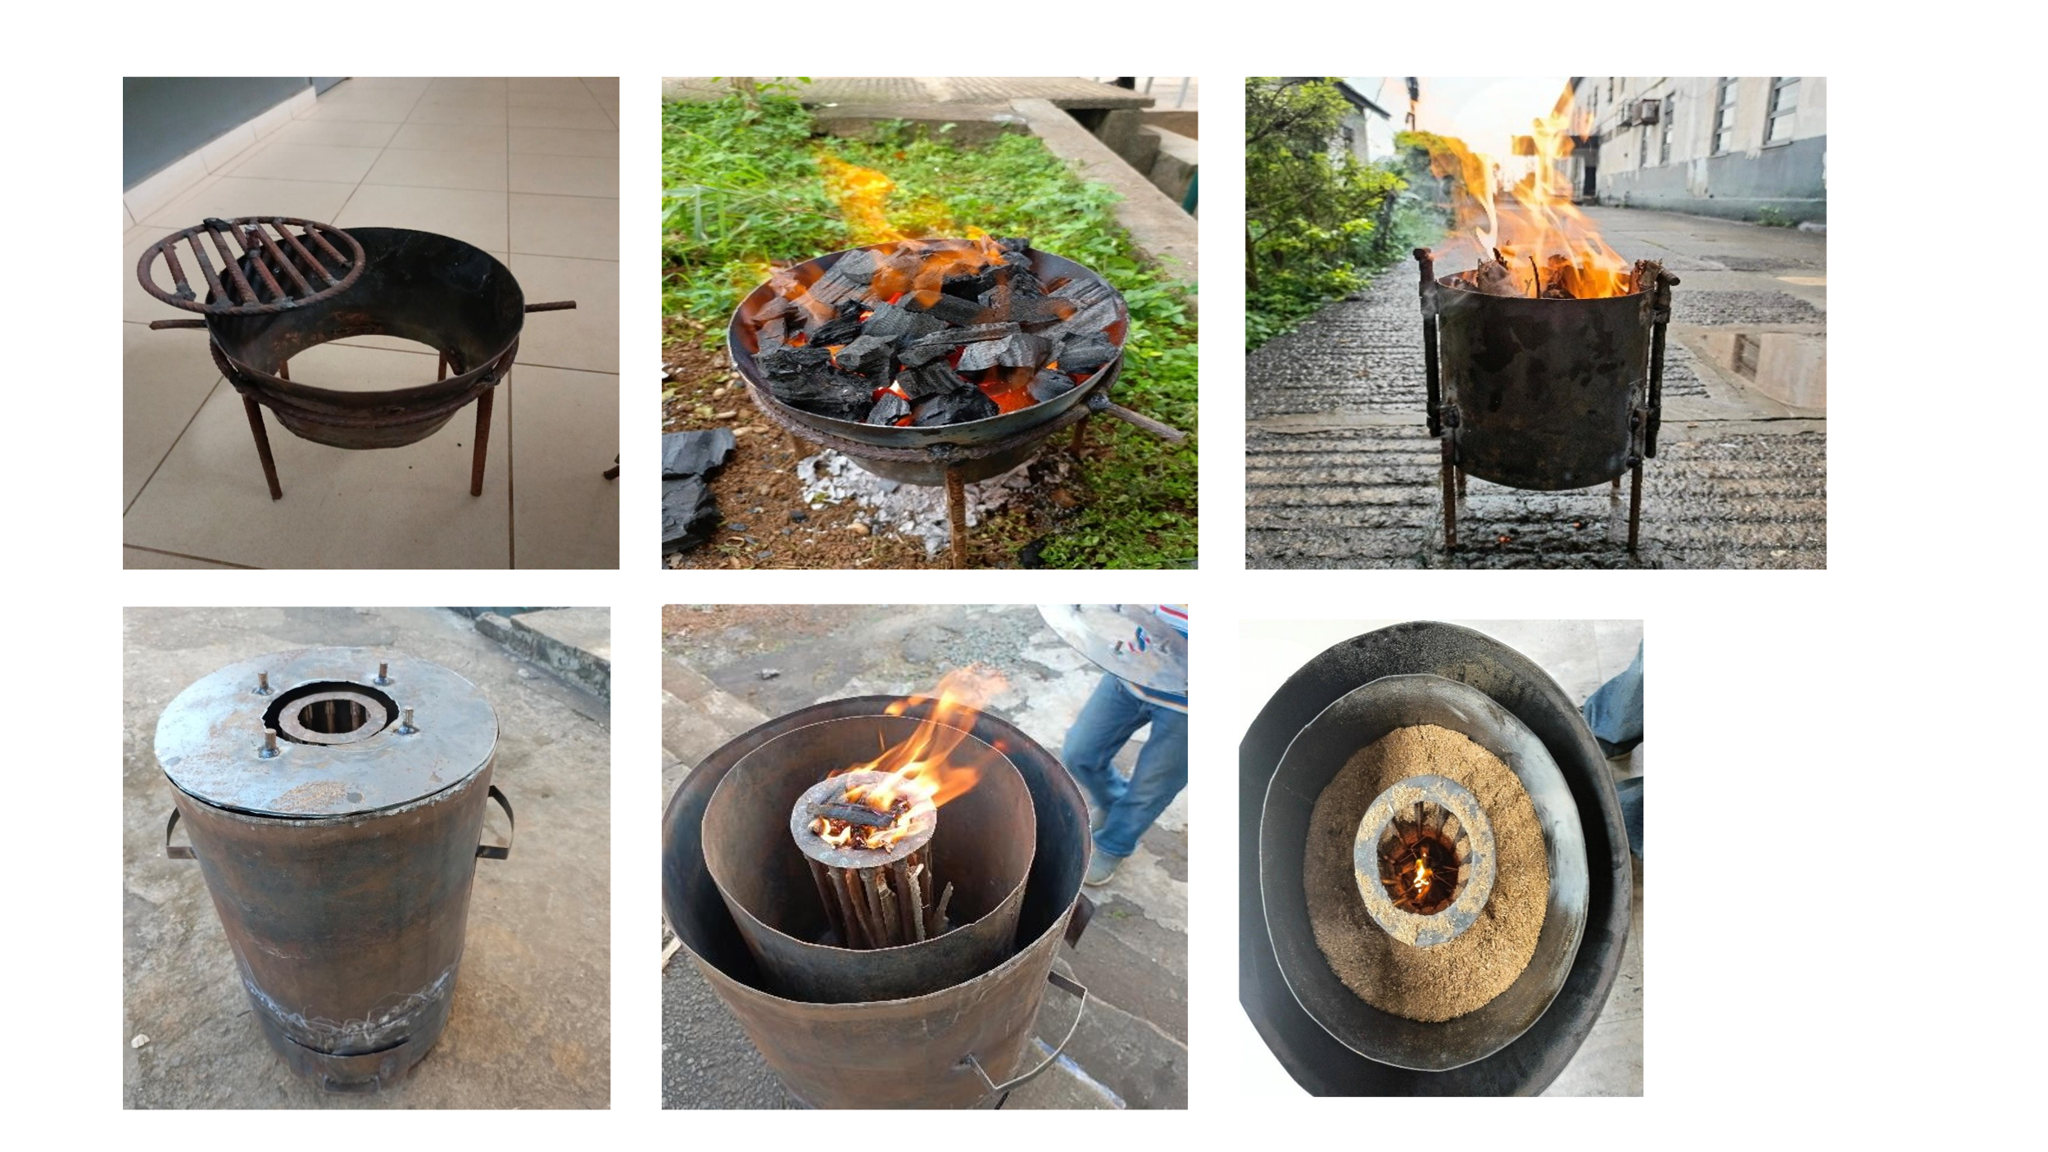
A multi biomass fueled continuously running stove and its environmental and social impact.

Slide 21
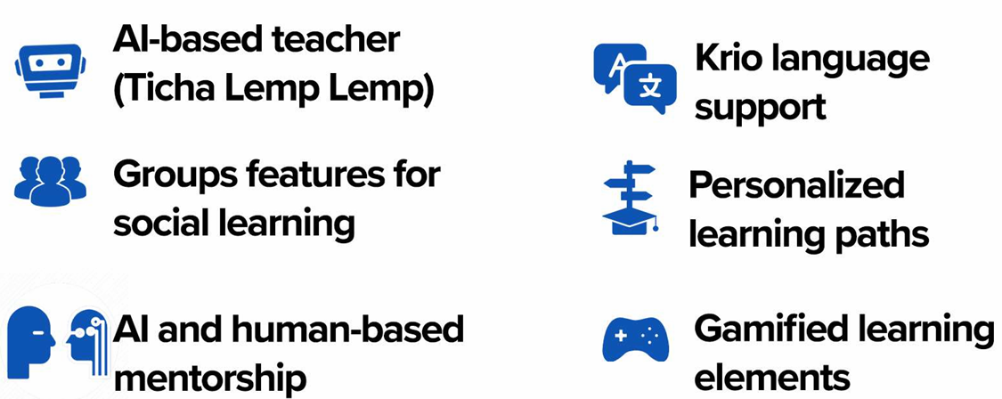
Artificial Intelligence in Education - Abu Sense Bod.
KEY FEATURES
PROGRESS
User Requirement research across 20 schools and involving over 1,000 students completed .
Frontend development at 90% completed
Backend development is at an advanced stage
Integration of local language support has been Successful.
Implemented AI teacher (Ticha Lemp Lemp)

Slide 22
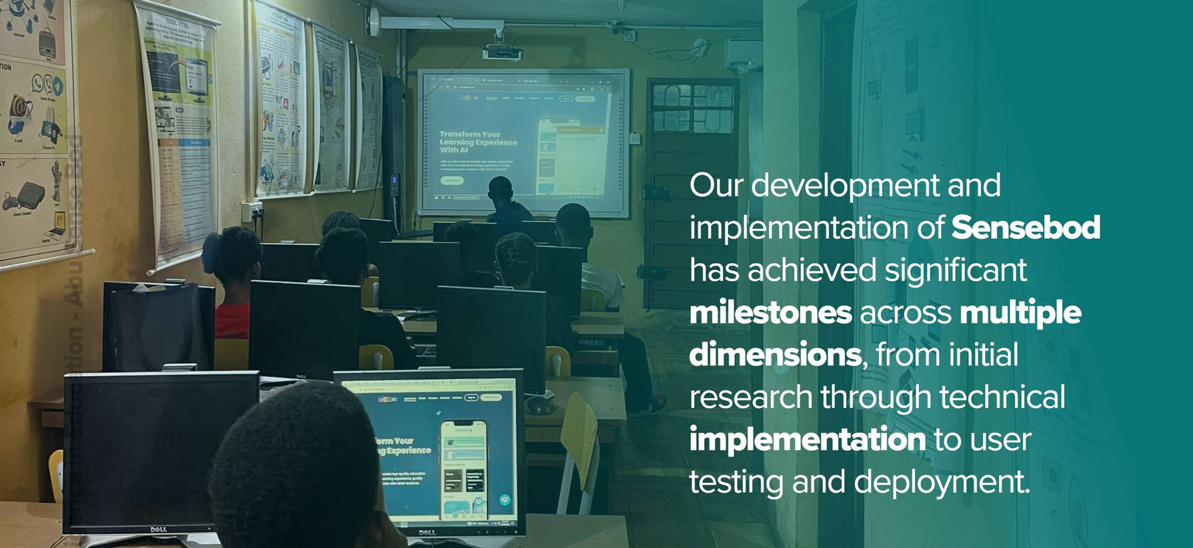
Artificial Intelligence in Education - Abu Sense Bod.

Slide 23
Expanded Pulmonary Aspergillosis assessment in patients with respiratory diseases in Sierra Leone (ePARSLE).
AIMS
PROGRESS
Collection of data samples from suspected TB Patients.
Do Primary and Secondary Data analysis
Developed Telehealth platform
Training of heath care workers
Obtain ethical approval
Conduct stakeholders’ engagement in the six project regions.
Procurement of test kits, laboratory consumables and other diagnostic tools.
Commencement of data collection
Establishment of the Telehealth platform

Slide 24
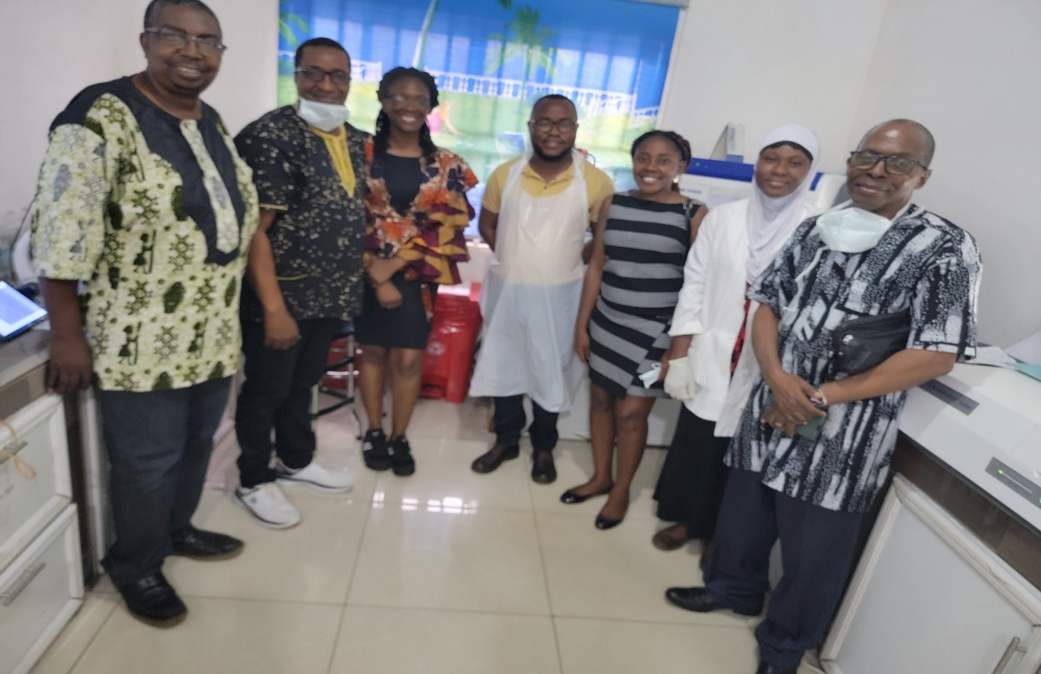
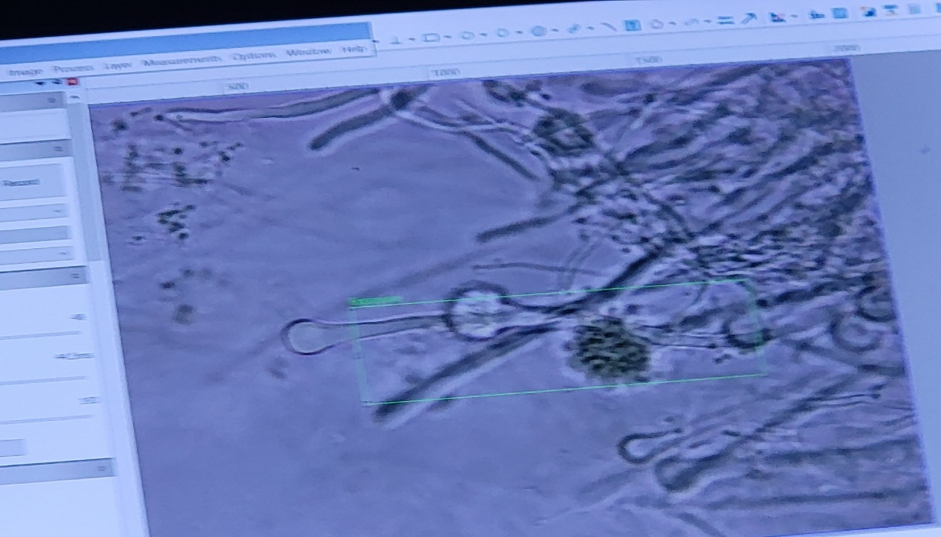
Expanded Pulmonary Aspergillosis assessment in patients with respiratory diseases in Sierra Leone (ePARSLE).
A positive case for Aspergillosis

Slide 25
NSTIC’s Immediate Priorities and challenges and Progress Made
S/N | Strategic Action | To start | Ongoing | Completed
1 | Develop its strategic plan | √
2 | Establish Secretariat and Recruit administrative staff | √
3 | Capacitate the Council and administrative staff |  | √
4 | Popularize the STI & OS Policies nationwide |  |  | √
5 | Develop a grants management system |  | √
6 | Learning Visits to High-performance Councils |  | √
7 | Undertake IP Audit in HEIs and Research Institutions and develop IPR Policy |  | √
8 | Design and manage high quality research Calls |  | √

Slide 26
NSTIC’s Way Forward
S/N | Strategic Action | Ongoing | Comments
1 | Develop its strategic plan |  | Working with MESTI
2 | Establish Secretariat and Recruit administrative staff |  | Funding remains a challenge
3 | Popularize the STI & OS Policies nationwide |  | Task force groups established not fully functional

Slide 27
NSTIC’s Way Forward
S/N | Strategic Action | Ongoing | Comments
5 | Develop a grants management system | √ | Establishing incentives to retain the interests of the software developpers. Establish income generation
7 | Undertake IP Audit in HEIs and Research Institutions and develop IPR Policy | √ | Limited funding. Escalating to other HEIs and migrating to our Repositories. Support from SLREN promised
8 | Design and manage high quality research Calls | √ | Continue to upgrade and update the portal Generate local calls with HEIs and RIs

Slide 28
CONCLUSIONS
NSTIC-SL has greatly benefitted from the support through the SGCI agencies and funders of AAU, ACTS, ATPS, IDRC, FCDO through WACREN
NSTIC-SL continues to engage with the Uganda SCG in the evolution of our portal and support for our young software developpers.
The P2P learning activities have greatly benefited our relatively young Council in getting its focus sharpened, and realizing that we are not alone in encountering challenges and working at their solutions.
Funding for the setting up of our Secretariat and recruiting Administrative personnel is a big challenge, and we are continuing to engage our line Ministry for its support.

Slide 29
RECOMMENDATIONS
CTAs to provide a draft calendar of activities for the year to facilitate better planning
CTAs to provide their specific areas of research and innovation that they can fund.
Capacity building through the P2P learning should continue
A comity of users and softwaredevelopersr should be established

