Slide 1
Content
Grant management process
Overview of the OGMS
Benefits of the OGMS
Customization thus far
Challenges faced and solutions implemented
Sustainability Plan of the OGMS
Additional modules or features recommendations for the OGMS

Slide 2
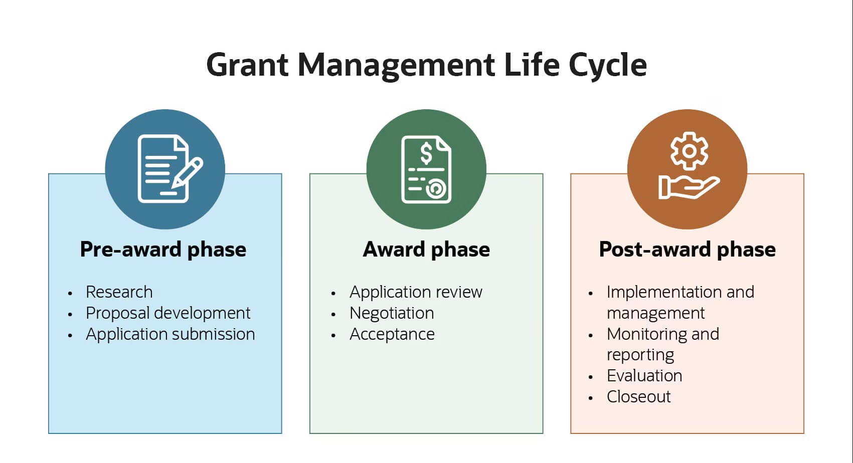
Grant management process
All above activities were done manually, hence the introduction of the online grant management system

Slide 3
Overview and functionalities of the online grant management system
Customized and implemented internally since 2023
8 calls advertised; all have been awarded- under implementation
As of now, there are 457 users, and a total of 85 submissions have been received
Key Features
The NCRST Online Grant Management System encompasses several essential functionalities:
Application Portal: Researchers can submit their grant applications online, ensuring a streamlined process.
Document Management: The system allows for the efficient handling of all related documentation, including applications, agreements, and reports.
Reviewers Portal: Allows for evaluation of proposals to be done on the system by reviewers
Grants officer/ management Portal: Management of grant, reporting on grant outcomes, enhancing accountability.
Super Admin Portal: IT office
Communication Tools: The platform facilitates communication between applicants and NCRST officials for queries and support.

Slide 4
Benefits of the OGMS (to Researchers and the NCRST)
Automated Grant Management:
Reduced manual work, saving time and resources.
Faster application processing and evaluation.
Streamlined grant processes through automation (Reporting reminders).
Enhance monitoring and evaluation of funded projects
Increased Confidence of Potential Donors Resource Mobilisation Tool:
Transparent and efficient grant management system.
Clear documentation of projects and their progress.
Gain trust and confidence of potential donors.
Real-Time Data and Reporting:
Easy access to real-time data for informed decision-making.
Efficient tracking of grant utilization and impact.
Enhanced reporting to stakeholders.
Improve transparency and accessibility for researchers, reviewers and institutions.

Slide 5
Modifications/ changes to the system?
Applicants Portal
Captcha verification implemented for enhanced security
Award amounts and currencies display on the applicant’s budget
Added 'Submit' and 'Next' buttons
Made research attachments mandatory.
Users’ downloadable submission
Grants Office Portal
Rejection automated email
Award decision modification
“Reject with comments” changed to “Accept with comments”

Slide 6
Modifications/ changes to the system?
Grants Office Portal
Dropdown on Review Progress Report
Technical Report heading from financial report
Corrected scoring errors and display issues on proposal review pages
Reviewers Portal
Resolved issues with email notifications for reviewers.
Enabled re-assignment of reviewers.

Slide 7
Challenges and solutions
1. Access and Login Issues
Challenge: Reviewers previously registered as applicants faced login difficulties.
Impact: Delays in review processes due to credential or system role conflicts.
Solution: Registered with different credentials for differentiation
Recommendation: Implement role-based access profiles and ensure seamless role-switching capabilities.
2. System Cache Interference
Challenge: Applicants are hindered by system cache issues that delayed the grant management process.
Impact: Time lost due to outdated data or session conflicts.
Solution: manual cache clearing

Slide 8
Challenges faced thus far
3. Upload and Submission Issues
Challenge: Reviewers experienced difficulty uploading review marks.
Challenge: Applicants could not upload required documents due to system glitches.
Impact: Incomplete submissions; potential loss of review data.
Recommendation: Improve file handling reliability and implement clearer user prompts or fail-safes (e.g., save drafts, upload confirmation messages)
4. Incomplete Rejection Workflow
Challenge: Rejected project proposals do not appear under the “Rejected Proposals” tab after completion checks.
Challenge: Once applications are rejected post-completion check, grant officers cannot download them.
Impact: Loss of transparency and inability to audit or reprocess rejected submissions.
Solution/ Recommendation: Revise system logic to log and archive all proposal states and enable continued access for administrative users (√)
5. Internal Software Developer on study leave

Slide 9
Sustainability Plan of the System
Regularly develop and update the system to align with technological advancements.
Awareness on different platforms initiated
Internal Software developers to allow for customisation and fixes
Pamphlet on the GMS drafted
Instructional videos planned

Slide 10
Additional modules or features recommendations
Alerts to applicant on reporting (reminders)
Quarterly, annual and completeness reports
Incorporate a functionality for archiving past Calls (including those outside of the SGCI)
Allow the system to download documents even after project proposals have been rejected
AI can also flag proposals that contain suspicious content or potential plagiarism by comparing them against existing documents. Integration of IThenticate into the internal review process as a module on the system
Use AI to automatically screen proposals for completeness (e.g., check if all required documents are uploaded, if the proposal adheres to word limits or budget constraints).
Introduce an AI-powered notification system that sends contextual reminders to applicants and reviewers about key deadlines, incomplete tasks, or follow-ups.
After reviewers submit their evaluations, the system could use AI to automatically generate feedback for applicants, based on scoring and comments. This would reduce the workload on reviewers and ensure timely responses.

Slide 11
Thank you for listening
Do not forget to visit https://gms.ncrst.na and start your research journey with us!
.

