Slide 1
Maximizing Ownership: Maintaining a Functional OGMS
ABENA POKUAH DEDE CORLETEY
ASSITANT SOFTWARE DEVELOPER - SGCI
Notes:
Good morning distinguished participants. I’m Abena Corletey from the Association of African Universities, and I’m grateful for the opportunity to engage with you all today. Over the next few minutes, we’ll delve into what it truly means to maintain a functional OGMS, not just technically, but from a governance and ownership standpoint. While software developers build and fix, the real engine of system sustainability is the operational staff — particularly the Grants Officers. This session explores how your everyday actions shape the functionality, credibility, and trustworthiness of your digital grants system.

Slide 2
The Grants Officer’s Role Beyond Grants
The OGMS is more than a tech tool — it reflects your council’s identity and efficiency.
Grants Officers are the custodians of operational relevance; if it's broken or outdated, they are the first to know (and act)
Prompt detection of errors or outdated content
Notes:
A functional system is not just about programming. It's about accuracy, clarity, and trust. Grants Officers are often the first to notice if something on the site is outdated or broken. That insight is valuable and action must follow it. The system reflects your council's professionalism.
You are not only responsible for coordinating calls and reviews — you are system ambassadors. If a submission deadline is wrong, if outdated news sits on the front page, or if applicants send complaints that remain unresolved — that’s not just an IT issue. It reflects on your council's professionalism. Own the space. Ask yourself daily: Is our system reflecting the excellence we claim?

Slide 3
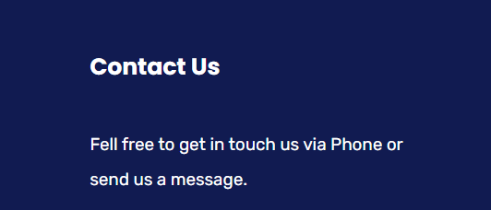
First Impressions Matter
Ensure banners, logos, and content are clear and current.
Know the image dimensions or request them from your developer.
Provide actionable recommendations for enhanced functionality.
Foster collaboration for mutual growth.
Notes:
Are your homepage banners cropped or blurry? Do you know the size specs for uploading logos or hero images?
What about social media links — do they direct users to the correct channels?
Visitors may judge your entire grants process by how your site looks and reads. If your homepage banner is stretched or blurry, or if you still have an old logo or deadline showing, it reflects poorly. These are simple fixes, but they must be actively monitored.
Our platforms are public-facing. The smallest inconsistency – like a stretched logo or an expired banner – damages credibility. Most councils don’t know the exact banner dimensions or how to crop logos. But you don’t have to know Photoshop. What matters is: can you recognize visual inconsistencies and raise the flag? This also includes content accuracy. Always check what’s been uploaded. Is it current? Is it branded? And does it reflect your message clearly?

Slide 4
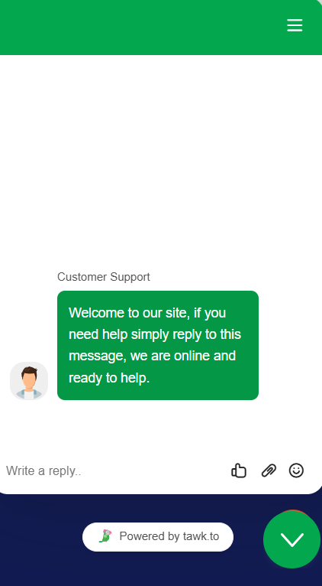
Chat Support – Active or Idle? Who’s There to Help?
Tawk.to chatbot installed on every grants system.
If not monitored, it creates a false sense of support.
Provide actionable recommendations for enhanced functionality.
Foster collaboration for mutual growth.
Notes:
A dormant chatbot displaying “We are online and ready to help” but receiving no response is worse than no chatbot at all.
Ideally, assign at least two team members to monitor the chat during working hours or review messages daily. It’s a small action with high impact.
It’s a powerful support mechanism — if used. But imagine an applicant reaching out via chat, seeing “We are online and ready to help,” and getting no reply for days. That undermines trust. Councils should designate at least one or two officers to handle or monitor incoming messages. If the chat is always offline, consider removing or hiding it. But if it’s visible, it must be managed — daily if possible.

Slide 5
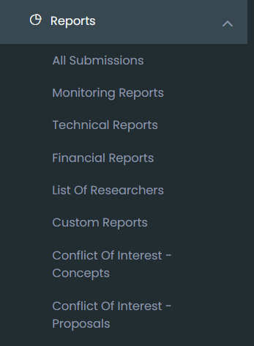
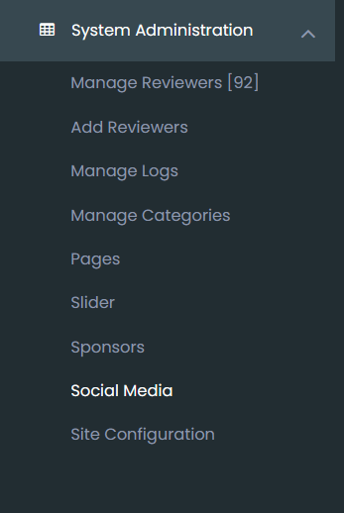
Reports Don’t Generate Themselves
Monitoring, Technical, Financial, and Concept/Proposal reports should be generated regularly / quarterly.
Encourage regular use of monitoring, financial, and technical reports.
Support the submission of quarterly performance summaries.
Notes:
Many of the systems come with reporting capabilities — applicant counts, reviewer logs, evaluation stats. But are these ever exported? Do you generate quarterly reports showing how many calls ran, how many applicants applied, or how many proposals were approved? These are key indicators not just for internal review, but also for SGCI-wide learning. Grants Officers must make this a routine task — not an annual scramble.
Many councils underutilize the reporting features. These reports inform future improvements and validate system value. At least quarterly, generate and review key submissions and evaluations to understand where support or policy change is needed.

Slide 6
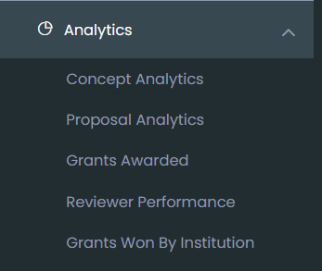
Advocate, Don’t Wait
Use the Analytics dashboard, track awarded grants, reviewer performance, and proposals submitted.
Help your IT team understand which dashboards should be tailored to your needs.
Issues should be escalated promptly.
Keep a list of needed fixes or feature requests.
Notes:
Waiting for the developer to notice or prioritize your issues won’t help. Be proactive. Maintain a living log of user feedback and system faults. When something isn’t working, don’t just report it once — follow up. Keep a simple ticket list, even if it’s a Word document. It shows seriousness and helps prioritize fixes. You know the system more intimately than most. Your proactive voice shapes its evolution.
You don’t need coding skills to contribute to system growth. Be the advocate who notices problems, logs them, and follows up. Sometimes the developer just needs your push. Documenting feedback from users also helps build the case for upgrades.

Slide 7
Own the System
Your involvement equals better service delivery.
Let’s move from users to co-owners.
Notes:
Customization is more than colors and fonts. It’s about relevance. Are your research areas updated? Do the modules reflect the local funding cycle? Does the application form speak your language? This is your system. Push for the changes that make it yours. For instance, some councils wanted a French interface, while others requested new drop-down filters — both are valid and achievable if advocated for. Be the bridge between user experience and technical implementation.
In closing, I want to encourage every participant, especially Grants Officers, to own your system. You are not just a user. You are a key stakeholder. A proactive role ensures that the OGMS continues to serve not just today’s needs, but also tomorrow’s expectations. Thank you.

Slide 8
This system is yours.
The more involved you are, the more impactful it becomes.
Let’s move from users to co-owners.
Name: Abena Corletey
Email: apdcorletey@aau.org
Mobile: (233) 57 021 7936

