Slide 1
project Background – key targets and EXPECTED CONTRIBUTIONS BY COUNCILS
Dr. Felicia Nkrumah Kuagbedzi & Mr. Collins Mwesigwa
8 May 2025
WINDHOEK, NAMIBIA

Slide 2
SGCI 2 Thematic Areas
Theme 1 – Strengthening the ability of Science Granting Councils in research management. (Association of African Universities, AAU/ Southern African Research and Innovation Management Association, SARIMA).
Theme 2 – Strengthening the Capacity of Science Granting Councils to use data and evidence in policy and decision making. (Unversity of Johannesburg, UJ).
Theme 3 – Supporting the ability of Science Granting Councils to fund research and innovation. (African Centre for Technology Studies, ACTS and Association of African Universities, AAU).
Theme 4 – Supporting strategic communications and knowledge uptake. (CABI-SciDev).
Theme 5 – Strengthening the Capacities of Science Granting Councils in gender equality and inclusivity. (Human Sciences Research Council, HSRC).
Theme 6 - Supporting the Science Granting Councils to develop frameworks and enabling structures for public-private sector partnerships in research and innovation. (Scinnovent Centre, Association of African Universities, ATDF Entrepreneurship Hub)
Theme 7 - Supporting frameworks for the establishment of new funding agencies in West Africa (African Technology Policy Studies Network, ATPS)

Slide 3
Five Project Objectives
To provide technical support to the Councils to undertake IP audits of the projects they have funded.
Provide technical support to the Councils to develop institutional IP policies and/or strategies.
Support the Councils to develop private sector engagement frameworks.
Support the Councils to develop and implement commercialization and technology transfer frameworks.
Support councils to customize and implement the infrastructure sharing protocol. This objective is building on the Uganda National Council for Science and Technology’s (UNCST) online platform called Technomart - supporting it to completion and sharing it with other councils to enhance peer-to-peer learning and infrastructure sharing.

Slide 4
Aims of Theme 6
To support the SGCs to develop frameworks and enabling structures for public-private sector partnerships in research and innovation.
Objective 5 under this theme focuses on supporting councils to customize and implement an infrastructure sharing protocol.
This objective builds on the Uganda National Council for Science and Technology (UNCST)’s earlier work of building an online platform (Technomart) which has been supported to completion and positioned to be shared with other councils to facilitate research infrastructure sharing and enhance peer-to-peer learning and research.
The AAU is collaborating with the UNCST, to implement objective 5 to strengthen research infrastructure management through the Technomart platform.

Slide 5
The Research Infrastructure Challenge in Sub-Saharan Africa
1. Limited discoverability and accessibility: Research equipment and facilities are often scattered, underutilized, or unknown to potential users, hindering research productivity.
2. Inefficient resource allocation: Lack of visibility into existing research infrastructure leads to duplication of resources, underutilization, or inadequate allocation, wasting valuable resources.
3. Inadequate knowledge sharing and collaboration: Researchers and institutions often work in silos, missing opportunities for partnership, knowledge exchange, and mutual benefit.
4. Data-driven decision-making gaps: Insufficient data on research infrastructure utilization and needs hinders informed decision-making for resource allocation and development.
5. Capacity gaps and ineffective infrastructure use: Researchers and institutions may lack the knowledge and skills to optimize research infrastructure use, leading to suboptimal research outcomes.

Slide 6
The Technomart Platform as a Solution
The Technomart platform offers a comprehensive solution to these challenges by:
Improving discoverability and accessibility: A centralized digital repository of research equipment and facilities enhances visibility and accessibility.
Facilitating resource sharing: The platform promotes intra- and inter-institutional sharing of research resources, maximizing utilization and reducing duplication.
Fostering collaboration and knowledge exchange: Technomart builds a network for researchers and institutions to connect, share knowledge, and partner.
Providing data-driven insights: The platform generates valuable data for informed decision-making on research infrastructure development and resource allocation.
Empowering researchers and institutions: Technomart equips users with knowledge and tools for effective research infrastructure use, optimizing research outcomes.

Slide 7
How the Technomart Platform Works
Technomart is an online (web based) platform facilitating research infrastructure management and sharing across Sub-Saharan Africa - https://technomartafrica.com/
Its key features include:
a. Inventory management: Institutions list available equipment and resources.
b. Resource discovery: Researchers search, find and access needed infrastructure and needed experts.
c. Collaboration: Researchers connect, share knowledge, and collaborate on projects.
.

Slide 8
Value Proposition:
Optimal use of Research Equipment (Value for Money)
Efficiency gains for the Research community ( Turn around Time and Finances)
Income generation from rentals to Research Institutions
Improved research outputs
Peer to peer collaboration amongst researchers (discovery and collaborations)

Slide 9
Purpose and Guidance [Big Picture]
Effective and Efficient use of Techno resources within the SGCs:
Techno resources:
Research Infrastructure and Equipment
Innovations
STI Products
STI Experts
Ideas
Prototypes
How?
Collaborations and partnerships
Resource sharing
Funding opportunities
Sharing of ideas
Inspiration

Slide 10
Objectives
EFFECTIVE AND Efficient Use Of Techno Resources Across The SGCI Member Countries.
Enhanced Peer To Peer Collaborations And Partnerships within the STI community in SGCs.
Visibility, Tracking And Management Of Techno Resources Within SGCI

Slide 11
Some Key Achievements SO FAR
Survey on systems requirements undertaken within the reporting period. The survey report can be accessed from here - https://blog.aau.org/wp-content/uploads/2024/05/Survey-Report-Research-Infrastructures-.pdf
Two online consultation sessions were organized in August 2023 – an Anglophone/Lusophone session and another session for the Francophone SGCs. These sessions provided the unique opportunity for councils to effectively contribute to the design of the structure and refinement of the Infrastructure Resource Sharing Platform – Technomart.
Technomart has been developed and customised to align with the requirements of councils to promote the efficient utilisation of available research infrastructures by the SGCI participating countries. Technomart, is a digital tool that supports the upload and management of country-specific data on research infrastructure and has been significantly enhanced, incorporating the council’s feedback and essential features. Technomart is now live, and accessible via https://technomartafrica.com/
Furthermore, the team developed an information package and a User Manual, aimed at empowering councils to engage researchers effectively and to utilize the platform efficiently. These resources are available at https://blog.aau.org/wp-content/uploads/2024/03/Technomart-Information-Package.pdf and https://blog.aau.org/wp-content/uploads/2024/03/Technomart-User-Manual.pdf respectively.

Slide 12
Target Users (Public and Private)
Policy Makers
Inventors and innovators
Research Funders
Researchers and Managers
Infrastructure Managers
Investors
Academic Institutions
STI Experts

Slide 13
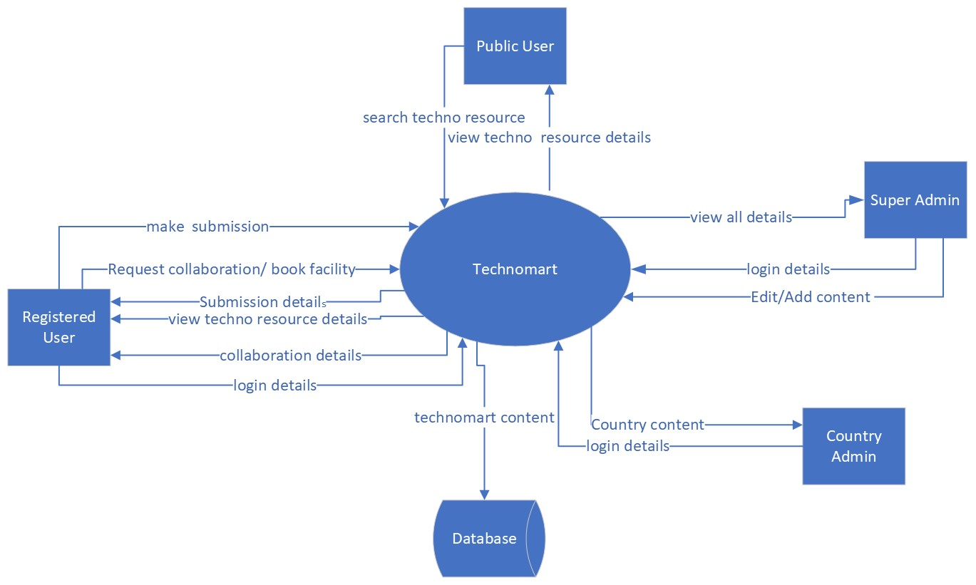
Technomart

Slide 14
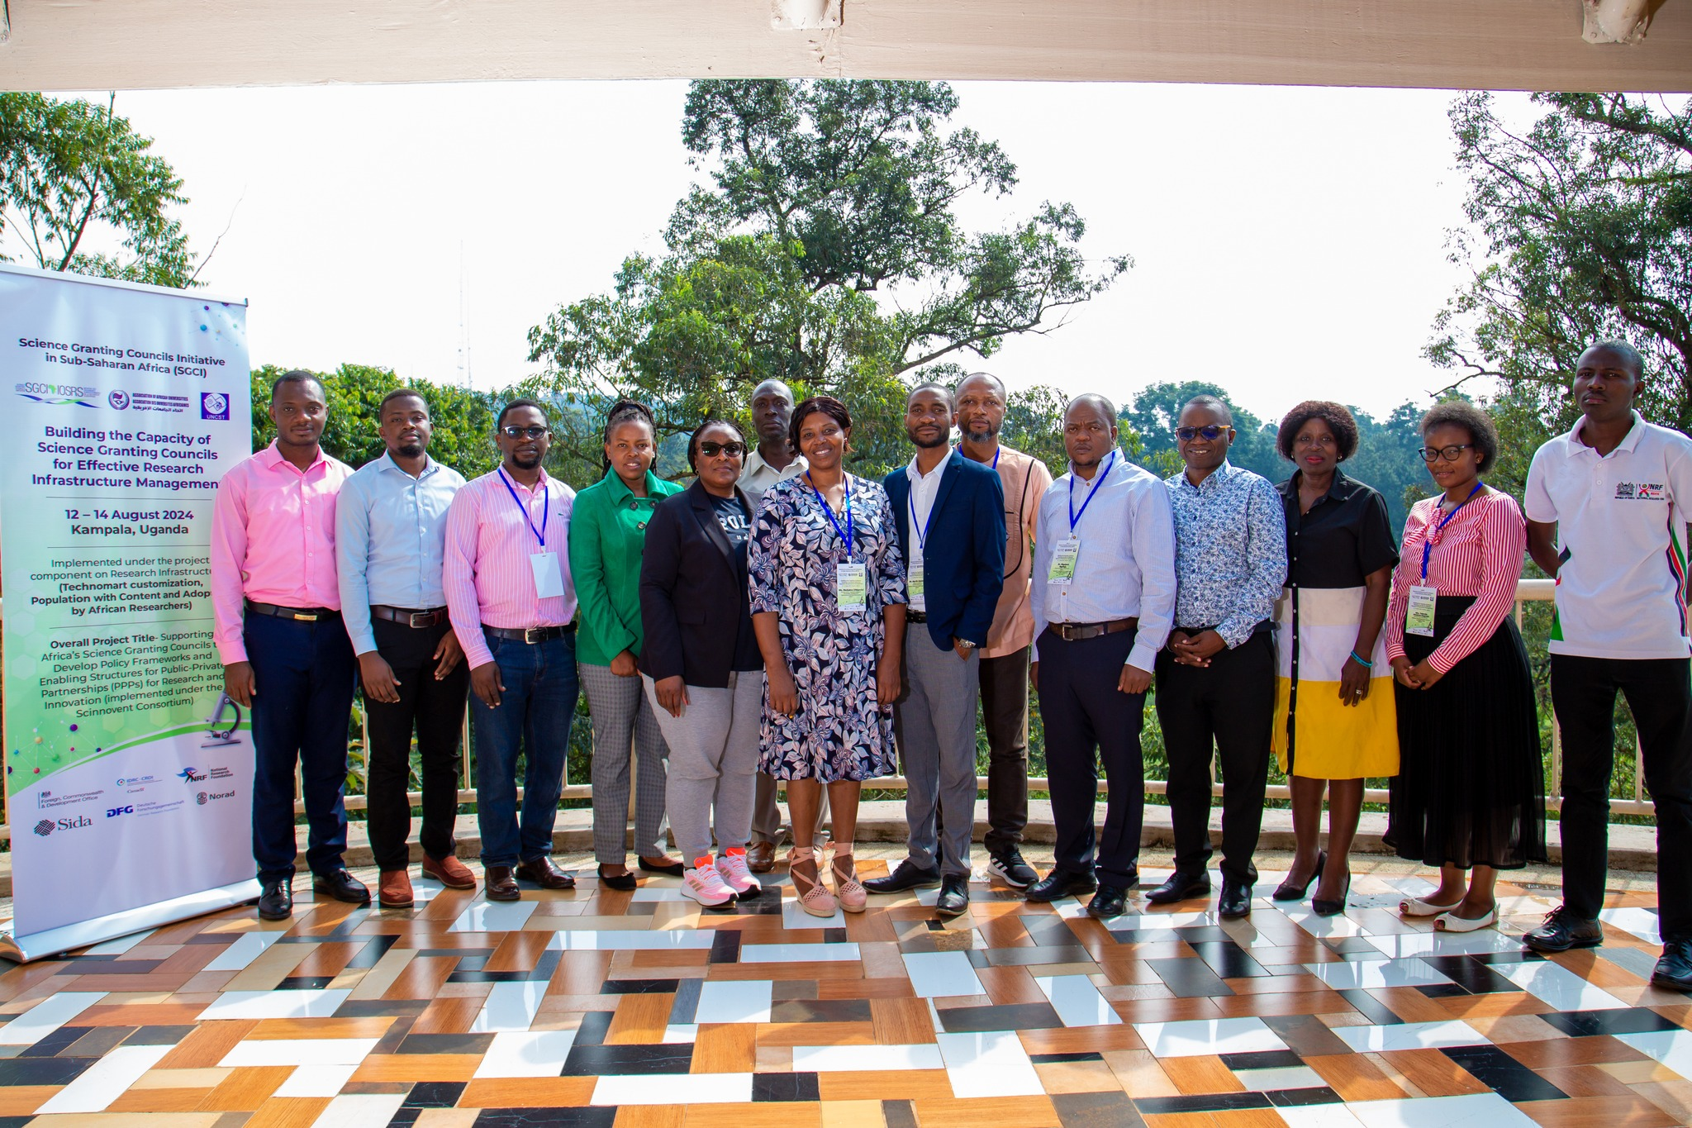
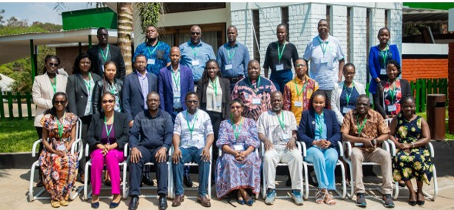
Trainings CONDUCTED
Uganda – August 2024
Malawi – August 2024

Slide 15
Research Infrastructure Protocol A Model Structure of a Memorandum of Understanding (MoU)
1. Date of Memorandum and Duration
2. Description of the parties
3. Recitation/preamble
4. Objectives
5. Scope of Agreement/areas of collaboration
6. Substantive parts
a. Specific areas of interest
b. Access to and Sharing of equipment
c. Staff exchanges
d. Student exchanges
e. Sharing of accrued information
f. Confidentiality
j. Ownership of IP
g. Ownership of equipment purchased through project funds
h. Costs of visiting researchers i. Publication of research results

Slide 16
A Model Structure of a Memorandum of Understanding (MoU)
7. Obligations of each party
8. Insurance/indemnity
9. Funding/costs
10. Force majeure
11. Cancellation
12. Disclaimer /non-legal nature of the MoU
13. Dispute resolution
14. Contacts – administrators of the MoU

Slide 17
HOW CAN COUNCILS ENGAGE – EXPECTED CONTRIBUTIONS FROM COUNCILS
Technomart Platform
We need the support of councils in the population and usage of the platform
Research Infrastructure Protocol
Review of MoUs to meet the standards stipulated in the protocol

Slide 18
Appreciation

