Slide 1
Research Excellence & Research Ethics
Prof. Frederick Ato Armah, FGA
Director of Research and Programmes
Association of African Universities
Research Excellence Workshop, Accra, 15-16 April 2025

Slide 2
Presentation Outline
Research Project Lifecycle
Dimensions of Research Quality
Dimensions of Research Excellence
Research Quality Plus (RQ+)
Ethical Research Dilemmas
Open Science & Research Data Management
Grants Proposal Writing & Research Funds
Stakeholder Engagement & Research Impact
Tips for writing inter-& trans-disciplinary research projects

Slide 4
Brain Teaser on Research Excellence (Scan the QR Code)
What makes for a
successful researcher?
https://www.menti.com/alcsztrh1txv

Slide 5
Research Project Lifecycle

Slide 6
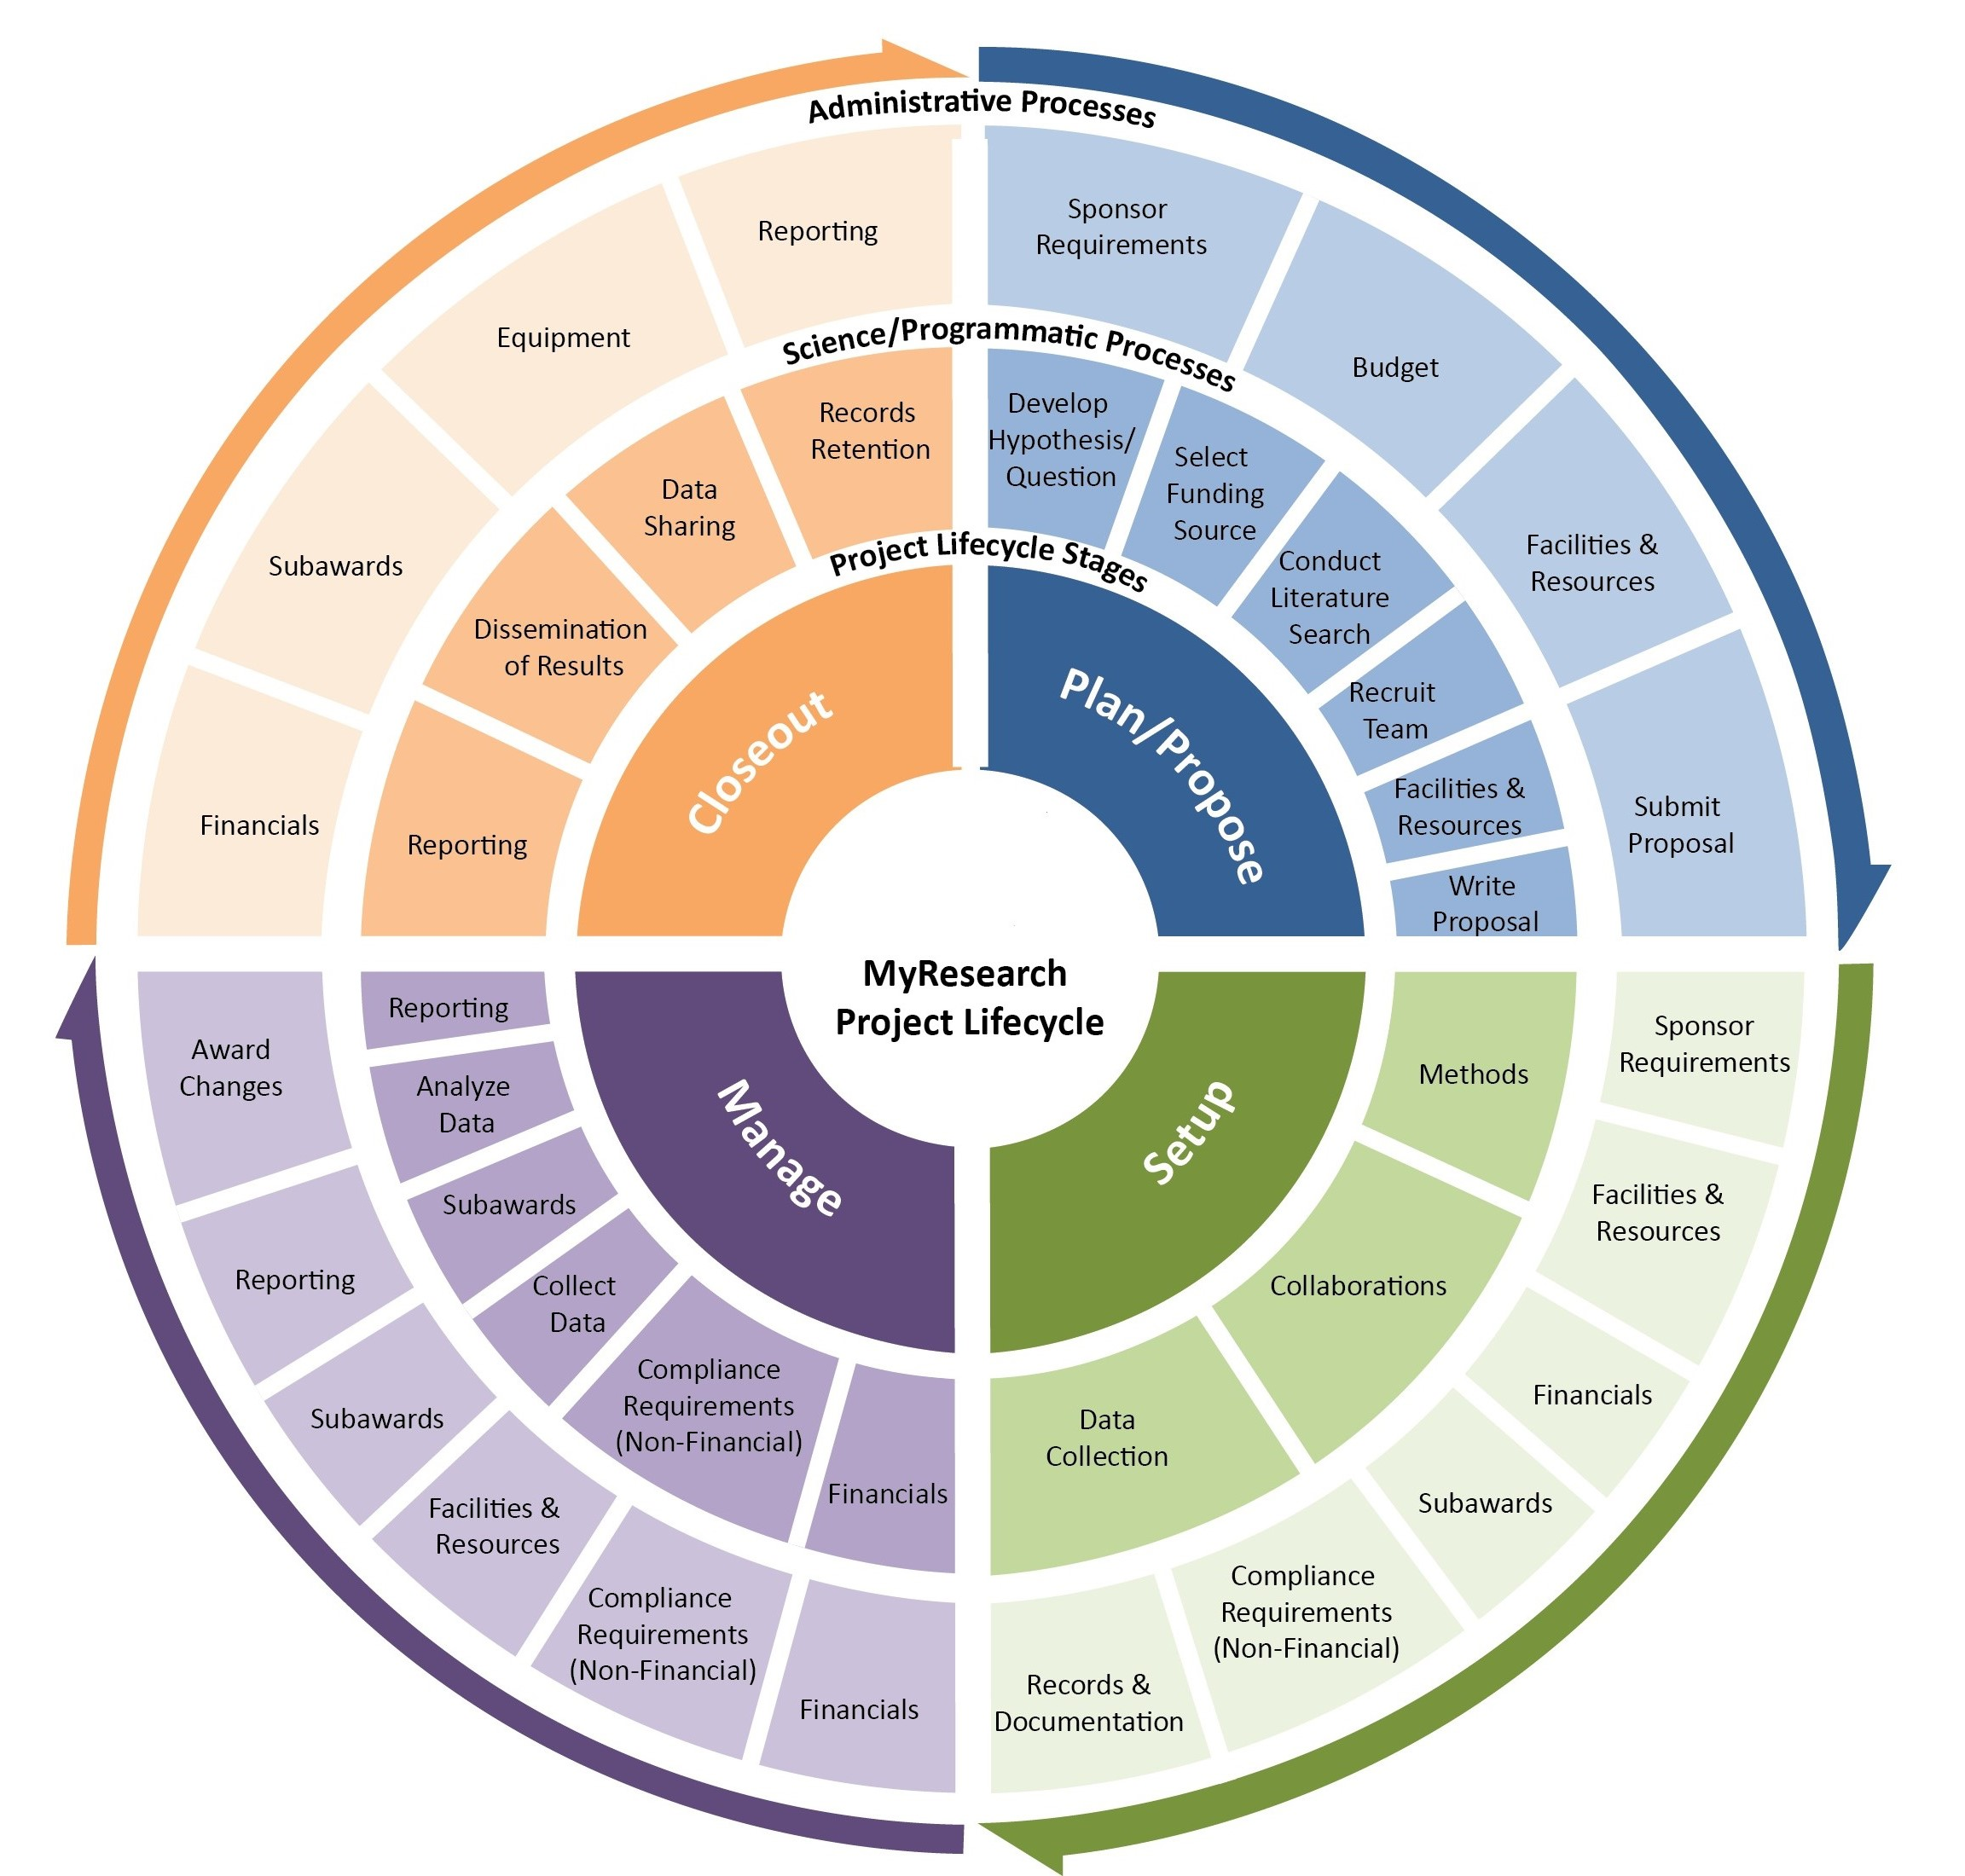
Research Project Lifecycle
At which stage(s) is Quality required?

Slide 7
Dimensions of Research Quality

Slide 8
Dimensions of Research Quality
Certain key issues need to be taken into account:
RELIABILITY
Can the research be replicated or verified by others?
TIMELINESS
Is the research up-to-date and relevant to current needs?
RELEVANCE
How well does the research address a significant problem or question?
VALIDITY
Do the research methods and conclusions align with the research question?
ACCURACY
How precise and reliable are the research findings?

Slide 9
Dimensions of Research Quality
Certain key issues need to be taken into account:
ETHICS
Were ethical standards followed in the research process?
IMPACT
Does the research have practical applications or influence?
COHERENCE
How well do the research components fit together?
ORIGINALITY
Does the research contribute new knowledge or insights?
COMPREHENSIVENESS
Does the research cover all necessary aspects of the topic?

Slide 10
Dimensions of Research Quality
Certain key issues need to be taken into account:
GENERALISABILITY
Can the research findings be applied to other contexts?
SIGNIFICANCE
Does the research contribute to the academic field, policy or society?
TRANSPARENCY
Is the research methodology and data clearly presented?
REPLICABILITY
Can others reproduce the research results?
OBJECTIVITY
Was the research conducted without bias?

Slide 11
Research Quality
METHODOLOGICAL QUALITY
Study design:
Employing suitable study designs, such as experiments, surveys, or observational studies.
Sampling strategies: Using robust sampling strategies to ensure representative and generalizable findings.
Data collection and analysis:
Employing reliable and valid data collection methods and analytical techniques.
THEORETICAL & CONCEPTUAL QUALITY
Theoretical frameworks: Grounding research in well-established theoretical frameworks and concepts.
Conceptual clarity: Ensuring clear and concise definitions of research concepts and variables.
Literature integration: Integrating research findings with existing literature to advance knowledge.
RELEVANCE & IMPACT
Societal relevance: Addressing pressing societal challenges and needs.
Practical applicability: Ensuring research findings are applicable to real-world contexts.
Policy and practice influence:
Informing policy, practice, and decision-making.
ETHICAL QUALITY
Respect for participants:
Ensuring the rights, dignity, and well-being of research participants.
Informed consent: Obtaining informed consent from participants and maintaining confidentiality.
Avoiding harm:
Minimizing potential harm to participants, environments, and communities.
DISSEMINATION
& COMMUNICATION
Clear and concise reporting:
Presenting research findings in a clear, concise, and transparent manner.
Accessibility:
Making research findings accessible to diverse audiences, including policymakers, practitioners, and the general public.
Knowledge translation: Translating research findings into practical applications and policies.
REPRODUCIBILITY
& TRANSPARENCY
Data sharing:
Sharing research data to facilitate reproducibility and reuse.
Methodological transparency:
Providing detailed descriptions of research methods and materials.
Openness to critique and revision:
Encouraging peer review, critique, and revision to improve research quality.

Slide 13
Dimensions of Research Excellence

Slide 14
Research Excellence
INTELLECTUAL EXCELLENCE
Originality and innovation:
Pursuing novel research questions, methods, and approaches.
Rigour and methodological excellence:
Employing robust, reliable, and transparent research methods.
Interdisciplinary approaches:
Integrating insights and methods from multiple disciplines.
IMPACT & RELEVANCE
Societal relevance: Addressing pressing societal challenges and needs.
Economic impact: Contributing to economic growth, innovation, and competitiveness.
Policy and practice influence:
Informing policy, practice, and decision-making.
CAPACITY BUILDING
& TALENT DEVELOPMENT
Research training and mentorship:
Providing training and mentorship for early-career researchers.
Diversity, equity, and inclusion:
Fostering a diverse, equitable, and inclusive research environment.
Career development and support:
Supporting researchers' career development and well-being.
RESEARCH INTEGRITY
& ETHICS
Responsible conduct of research:
Upholding the highest standards of research integrity and ethics.
Ethics review and approval:
Ensuring that research is reviewed and approved by ethics committees.
Transparency and accountability: Promoting transparency and accountability in research practices.
COLLABORATION & PARTNERSHIPS
Inter-institutional collaborations:
Fostering partnerships among academic institutions.
Industry and sector partnerships: Collaborating with industry, government, and non-profit sectors.
Global and international collaborations:
Engaging in international research collaborations.
OPENNESS & ACCESSIBILITY
Open access publishing:
Making research findings widely available through open-access publishing.
Open data and materials:
Sharing research data and materials to facilitate reproducibility and reuse.
Citizen engagement
& participation:
Involving citizens in research design, conduct, and dissemination.

Slide 15
Reliable Composite Indicators for Assessing Research Excellence
ENGAGEMENT WITH RESEARCH ACTORS: KNOWLEDGE PRODUCTION & IMPACT
Publications per 1000 researchers in public research
Average of relative citations (ARC)
% Highly cited publications / % publications
Specialisation in publications in the fields of the grand societal challenges (Agenda 2063 & SDGs 2030)
Specialisation in publications in the fields of key enabling technologies (KETs)
# of students and staff supported through mobility grants to access RI platforms in partner SGCs and /or global partner institutions
ENGAGEMENT WITH RESEARCH ACTORS: INSTITUTIONAL ARRANGEMENTS, INTERACTION SCHEMES INCLUDING OPENNESS
Collaboration index (regional, continental and international)
% Foreigners in national programmes
% SGCI member participation in international collaborative projects
ENGAGEMENT WITH INDUSTRIAL INNOVATION: KNOWLEDGE PRODUCTION & IMPACT
% Joint research and education programmes with industry actors
% Industry funded internship programmes
Public-private co-publications per million population
Technology transfer office capacity development training
Patent applications by HEIs + research institutions (per 1000 researchers)
ENGAGEMENT WITH SOCIETAL, ECONOMIC & POLITICAL ACTORS: KNOWLEDGE PRODUCTION & IMPACT
Advocacy
Lobbying
Policy influence
ENGAGEMENT WITH CIVIL SOCIETY & TRANSFORMING THE SCIENCE-SOCIETY ENGAGEMENT
% Researchers engaging teachers on STEMI
% SGC budget targeted towards public awareness and outreach to civil society on STEMI (e.g., Corona virus factsheets)
% Public awareness and outreach activities e.g., booklets and factsheets, translated into native languages

Slide 16
Reliable Composite Indicators for Assessing Research Excellence
WORLD CLASS PEER REVIEW AND MEL SYSTEMS & PROCESSES
Digital grants management system in place
World class peer review processes and platforms in place
Review processes underpinned by Research Excellence and Rigour
MEL processes and platforms in place
OPEN SCIENCE IMPLEMENTATION
Number of enabling tools in place to promote OS principles e.g., SGC Digital Space for uploading all outputs linked to SGC funded projects
% Institutions in SGCI countries using OS platforms
% Researchers supported by the SGC that publish in OS journals
% Research institutions supported by SGCs in SGCI-participating member countries, with OS policies and frameworks in place
ENGAGEMENT WITH INDUSTRIAL INNOVATION ACTORS: INSTITUTIONAL ARRANGEMENTS, INTERACTION SCHEMES, INCLUDING OPENNESS
Public-private co-publications per million population
% (national) HERD + GOVERD financed by business
% R&D financed by business
% Industry funded projects at HEIs + research-performing institutions
WORLD CLASS RESEARCH INFRASTRUCTURES
Develop an African RI roadmap that supports capacity building; knowledge exchanges; access to world class infrastructures; and/or establishing RI platforms nationally
INNOVATION OUTPUTS
Number of patent applications by HEIs + research-performing institutions (per 1000 researchers)
Specialisation in patenting in the fields of grand social challenges (Agenda 2063 and SDGs 2030)
Specialisation in patenting in the key enabling technologies (KETs)

Slide 17
Research excellence and research quality are interconnected concepts that reinforce each other
Here are some key linkages:
RESEARCH EXCELLENCE ENABLES RESEARCH QUALITY
Rigorous methodology: Research excellence ensures the use of rigorous methodologies, which is essential for producing high-quality research.
Innovative approaches: Excellence in research encourages innovative approaches, leading to novel and impactful findings.
Interdisciplinary collaboration: Research excellence fosters interdisciplinary collaboration, which enhances research quality by integrating diverse perspectives and expertise.
RESEARCH QUALITY ENHANCES RESEARCH EXCELLENCE
Valid and reliable findings:
High-quality research produces valid and reliable findings, which are essential for research excellence.
Impact and relevance:
Research quality ensures that findings are relevant and impactful, contributing to research excellence.
Transparency and accountability: Quality research promotes transparency and accountability, which are critical components of research excellence.
SHARED DIMENSIONS
Originality and innovation:
Both research excellence and quality emphasize the importance of originality and innovation.
Methodological rigour:
Both concepts require rigorous methodologies and attention to detail.
Impact and relevance:
Both research excellence and quality aim to produce findings that are impactful and relevant to society.
SYNERGISTIC RELATIONSHIP
Reinforcing cycle:
Research excellence and quality reinforce each other, creating a cycle of continuous improvement.
Mutual enhancement: Excellence in research enhances research quality, and high-quality research contributes to research excellence.
Elevating research standards: The interconnection between research excellence and quality elevates research standards, driving innovation and progress.

Slide 18
Research Quality Plus (RQ+)

Slide 19
Research Quality Plus
It is a framework that goes beyond traditional notions of research quality, emphasizing the importance of relevance, impact, and inclusivity in research endeavors.
Developed by IDRC in close collaboration with voices from the global south

Slide 20
Key Elements of RQ+
RESEARCH QUALITY
RQ+ builds upon traditional notions of research quality, including methodological rigour, validity, and reliability.
RELEVANCE
RQ+ emphasizes the importance of research being relevant to society, addressing pressing challenges and needs.
IMPACT
RQ+ prioritizes research that has the potential to drive positive impact, whether economic, social, or environmental.
INCLUSIVITY
RQ+ promotes inclusivity in research, encouraging diversity, equity, and accessibility in research teams, methods, and outcomes.

Slide 21
Principles of RQ+
CO-CREATION
RQ+ encourages collaboration among researchers, stakeholders, and communities to co-create research agendas and outcomes.
TRANSDISCIPLINARITY
RQ+ promotes transdisciplinary research, integrating insights and methods from multiple disciplines and fields.
OPENNESS
RQ+ advocates for openness in research, including open data, open access, and transparent research practices.
RESPONSIVENESS
RQ+ emphasizes the importance of research being responsive to societal needs and challenges.

Slide 22
Benefits of RQ+
IMPROVED RESEARCH RELEVANCE
RQ+ ensures that research addresses pressing societal challenges and needs.
INCREASED RESEARCH IMPACT
RQ+ prioritizes research that drives positive impact, whether economic, social, or environmental.
ENHANCED RESEARCH QUALITY
RQ+ builds upon traditional notions of research quality, emphasizing methodological rigour and validity.
MORE INCLUSIVE RESEARCH PRACTICES
RQ+ promotes inclusivity in research, encouraging diversity, equity, and accessibility in research teams, methods, and outcomes.

Slide 23
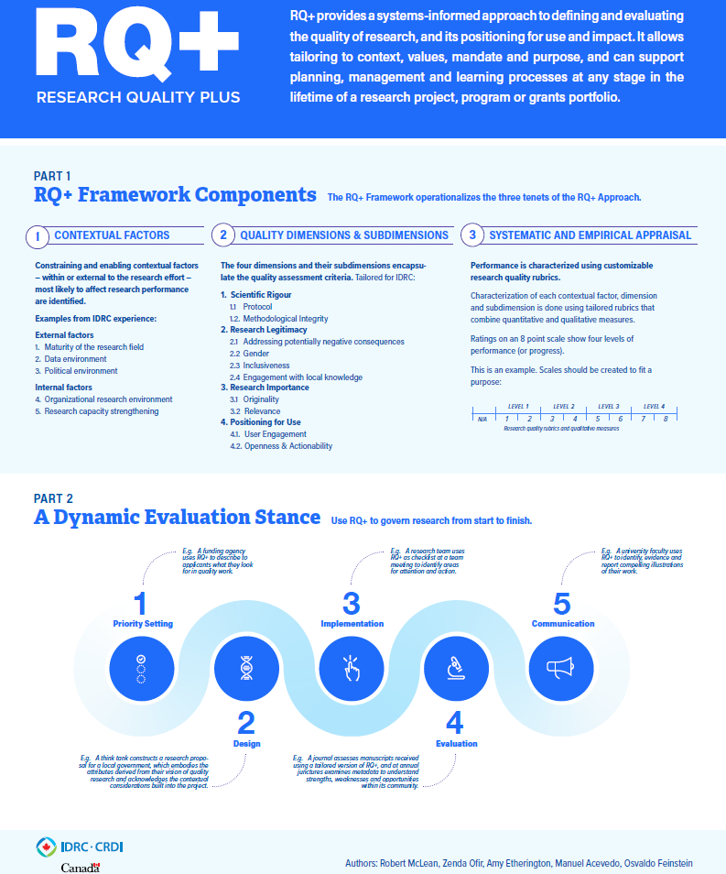

Slide 24
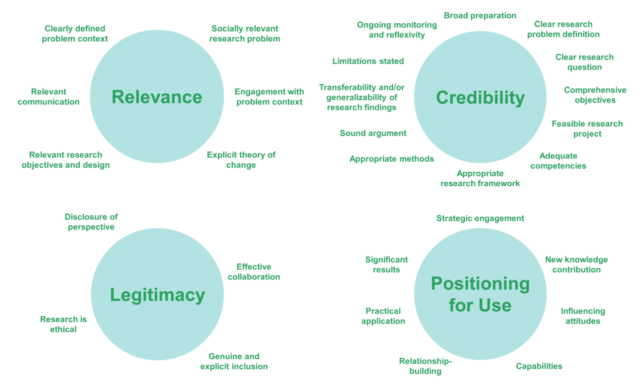
Sustainability Research Effectiveness Program. (2021). Transdisciplinary Research Quality Assessment Framework 2.0 (Interactive Prezi). https://prezi.com/p/52ap5yagsezm/quality-assessment-framework-qaf-20/

Slide 25
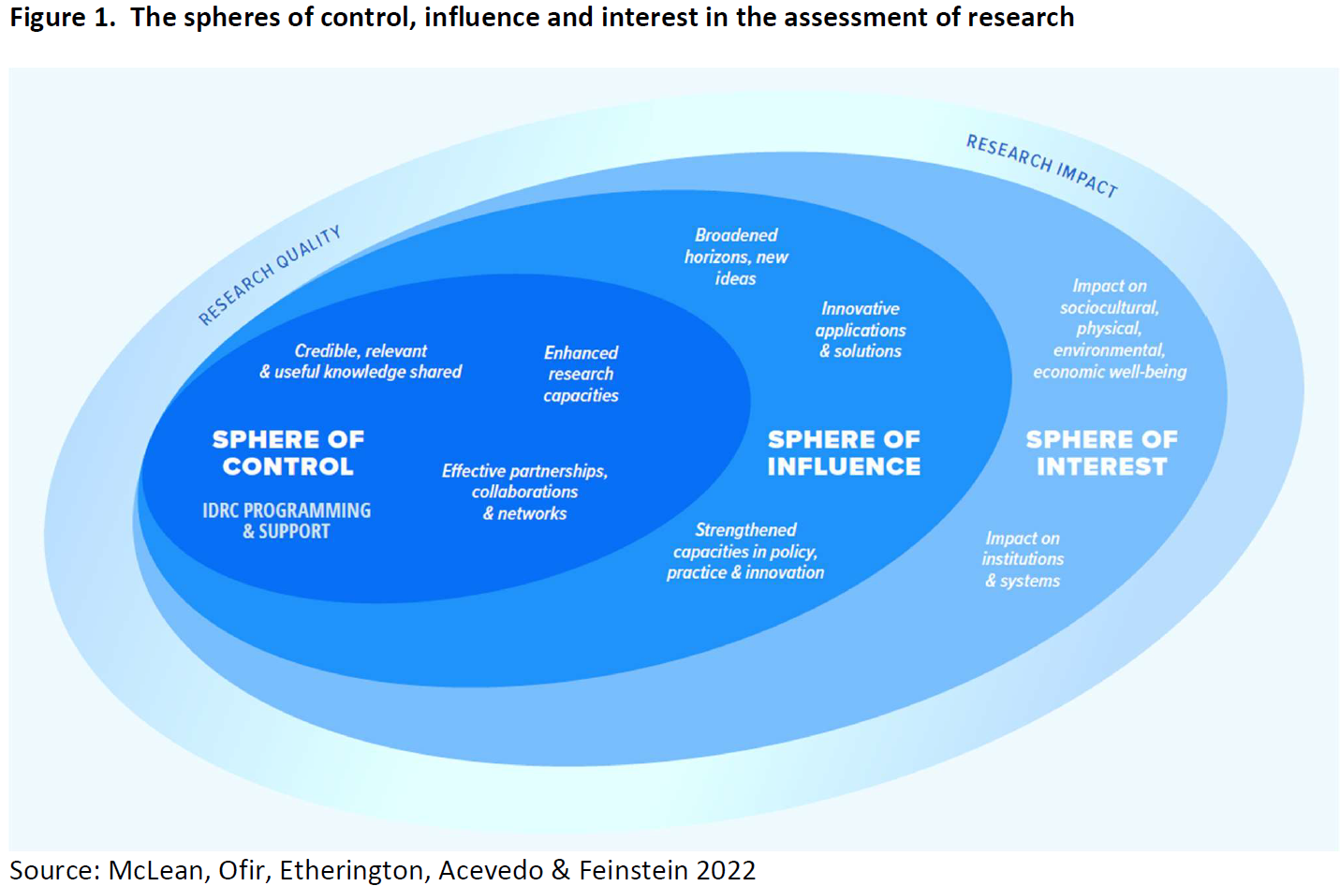

Slide 26
Research Quality Plus
For IDRC, excellent research has technical merit (e.g., methodologically sound, empirically warranted conclusions) and is effective, where the latter refers to use, influence, policy relevance, “relevance for development”, actionable knowledge, or impact.
It understands that technical quality is a necessary but not sufficient condition for an overall determination of research excellence.

Slide 27
Research Quality Plus
Yet IDRC as a research funder also recognizes that the assessment of research quality focused on what is within its sphere of control is critical for learning and improvement, in addition to its typical emphasis on evaluating outcomes in the sphere of influence (outcomes are examined in project/program evaluations, which go beyond their research components).
Technical quality of research is within the control of IDRC and its research partners. However, the uptake, use, influence and impact of research are not under their control because of the interaction of multiple actors, agencies, and socio-political circumstances

Slide 28
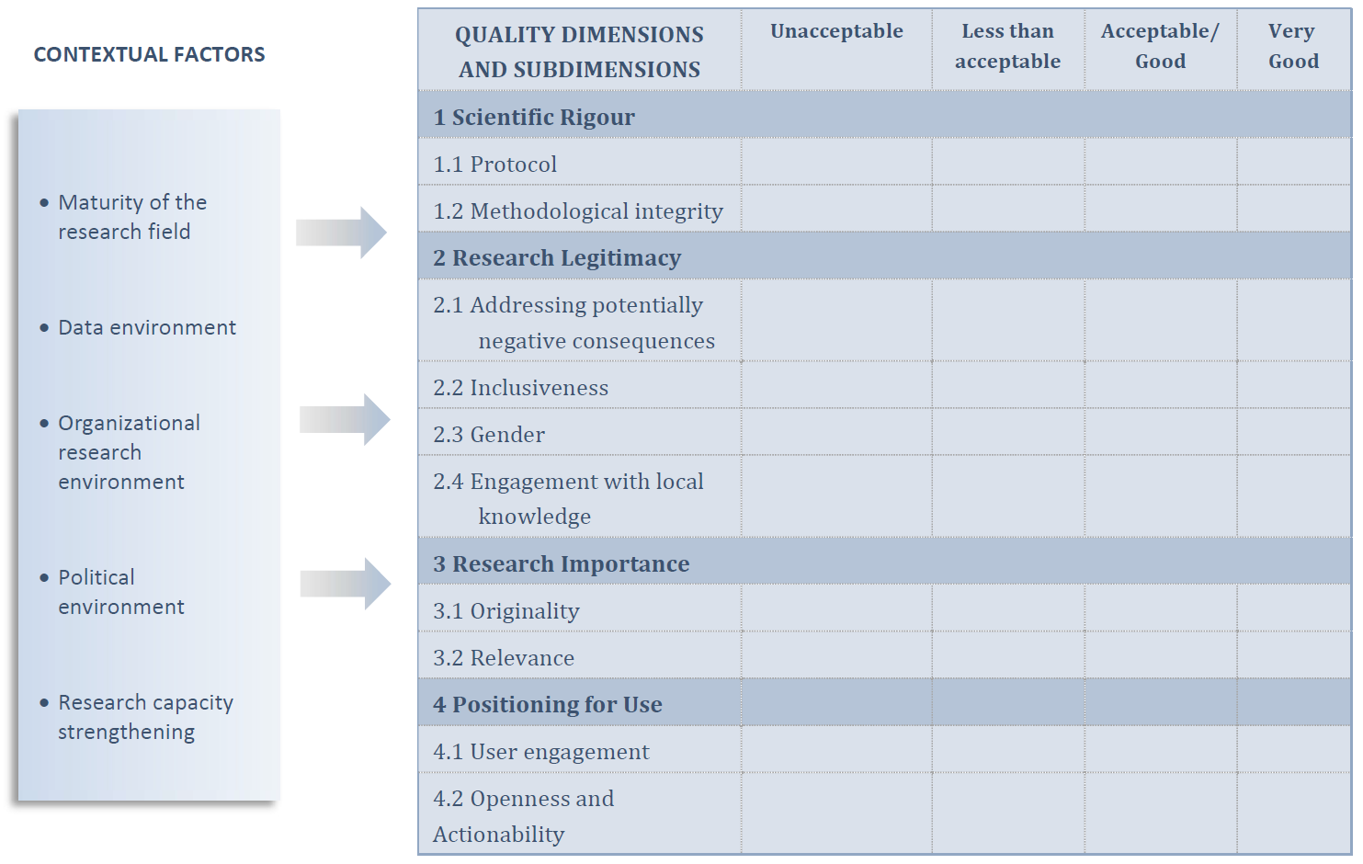

Slide 29
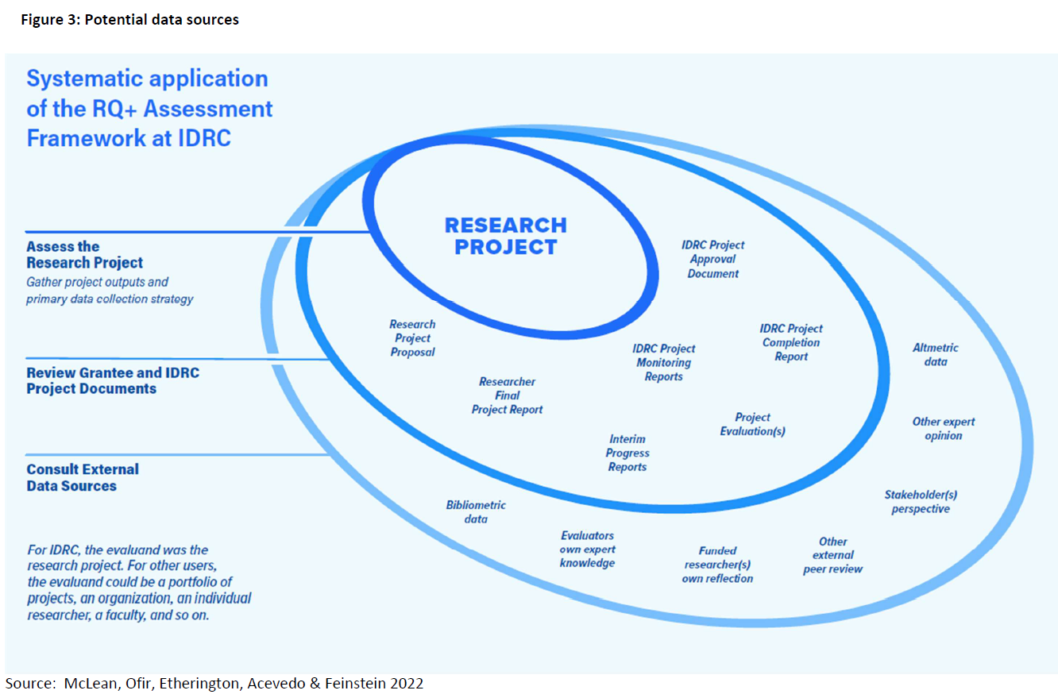

Slide 31
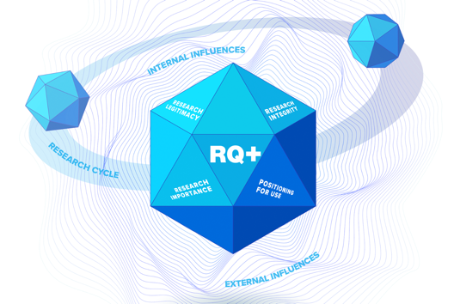

Slide 32
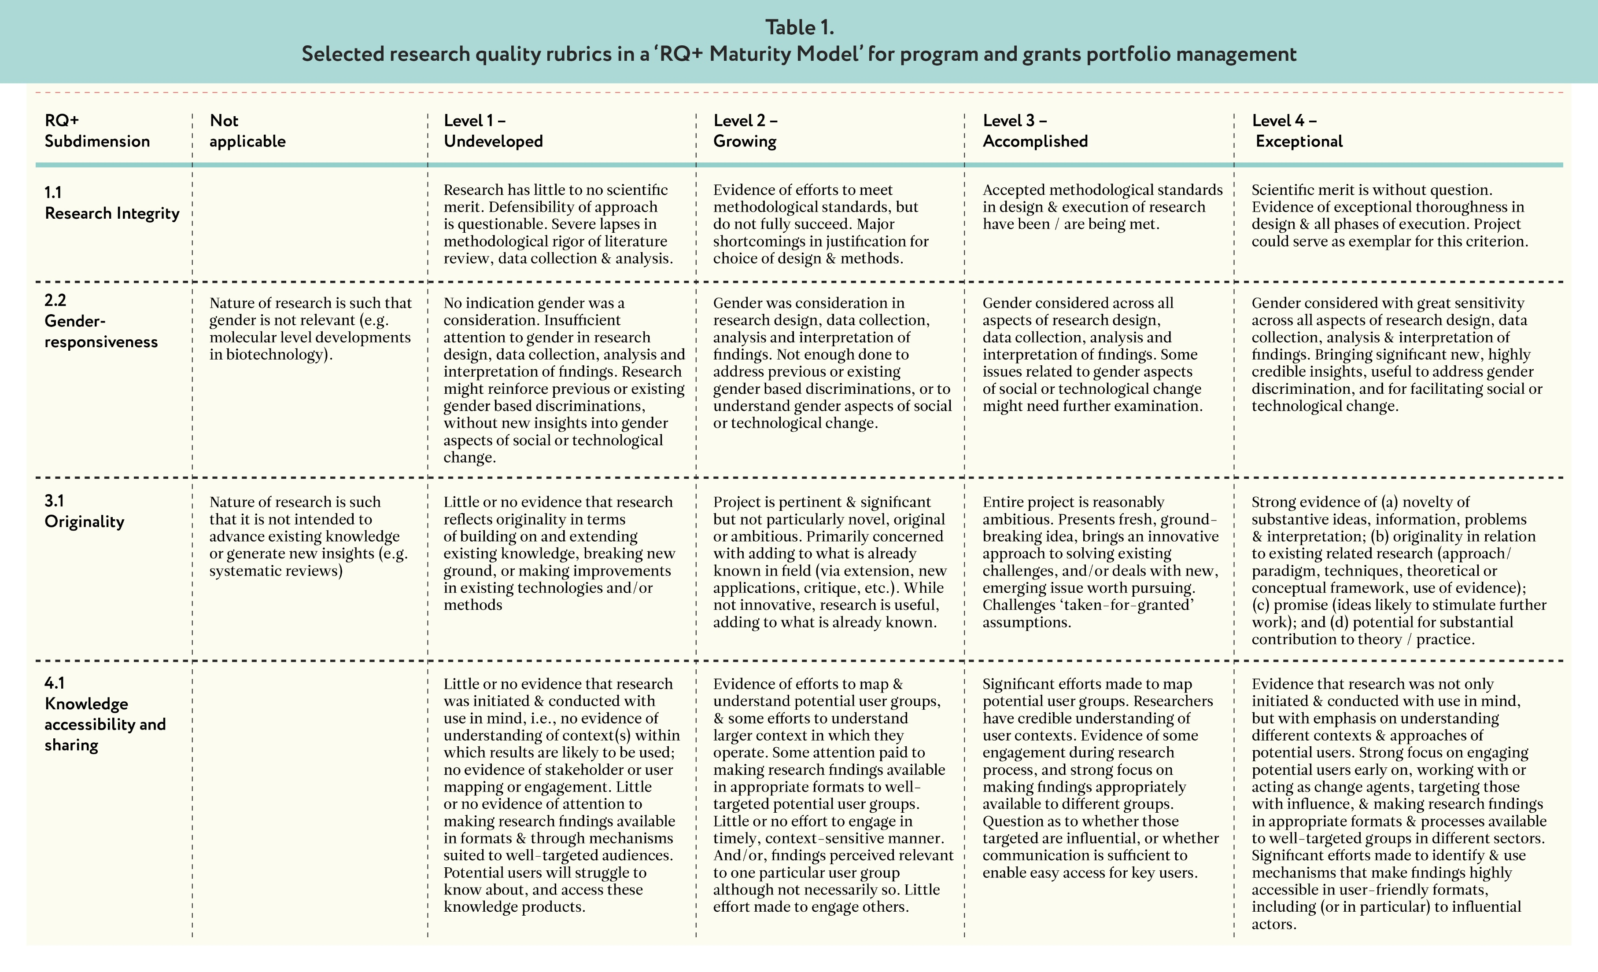

Slide 33
Ethical Research Dilemmas

Slide 34
Source: https://researchmethodscommunity.sagepub.com/blog/a-big-picture-look-at-research-ethics

Slide 35
Source: Drolet, M. J., Rose-Derouin, E., Leblanc, J. C., Ruest, M., & Williams-Jones, B. (2023). Ethical issues in research: Perceptions of researchers, research ethics board members and research ethics experts. Journal of Academic Ethics, 21(2), 269-292.

Slide 36
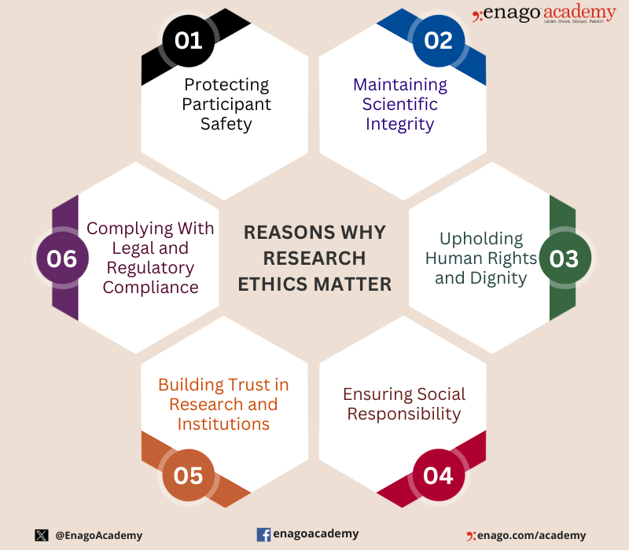

Slide 37
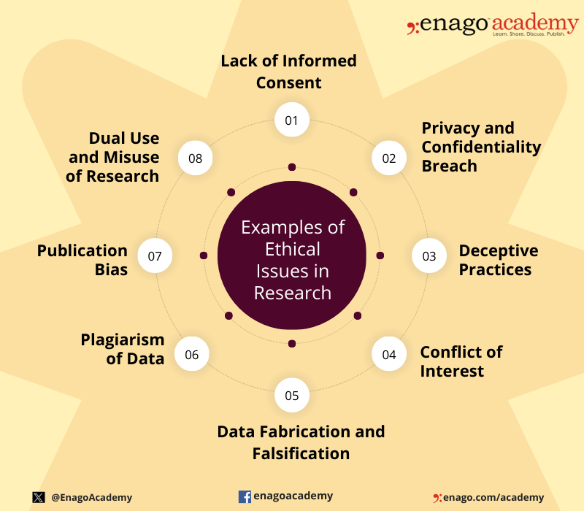

Slide 38
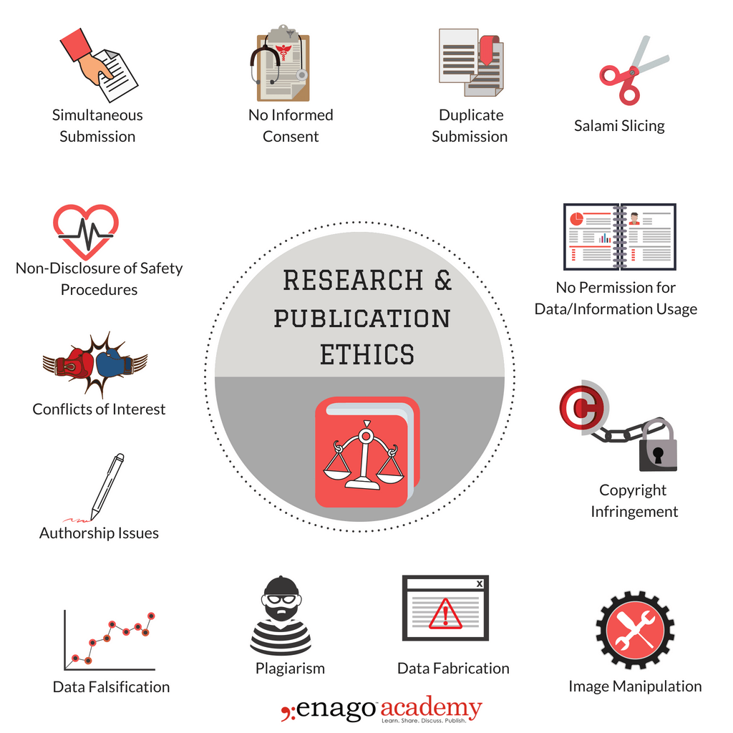

Slide 39
Safeguards in Research Projects

Slide 40
Safeguards in research projects
Safeguards in research projects refer to the measures taken to protect the rights, welfare, and safety of research participants, as well as the integrity and validity of the research findings.

Slide 41
Types of Safeguards
1. Informed consent: Ensuring that participants understand the research purpose, risks, benefits, and their rights.
2. Confidentiality and anonymity: Protecting participants' personal information and maintaining their anonymity.
3. Risk assessment and mitigation: Identifying potential risks and taking steps to minimize them.
4. Data protection and security: Ensuring the secure storage, transmission, and disposal of research data.
5. Participant selection and recruitment: Ensuring that participants are selected and recruited fairly and without coercion.
6. Research design and methodology: Ensuring that the research design and methodology are sound and minimize potential harm.
7. Monitoring and review: Regularly monitoring and reviewing the research project to ensure that safeguards are in place.

Slide 42
Safeguards for Vulnerable Populations
1. Children and minors: Ensuring that parents or guardians provide informed consent and that the research is designed to minimize potential harm.
2. Pregnant women: Ensuring that the research is designed to minimize potential harm to the mother and fetus.
3. Prisoners and detainees: Ensuring that the research is designed to minimize potential harm and that participants are not coerced.
4. Individuals with disabilities: Ensuring that the research is accessible and that participants are not exploited.

Slide 43
Institutional Safeguards
Institutional Review Boards (IRBs): Ensuring that research proposals are reviewed and approved by an IRB.
2. Research ethics committees: Ensuring that research proposals are reviewed and approved by a research ethics committee.
3. Data safety monitoring boards: Ensuring that research data is monitored for safety and efficacy.

Slide 44
Benefits of Safeguards in Research Projects
1. Protection of participants: Ensuring that participants are protected from harm and exploitation.
2. Integrity of research findings: Ensuring that research findings are valid and reliable.
3. Public trust: Maintaining public trust in research by ensuring that safeguards are in place.
4. Compliance with regulations: Ensuring that research projects comply with relevant regulations and guidelines.

Slide 45
The linkages between safeguards and research excellence are crucial for ensuring that research is conducted in an ethical, responsible, and rigorous manner.
DATA QUALITY & INTEGRITY
Implementing safeguards to ensure the accuracy, completeness, and reliability of research data, which is critical for producing high-quality research findings.
RESEARCH RIGOUR & VALIDITY
Ensuring that research is designed and conducted in a way that minimizes bias and ensures the validity of findings, which is essential for producing research that is reliable and generalizable.
ACCOUNTABILITY & TRANSPARENCY
Implementing safeguards to ensure that research is conducted in a transparent and accountable manner, which is critical for maintaining public trust and ensuring that research is conducted in an ethical and responsible manner.
PROTECTION OF PARTICIPANTS
Ensuring that participants are protected from harm and exploitation, which is essential for maintaining public trust and ensuring the integrity of research findings.
Safeguards as a foundation for Research Excellence

Slide 46
Safeguards as a Means of Enhancing Research Excellence
COLLABORATION & KNOWLEDGE SHARING
Safeguards can facilitate collaboration and knowledge-sharing among researchers, which is essential for advancing knowledge and producing high-quality research findings.
FOSTERING INNOVATION & CREATIVITY
By providing a framework for responsible and ethical research, safeguards can foster innovation and creativity, as researchers are encouraged to explore new ideas and approaches.
ENHANCING RESEARCH IMPACT
Safeguards can help ensure that research is conducted in a way that maximizes its impact, by ensuring that findings are reliable, valid, and relevant to real-world problems.
PROMOTING A CULTURE OF EXCELLENCE
Implementing safeguards can help promote a culture of excellence within research institutions, where researchers are encouraged to strive for the highest standards of quality and integrity.

Slide 47
Benefits of Linking Safeguards and Research Excellence
INCREASED PUBLIC TRUST
By demonstrating a commitment to safeguards and research excellence, researchers can increase public trust in research, which is essential for maintaining support for research funding and participation.
ENHANCED RESEARCH COLLABORATION
Linking safeguards and research excellence can facilitate collaboration among researchers, by providing a shared framework for responsible and ethical research.
GREATER RESEARCH IMPACT
By ensuring that research is conducted in a way that maximizes its impact, linking safeguards and research excellence can help produce research findings that are relevant, reliable, and valid.
IMPROVED RESEARCH QUALITY
Linking safeguards and research excellence can help improve the quality of research findings, by ensuring that research is conducted in a rigorous and responsible manner.

Slide 48
Ethics as a Foundation for Safeguards
1. Respect for persons: Ethics provides a foundation for safeguards by emphasizing the importance of respecting participants' autonomy, dignity, and rights.
2. Beneficence: Ethics provides a foundation for safeguards by emphasizing the importance of promoting participants' welfare and minimizing harm.
3. Non-maleficence: Ethics provides a foundation for safeguards by emphasizing the importance of avoiding harm to participants.
4. Justice: Ethics provides a foundation for safeguards by emphasizing the importance of ensuring that participants are treated fairly and without bias.

Slide 49
Safeguards as a Means of Upholding Ethics
1. Protection of participants: Safeguards ensure that participants are protected from harm, exploitation, and undue risk, upholding the ethical principle of respect for persons.
2. Informed consent: Safeguards ensure that participants provide informed consent, upholding the ethical principle of autonomy.
3. Confidentiality and anonymity: Safeguards ensure that participants' personal information is protected, upholding the ethical principle of confidentiality.
4. Data integrity and security: Safeguards ensure that research data is accurate, complete, and secure, upholding the ethical principle of data integrity.

Slide 50
Ethical Dilemma Game
The Dilemma Game confronts researchers with difficult dilemmas in the context of a critical dialogue, supporting them in further developing their own 'moral compass'. The Dilemma Game app allows researchers to use the game anytime, anywhere, on their own, or together with peers and colleagues.
https://www.eur.nl/en/about-eur/policy-and-regulations/integrity/research-integrity/dilemma-game

Slide 51
Groups: Ethical Dilemma Game
Group 1: Dilemma #5, 7, 32 and 63
Group 2: Dilemma #10, 22, 49 and 68
Group 3: Dilemma #16, 27, 59 and 69
Group 4: Dilemma #18, 31, 66 and 74
Group 5: Dilemma #17, 25, 64 and 71

Slide 52
Ethical Dilemma Game
Click on https://www.eur.nl/en/media/2020-12-original-dilemma-card-game
https://www.eur.nl/en/media/2020-07-dilemma-game-app-instructions-and-suggestions
https://www.eur.nl/en/media/2020-06-privacy-statement-dilemma-game-app-1
Download the app Android: https://play.google.com/store/apps/details?id=nl.eur.dilemmagame&hl=en
Download the app iOS: https://apps.apple.com/us/app/dilemma-game/id1494087665

Slide 53
Interactive Session
Norms of the Code of Conduct for Research Integrity:
https://embassy.science/wiki/Resource:H5P-3
Acting with Research Integrity
https://embassy.science/wiki/Resource:H5P-4
ROSiE Test Ethical and societal foundations of open science
https://embassy.science/wiki/Resource:H5P-22

Slide 54
Ethics Dumping
https://youtu.be/gAP4U0Um0LU

Slide 55
Reporting Guidelines

Slide 56
Using publication checklists help researchers think through the essential elements of their study, facilitate complete and transparent reporting, and ensure quality for peer review and dissemination
PRISMA
Focuses on meta-analysis
http://www.prisma-statement.org/
AMSTAR
Focuses on rapid reviews
https://amstar.ca/Amstar_Checklist.php
CONSORT
Focuses on randomized control trials
http://www.consort-statement.org/
TREND
Focuses on Non-randomized control trials
https://www.cdc.gov/trendstatement/pdf/trendstatement_TREND_Checklist.pdf
STROBE
Focuses on cohort study, case-control or observational study
https://www.strobe-statement.org/fileadmin/Strobe/uploads/checklists/STROBE_checklist_v4_cohort.pdf
https://www.equator-network.org/

Slide 57
Using publication checklists help researchers think through the essential elements of their study, facilitate complete and transparent reporting, and ensure quality for peer review and dissemination
CHEERS
Focuses on economic evaluation
http://www.equator-network.org/wp-content/uploads/2013/04/Revised-CHEERS-Checklist-Oct13.pdf
COREQ
Focuses on qualitative research
http://cdn.elsevier.com/promis_misc/ISSM_COREQ_Checklist.pdf
SRQR
Focuses on qualitative research
https://www.elsevier.com/__data/promis_misc/04262_SRQR_Checklist.docx
CARE
Focuses on case reports
http://www.care-statement.org/resources/checklist
https://www.equator-network.org/

Slide 58
Research Data Management is CRITICAL Research Quality and Research Excellence

Slide 59
Time to Play a Game on Research Data Quality Assurance (The League of Data): https://lod.sshopencloud.eu/

Slide 60
Embassy of Good Science https://embassy.science/wiki/Special:BrowseData/Resource

Slide 61
Data management costing tool and checklist: https://ukdataservice.ac.uk//app/uploads/costingtool.pdf

Slide 62
Open Science enhances Research Quality and Research Excellence

Slide 63
Open Science Wheel
https://figshare.com/articles/figure/Wheel_of_Open_Science_practices_image_/4628014/2?file=7564978
Group exercise
Break the participants into small groups (3-4 people per group). Each group will focus on one of the Open Science Wheel components. Provide each group with a copy of the wheel, and ask them to discuss the following:
What does this component of open science mean?
Why is it important?
How can we implement this component in our own research or organization?
What challenges or barriers might we face in adopting this principle?
Encourage each group to write down their key insights, challenges, and ideas on sticky notes or a large sheet of paper.

Slide 64
Open Science Wheel
In the larger group, we will now discuss the following:
How are the different components of open science interconnected?
What are some immediate steps we could take to promote open science in our community?
Are there any examples of successful open science initiatives we can learn from?
What are the similarities and differences between the research project lifecycle and open science wheel?

Slide 65
Open Science Resources: https://www.fosteropenscience.eu/resources

Slide 66
Grant Proposal Writing

Slide 68
Before the funder gives you money…
What could the outcomes signify when it comes to disputing the underlying assumptions and theoretical framework that support the research?
What recommendations for further studies could emerge from the expected study results?
How will the outcomes affect practitioners in the real-world context of their workplace?
Will the study results impact forms of interventions, methods, and/or programmes?
How could the outcomes contribute to solving economic, environmental, social, or other types of issues?
Will the outcomes affect policy decisions?
How will people (stakeholders) benefit from your proposed research?
What specific aspects of life will be changed or enhanced as an outcome of the suggested study?
How will the research outcomes be implemented and what transformative insights or innovations could emerge when they are implemented?

Slide 69
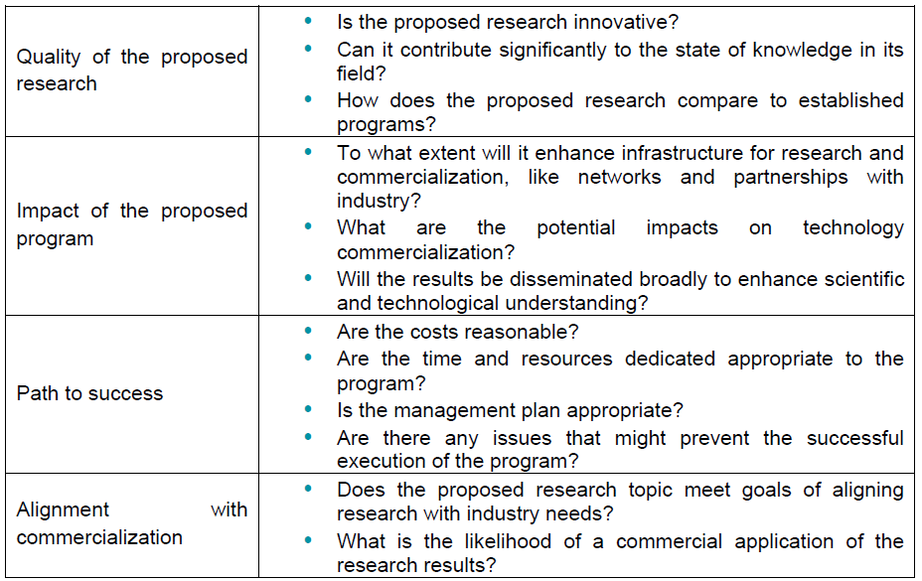
Before the funder gives you money…

Slide 70
For most funders, research is essentially a development issue, therefore IMPACT is key

Slide 71
What is Real Impact?
Discuss in pairs: what do you consider to be real impact?
Impact is the provable effects of research in the real world. Impact is the change we can see (demonstrate, measure, capture), beyond academia (in society, economy, environment) which happens because of our research (caused by, contributed to, attributable to)

Slide 72
What is Real Impact?
Impact may look and operate slightly differently across disciplines, and for fundamental vs. applied research, but ultimately it is about connecting academic research to changes in the real world
Impact is driven by a number of factors including funders’ requirements and research assessment.

Slide 73
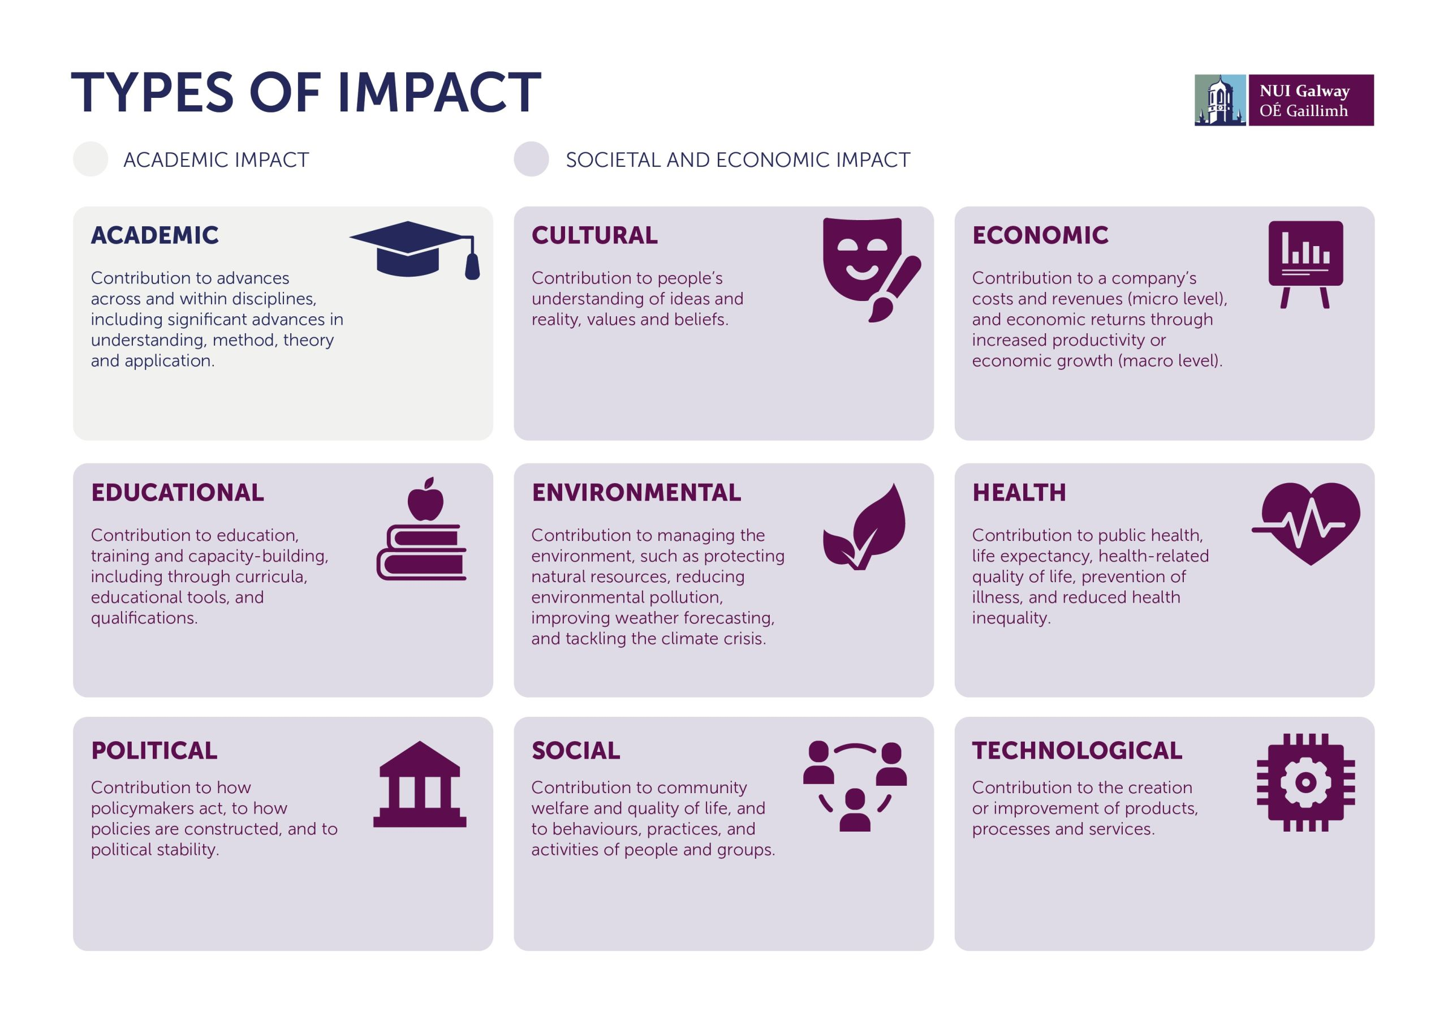

Slide 74
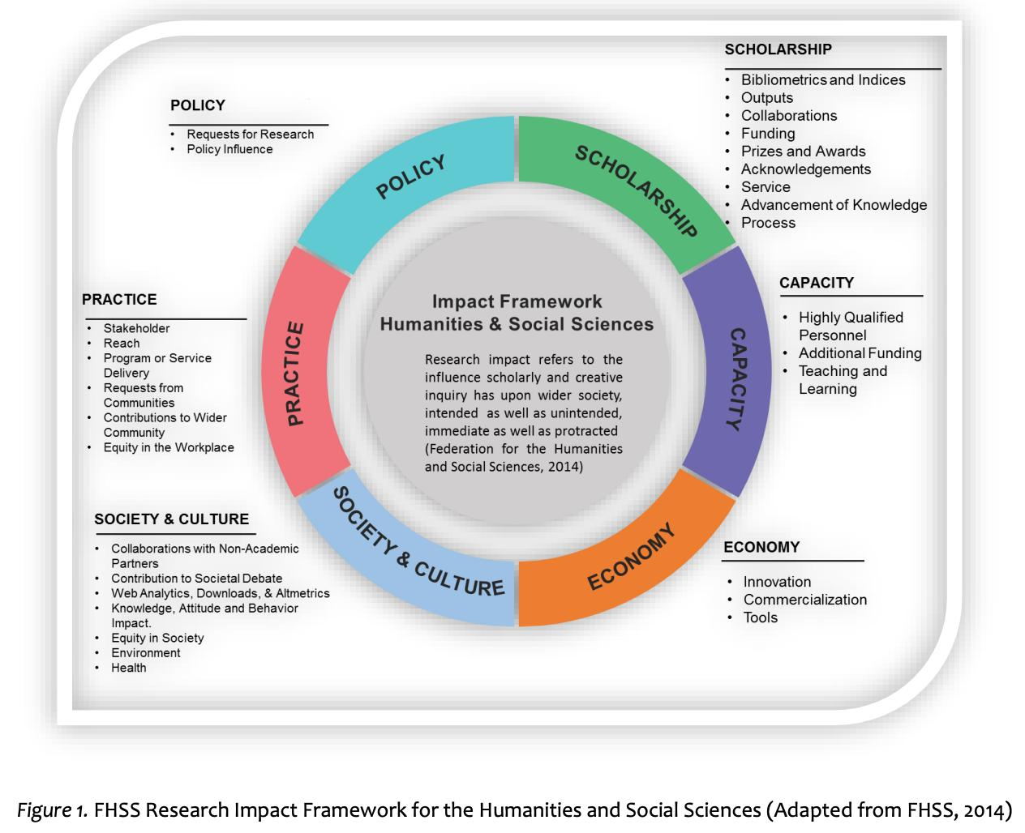
Research Impact Framework for the Humanities and Social Sciences (Adapted from FHSS, 2014)

Slide 76
The extent of research impact depends on the nature and scope of stakeholders involved in the design and implementation of the project

Slide 77
Some useful prompts to identify stakeholders
Who will be affected by the research work
Will the impacts be local, national or international
Who has the power to influence the outcomes of the work
Who are potential allies and opponents
What coalitions might build around the issues being tackled
Are there people whose voices or interests may not be heard
Who will be responsible for managing the outcome
Who can facilitate or impede the outcome through their participation, non-participation or opposition
Who can contribute financial or technical resources towards the work
Alternatively, consider examples of stakeholder categories, and ask if there are stakeholders from these categories that you should include
Government departments & politicians
Government agencies
Industry/producer representative bodies/associations
Media
Trading partners
Land owners & managers
Special interests/lobby groups
National representative and advisory groups
Research organisations
Professional groups and their representative bodies
Civil Society including NGOs and community groups
Representative groups e.g., for consumers
Development partners
Donor agencies

Slide 78
Understanding the research grants landscape

Slide 79
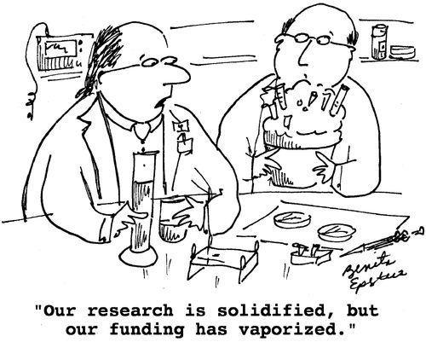
The Harsh Reality: Generally, a very good grant proposal by a new applicant has a success rate of 9%-10% Repeat applicants have a success rate of 14%-15%

Slide 80
POSITIONING IS A MUST
From the perspective of reviewers, academic disciplines are literatures. Literatures are characterized by waves, factions, debates, competing theories and schools of thought. But even if it is a complex mountain range, reviewers who know well their literature's topography, and who can often lay claim to a peak with their name on it, will have a sense of where any given individual stands in that literature and how their ideas can be plotted on the map
SCHOLAR
In the simplest terms, understanding how well-positioned an investigator is as a scholar means looking at their raw presence in the literature. In more sophisticated terms, academics must understand for themselves where they – and more importantly their ideas – are in the complex topography of their literature. Proposals from academics whose standing can be recognized, appreciated, and articulated are more likely to be appraised as capable of advancing the literature
RESEARCHER & REVIEWER
The first step is establishing a long-term research agenda. A well thought out and well-presented long-term research agenda allows academics to position their current work within a larger, more meaningful, and potentially more impactful framework. It gives context to their present work and a trajectory to their current and future plans; it provides a roadmap from their current study to the next study, and to the studies that will need to follow. Networking is key
GRANT WRITER
The appropriate roles should be represented on the team – subject experts, statisticians, technical experts – and also make sure that each player has a strong track record. Reviewers are not always content experts – often they are methodological or technical experts – but in all cases they are experienced in the process of carrying out large, complex projects within the confines of sponsor rules and requirements. Research the funder to understand the specific agency guidelines that accompany the solicitation

Slide 81
If your research/institution is attractive it will attract funds
RESEARCH/GRANT OFFICES
Locate relevant funding sources, identify collaborators, develop research plans, write convincing proposal narratives, prepare and monitor detailed grant budgets and expenditures, complete application forms, and navigate complex online application portals
GRANT WRITING BOOTCAMPS
The bootcamp will provide faculty with resources (e.g., tools and templates for proposals) and opportunities to find collaborators. It increases their sense of competence, autonomy, and relatedness
FACULTY RESEARCH DATABASE
Build a Faculty Research Interests and Expertise Database
Build a Research Output Monitor and Tracker at the Institutional and sub-institutional levels
Create a grant opportunity database
Using information in the databases, conduct targeted, personalized searches using grant opportunity database
GRANT OPPORTUNITY BULLETIN
Research office sends each faculty member a personalized grant opportunity bulletin, which lists all of the grants currently available in each of the research areas of interest to that faculty member
CONSOLIDATED RESEARCH WEBSITE
Shows examples of successful grant proposals and tips for writing them, suggestions for finding research participants, guidelines for serving on peer review panels, and links to the Faculty Research Interests and Expertise Database
CAPACITY BUILDING
Workshops, Research Symposia,
Internal research grants program, pre-award and post-award services, editorial services, early career development services, mentorship and internship opportunities
These strategic initiatives and services will eventually make the institution attractive

Slide 82
Becoming attractive to attract research funds
1) Participating in innovation consortia and other large scale strategic initiatives.
2) Developing strategic research areas in close dialogue with corporate partners.
3) Strengthening co-operation with corporations in regard to research positions, especially
industrial PhDs and post docs
4) Establishing and strengthening the strategic contact to and dialogue with research foundations.
5) Mapping strengths and targeting potential partners and foundations.
6) Enhancing support to key staff during larger applications.
7) Supporting researchers, departments in preparing ambitious applications (e.g. Centres of
Excellence).
8) Identifying potential areas of strength and potential academic partners and matching them
to prioritised societal challenges.
9) Supporting your researchers in coordinating or joining projects with researchers from various other disciplines and facilitating cross-disciplinary initiatives.
10) Promoting the institution as an attractive partner nationally and internationally.
11) Senior level: Targeting professorship programmes nationally and targeting the best candidates that can be eligible for larger grants, e.g. WB grants.
12) Junior level: Supporting recruitment of rising stars by increased focus on embedding post docs and PhDs in projects
13) Setting up a working group to develop a process for benchmarking.
14) Establishing quarterly management information about external funding.
15) Continuing the development of existing monitoring tools.
These strategic initiatives and services will eventually make the institution attractive

Slide 83
Research grants proposal writing is a process NOT an event

Slide 84
Seek answers to the following questions:
What are the deadlines for submission?
How long will the process take?
What is the proper way to approach them?
How many people apply each year and what percentage get grants?
Most answers can be found on the funding body’s website, research guide, annual report & future plans.
What are the current trends?
What are the current limitations and restrictions?
What subject areas were awarded funding recently?
What are the future plans of the funder?
Who are the decision-makers/assessors?
What review processes do they follow?

Slide 85
Some points to remember
You and the funders are both professionals coming together for a specific purpose.
Get to know relevant people in the funding body.
Get help of finance office on matters relating to staff costs, travel, overheads etc.
Seek professional advice on confidentiality, possible restrictions on publications, liabilities and disputes etc.
Funding bodies look for good researchers.
Think of them as potential investors in you and your ideas.
You must ‘sell’ your idea: Be enthusiastic about the work!
Why should they give a grant? See it from the funder’s point of view.
Remember that you are NOT begging.
You have ideas, they have money.

Slide 86
Approaching the Proposal
Always remember:
Your case will be read by one or two experts in your field but others in the judgement panel won’t be experts. You must write for their benefit too.
Ask lots of people to help you improve your proposal.
Make sure the first page acts as a stand-alone summary of the entire proposal.

Slide 87
Major Criteria: Questions to be Answered
Do the proposers have a good idea on which to base their work?
Does the proposal explain clearly what work will be done?
Is there evidence that the proposers know about relevant work that others have done?
Do the proposers have a good track record, both of doing good research and of publishing it?
What are the implications for policy and practice? How will these be taken up?
What are the objectives of the project?
What will be the outcomes?
Does the proposal address a well-formulated problem?
Is it a research problem or just a routine application of a known technique?
Is it an important problem, whose solution will have useful effects?
Is special funding necessary to solve the problem or to solve it quickly enough?

Slide 88
Secondary Criteria
An applicant with existing funding may be favoured due to evidence of a good track record.
Also priority is given to new researchers in the field.
Funders generally prefer to offer a reasonable balance of support for different research areas.
Evidence of industrial interest in the proposal and its potential for future exploitation will count in favour.

Slide 89
Common Shortcomings
There is no evidence that the proposers will succeed where others have failed.
A new idea is claimed but insufficient technical details are given.
The proposers seem unaware of related research.
The proposed research has already been done.
The proposal is badly presented or incomprehensible.
The proposers seem to be attempting too much for the funding requested and/or the time-scale envisaged.
The proposal is too expensive for the probable gain.
The proposers institution should be funding it.
It is not clear which research questions are being addressed by the proposal.
The questions being addressed are ill-formed.
It is not clear why the questions are worth addressing.
The proposal is just a routine application of a known technique.
Industry ought to be doing it instead.

Slide 90
Writing Grant Application - Formal Structure
Essential Contents:
Statement of the problem.
Summary of current developments in the field.
Statement of what is new about the project.
Indication of the extent to which the research builds on previous work by you and by others?
In certain cases, assurance that you are aware of existing work in the field despite no exhaustive literature review being available.

Slide 91
Methods: Questions to be answered
What methods will be applied to achieve the aims?
The methodology must be described in detail and clearly related to the research questions.
Are the chosen methods sufficiently rigorous to produce clear answers?
What is the timetable? This must be realistic.

Slide 92
Top 10 tips for writing inter- & transdisciplinary research proposals

Slide 93
Top 10 Tips for writing inter- and transdisciplinary research proposals
1
Remember your proposal will be read by a range of people, not just those within your research area: don’t assume knowledge of your discipline – describe (concisely) why your research is important, innovative, impactful etc. institutions
2
Don’t just describe your proposal as interdisciplinary or transdisciplinary. Explain why an inter- or transdisciplinary approach is necessary to achieve the intended research outcomes
3
Inter- and trans-disciplinary proposals may be evaluated by those with expertise in collaborative research rather than your discipline. Write clearly for a general reader – use the minimum of technical language and abbreviations and define specialist terms briefly when they are first used.
4
Collaboration and integration take many forms and work to achieve. Outline what kind(s) of collaboration/integration you envisage (theoretical, methodological, etc.) and the specific ways in which you hope to achieve this.
5
Explain the methods that you plan to use and, if they are novel, give examples where they have been successfully used in other fields.

Slide 94
Top 10 Tips for writing inter- and transdisciplinary research proposals
6
Bear in mind the extra costs associated with inter- or transdisciplinary research (such as, for example, additional network building), and budget for them accordingly.
7
If the research involves new collaborations, assume that these relationships will take time to develop and provide opportunities (formal and informal) for this to happen, especially at the start of the project
8
If the research includes non-academic partners describe what they bring to the research, what and when they are expected to contribute, and how they will benefit from taking part.
9
Plan for a range of outputs to be produced across the lifetime of the project – this protects against failure and satisfies the needs of different collaborators. Academic publications are usually of little importance to societal partners who will often need more focused outputs
10
Criteria for authorship vary considerably across disciplines. Describe how authorships for project outputs will be allocated - or a process for agreeing on this early in the project - otherwise this can become a major problem

Slide 95
Top 10 tips for developing inter- & trans-disciplinary research programmes

Slide 96
Top 10 Tips for developing inter- and transdisciplinary research funding programmes
1
Successful programmes take deliberate steps throughout to achieve integration and coherence. Additional small-scale funding for network- and community-building in the early stages of a research initiative contributes greatly to the degree and extent of integration.
2
The language used in a funding call is important: inclusive, accessible and jargon-free language can open up a topic in a way that invites different perspectives and encourages projects that challenge prevailing approaches
3
Consider which level(s) are to be the chief platform for inter- or transdisciplinarity: at programme level (for larger-scale initiatives); at theme level (i.e. a sub-programme level) where certain topics might be integrated across projects; or at project level, within a project team or individual project members
4
Who will provide the necessary inter- or transdisciplinary leadership: the funders, the academic Programme Director or a team of individuals in charge of component projects? How will external advisory boards be used to best effect?
5
When selecting leaders for inter- or transdisciplinary research programmes, leadership skills and integrative vision may need to be weighted more heavily than a conventional academic track record within a single discipline

Slide 97
Top 10 Tips for developing inter- and transdisciplinary research funding programmes
6
A great deal of tacit knowledge about the management of inter- or transdisciplinary research programmes can be held by funding agency staff: how will this people-embodied knowledge be captured to ensure continuity if key staff leave?
7
Capacity building—the development of knowledge and strengthening of skills, competencies and abilities of people, networks and the research community— is critical to the growth and longevity of inter- and transdisciplinary research.
8
Ensure that learning from past experiences of inter- and transdisciplinary investments becomes embedded within collective organisational memory. This requires greater continuity of research networks and communities, and also of research careers
9
Incorporating flexibility into a programme’s budget allows not only evolution but also an opportunity for research leaders to develop new ways to facilitate genuine inter- and transdisciplinarity and encourage organisational and cross-institutional learning
10
Inter- and transdisciplinary capacity-building is a long-term process: in understanding the needs of societal partners, funders need to recognise that negotiating and co-producing knowledge collaboratively can require more time to achieve the genuine integration and mutual understanding needed to solve a problem effectively.

Slide 98
Practical session: Roles and responsibilities at micro-, meso-, and macro-level

Slide 99
Managing research grants:
Involves engaging multiple internal and external stakeholders:
General research administration
Proposal proposal
Regulatory compliance
Award management and monitoring
Effort certification
Billing and collections

Slide 100
Group exercise
Work in groups: 3-4 members per group. Each group should have at least one female.
Open the excel sheet “Grant roles & responsibilities matrix blank”
Read the specific roles and responsibilities
Compare these responsibilities with the 8 duty bearers and offices
Match them by shading the cell where the roles and duty bearers converge. A set of roles and responsibilities for each domain should have the same colour. For instance, all the elements under proposal preparation should have an identical colour
After 30 minutes, please let us discuss your work in plenary
Which of the roles occur at the micro-, meso- and macro-levels

Slide 101
Roles and Responsibilities of the Research Grants Office
Discussion points
PERUSE THE ROLES
Peruse the roles and responsibilities
Is there an important role that is missing and where will you place it
Is there an important official missing and who might that be
How will his/her exclusion affect the implementation of a grant
COMPLETE THE MATRIX
Colour the cells to assign the roles to the appropriate officials
Which official has the most roles
Which official has the least roles
WHAT LESSONS DID YOU LEARN
Is the research grants office necessary based on the role assignment exercise
What administrative level will you place the Head of the office (Dean, Director, Provost, etc, and why)

Slide 102
Useful Resources
Participatory Engagement with Scientific and Technological Research through Performance (PERFORM)
http://www.perform-research.eu/toolkits/researchers-toolkit-v2/
Africa Centre for Evidence (ACE)
https://africacentreforevidence.org/
SIDA Research Calls & Grants
https://www.sida.se/en/for-partners/research-partners/research-calls-and-grants
Terra Viva Grants Directory
http://www.terravivagrants.info/
Enterpreneurship & Innovation
http://simonpriest.altervista.org/
AUTHORAID Funding
https://www.authoraid.info/en/funding/
IDEA Funding Opportunities
https://idea-phd.net/index.php/en/funding-opportunities
UCC Research Output Monitor
https://www.scholar.ucc.edu.gh/app

Slide 103
Useful Resources
https://www.swedev.dev/funding-opportunities/
https://aripd.net/aripd/index/worldwide_research_grants
https://www.cambridge-africa.cam.ac.uk/opportunities/funding-opportunities/?past
https://academy.worldbank.org/en/home
https://rise.articulate.com/share/fc0siRAD5L24ArhsMjNkay0R1jzZrHM4#/
https://www.daad.de/en/information-services-for-higher-education-institutions/further-information-on-daad-programmes/partnerships-with-sub-saharan-africa/
https://www.law.cam.ac.uk/research-link/international-research-groups-and-networks
https://dric.ucc.edu.gh/sites/default/files/research_grant_compendium.pdf

Slide 104
Useful Resources
Connected Papers
https://www.connectedpapers.com/
Open Knowledge Maps
https://openknowledgemaps.org/
Africa’s funding landscape, AI Companies in Africa, Edtech Companies in Africa
https://briterbridges.com/innovation-maps
Design Thinking
https://www.dtips.eu/post/sources-on-design-thinking
African Network for Economics of Learning, Innovation, and Competence Building Systems (AfricaLics)
https://www.africalics.org/free-materials/
Globelics: A worldwide, open and diverse community of scholars working on innovation and competence building in the context of economic development
https://www.globelics.org/

Slide 105
Useful Resources
An Inclusive History of Science Communication
https://app.us.lifeology.io/viewer/lifeology/scicomm/a-brief-history-of-science-communication#60141fee01c6
Centre for Frugal Innovation in Africa
https://www.cfia.nl/about-us/about-frugal-innovation
Fast Track Impact
https://www.fasttrackimpact.com/for-researchers
Collaboration.AI
https://teams.collaboration.ai/icebreakers/
Tools for Facilitation
https://learningforsustainability.net/facilitation/
Stakeholder engagement in evidence synthesis
https://stakeholderengagementtraining.github.io/
https://integgame.eu/1001
https://integgame.eu/dilemma

Slide 106
Thank you Questions

